Slide 1
Incoming Team
Visa Advisory Session

Slide 2
The basics
If you hold a passport of a member state of the European Union, Liechtenstein, Norway, or Switzerland, you do not need a visa. Please inform us about this ASAP!
Information on Visa D ➔ OEAD
Residence Permit
Visa D
Residing in Austria for longer than 6 months
Residing in Austria for up to 6 months

Slide 3
The basics – travelling to Austria
Depending on your nationality, you may legally enter and stay in Austria (Schengen Area) without a visa ➔ Schengen Area without a visa.
  If so, please check how many visa-free days you are granted (e.g. US & Canadian citizens have up to 90 days) ➔ Schengen visa calculator
Even if you are allowed to enter Austria visa-free, we still highly recommend applying for your visa D in your country of residence before travelling to Austria.
Travelling to Austria on visa-free days? ➔ Register at the European Entry-Exit-System (EES)!
  EES collects (digitally): personal data, travel document, facial image and/or fingerprints
  Attention: long waiting times at the airport!

Slide 4
Visa D - where to apply
Please apply at an Austrian embassy/consulate in your country of residence.
US & Canadian citizens apply at VFS offices.
  US: Chicago, Houston, Los Angeles, Miami, New York, San Francisco, Washington DC
  Canada: Edmonton, Ottawa, Vancouver
Book your appointment ASAP and no later than beginning of July!
Attention: the embassy/consulate keeps your passport during the application process!

Slide 5
Visa D - the paperwork
Documents to submit at the Austrian representative authority abroad (embassy/consulate/VFS):
Completed and signed Visa D application form
1 recent color passport picture, sized 3.5 x 4.5 cm for EU, not older than 6 months
Valid passport (valid until at least three months after leaving the Schengen territory; it must contain at lest 2 empty pages, it must have been issued within the past ten years)
  photocopy of data page of passport (black and white copy)
  photocopies of pages that contain entries and stamps (color copies)
Proof of accommodation in Austria (OEAD contract or tenancy contract)
Proof of appropriate health insurance
Proof of financial means to cover the living costs for the whole duration of the visa
WU Letter of acceptance = confirmation of admission to study in Austria
Letter of your home university = confirmation of your exchange at WU
Flight, bus or train reservation
→ At the appointment: show originals and hand in copies of EVERYTHING

Slide 6
The paperwork - application form
Filling in the form - clarifications:
  Bordercrossing = the place where you enter the Schengen Area
  Multiple entries = able to enter and leave the Shengen area more than once
  Intended arrival/departure date: semester dates; min. 91 days duration
  Inviting person = accommodation provider
See filled-in application form sample.

Slide 7
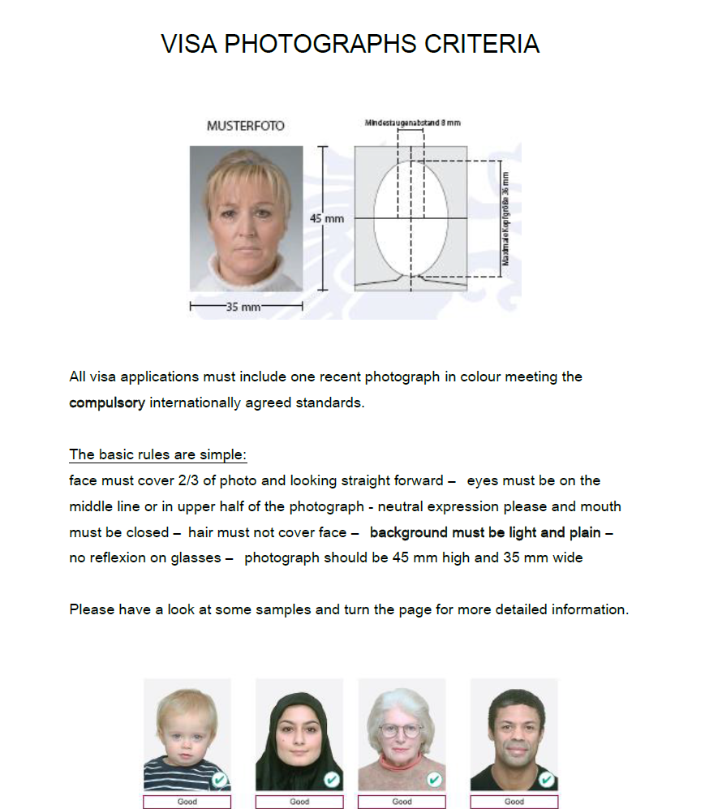
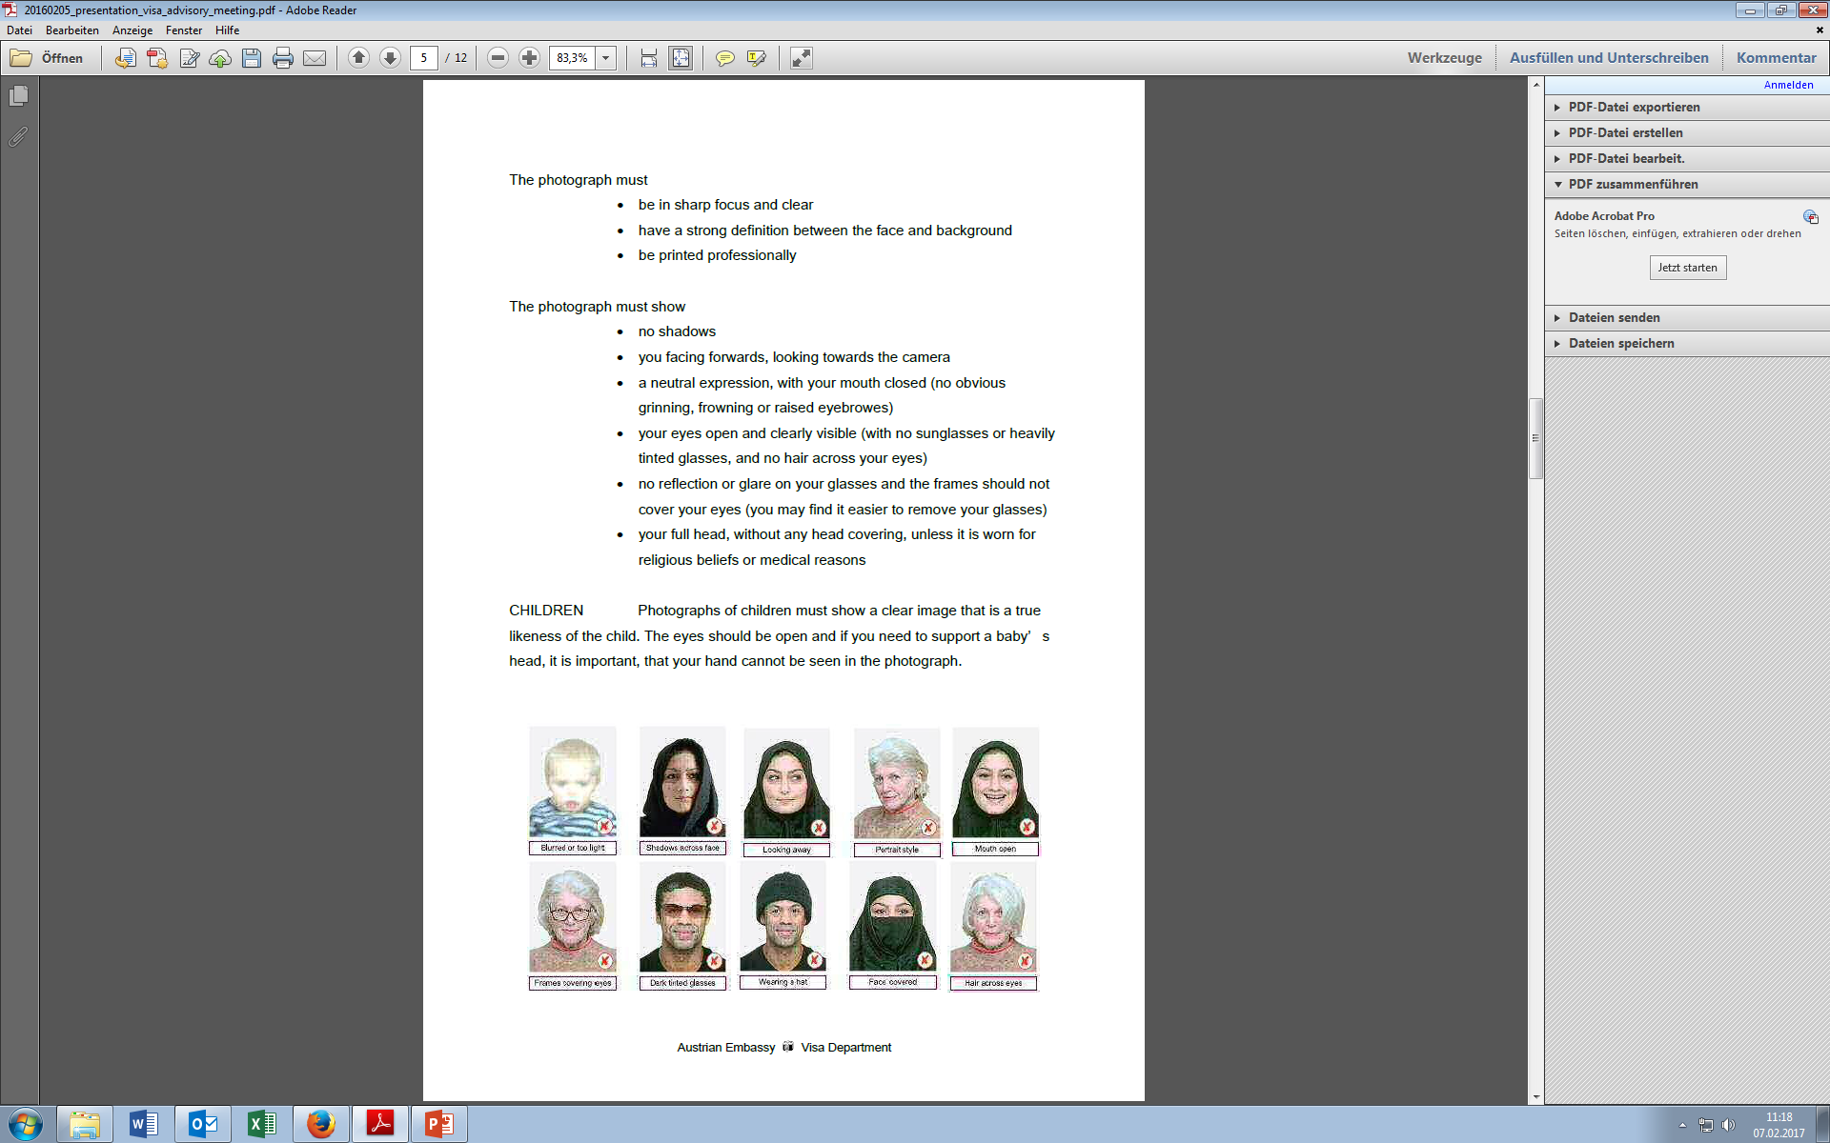
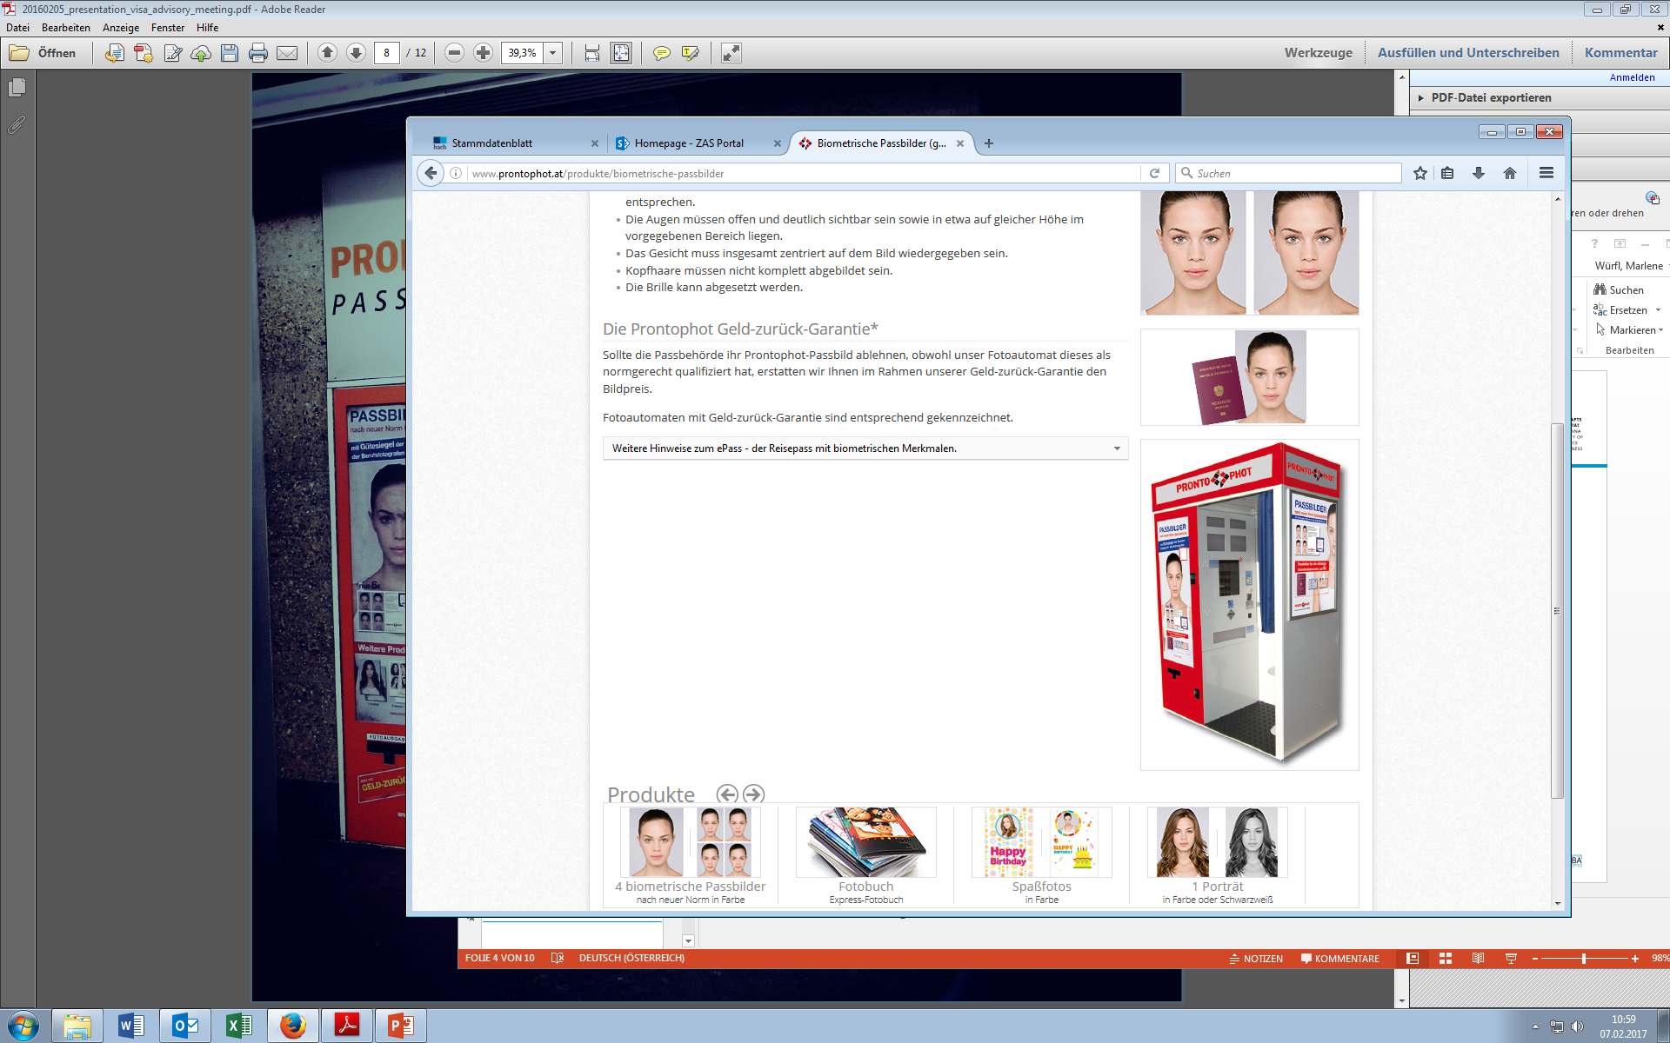
The paperwork - picture
Must meet EU photo standards

Slide 8
The paperwork – travel health insurance
You must purchase appropriate travel health insurance ➔ insurance card is NOT sufficient!
The insurance company must provide you with an explicit written statement, which includes:
  Your name
  Countries of validity (Europe or Worldwide)
  Period of validity (must cover the entire visa period)
  Minimum coverage sum: EUR 30,000 (= USD 50,000) or unlimited
  Guarantee to cover various health issues AND possible recovery and repatriation costs

Slide 9
The paperwork - financial means
Necessary amount: app. 4,500 to 6,000 EUR (depending on age/accommodation costs).
The amount must be in a bank account in your name (only).
You can submit a foreign bank account. Please include the currency conversion rate, if needed. You must have full access to it while in Austria.
Proof of sources of financial means:
    Bank statements of the past 3 months clearly showing the full transactions and including the name/address of the bank account holder ➔ your own or your sponsor’s
    If financially sponsored, also include sponsor’s letter of support
    Scholarships, letter of grants etc. stating clearly time period and amount

Slide 10
Q&A
Any questions from your side?

