Slide 1






Initial proposals for the promotion of eco-mobility in the Austro-Hungarian border region
            EMAH project
            Álmos VIRÁG, project leader

Slide 2
Reasons for improvements
On weekdays (Tuesday, Friday), a total of
6300 passengers crossed the border by train (May 2013)
49200 vehicles crossed the border
avg. vehicle occupancy (based on the interviews): 1.74
according to this, the number of passengers of individual traffic:
85600 ps.
The approximate ratio of the two transport sectors: 7:93

Slide 3
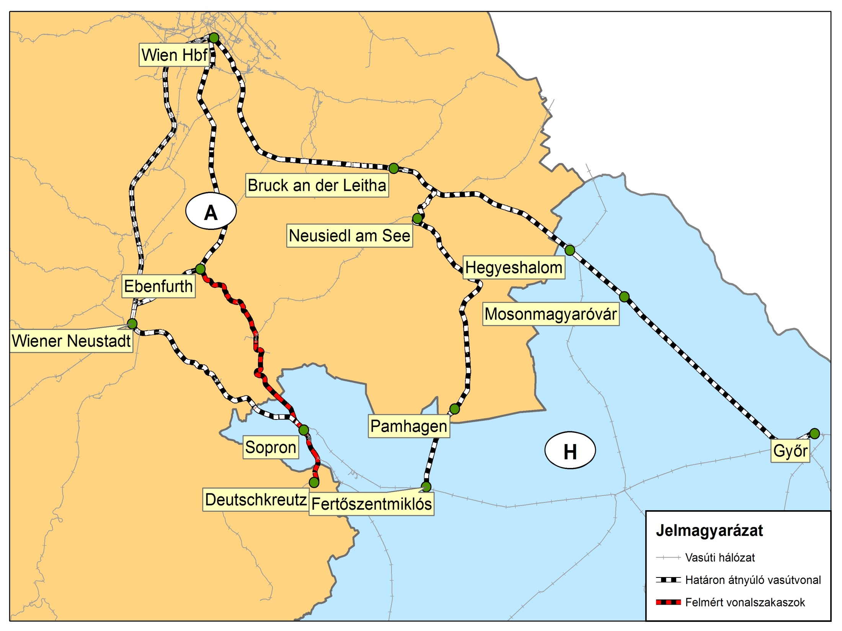
Railway line 512: Deutschkreutz – Ebenfurth [–Wien]
Direct trains towards Eisenstadt
  At peak hours, every 2nd train goes to Eisenstadt?
  Direct buses?
More frequent trains at off-peak times

Slide 4
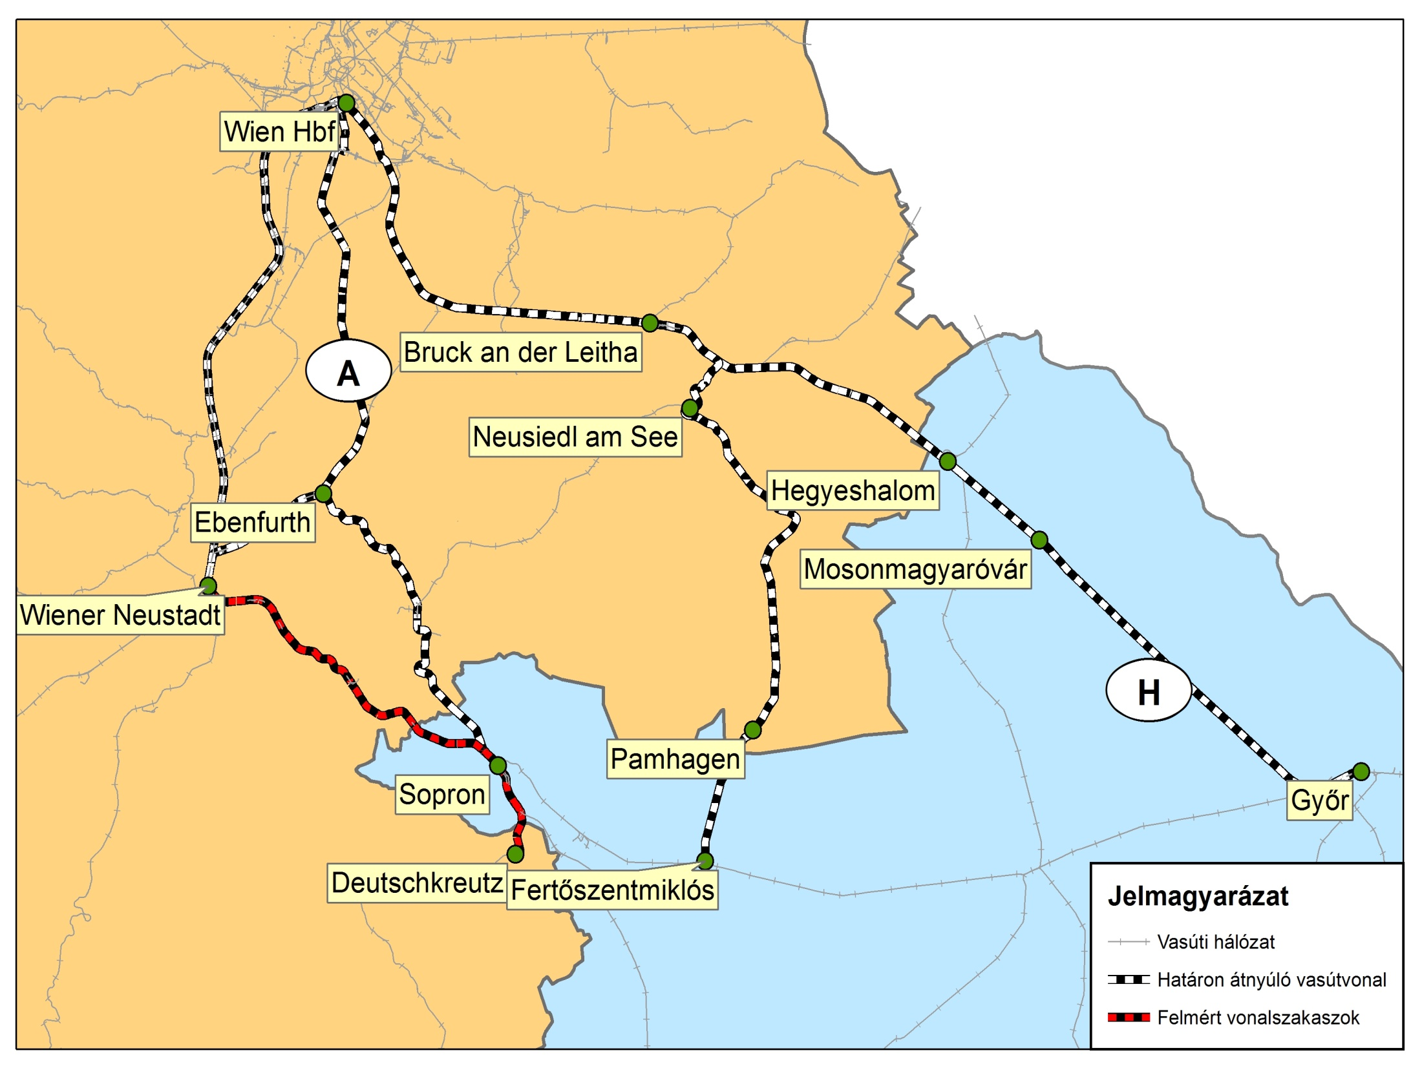
Railway line 524: Sopron – Wiener Neustadt
Increase in capacity
Electrification
  Newer trains with larger capacity
  Possibility to run direct trains to Győr or Szombathely

Slide 5
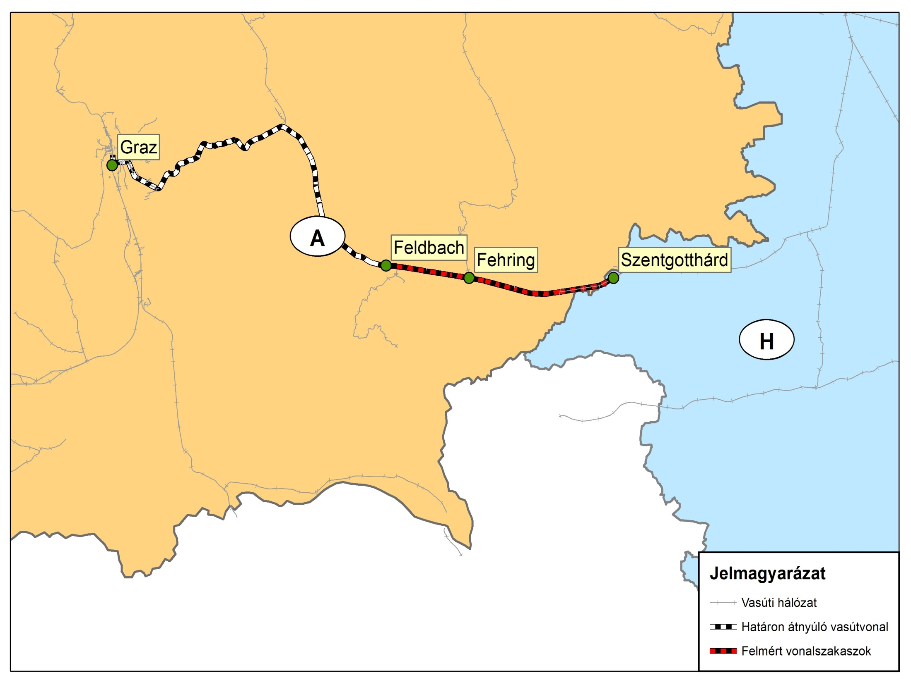
Railway line 530: Szentgotthárd – Graz
New schedule: design of a zone-based structure (internal endpoint: Feldbach or Gleisdorf)
  Provided that the electrification and the double-track sections are completed

Slide 6
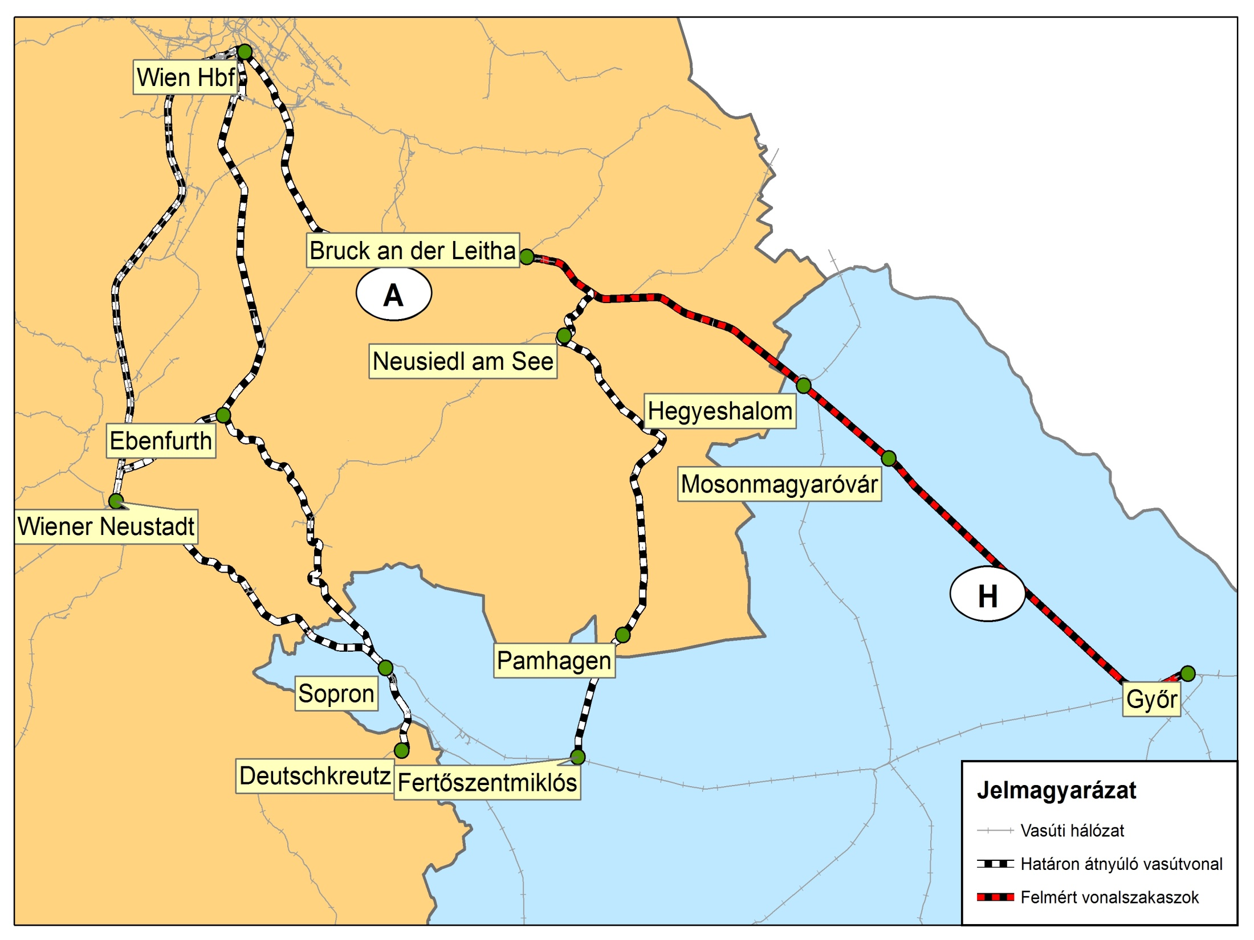
Railway line 700: Győr – Bruck/Leitha [–Wien]
Direct connections
  section between Bruck/Leitha and Wien would get more crowded
  equalisation of mileages can also cause problems
Extension of the operation time

Slide 7
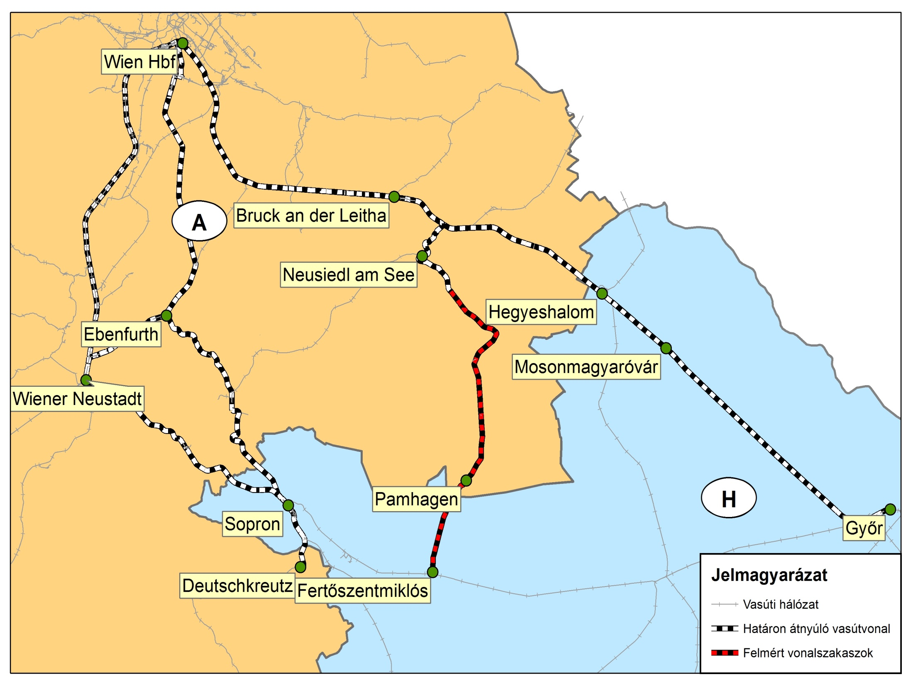
Railway line 731: Fertőszentmiklós – Neusiedl/See
More comprehensible and predictable timetables
  abolition of the complex, seasonal constraints
  trains getting to Hungary
  more frequently
Refurbishment of the Hungarian tracks
  track speed from 60 to 100 km/h

Slide 8
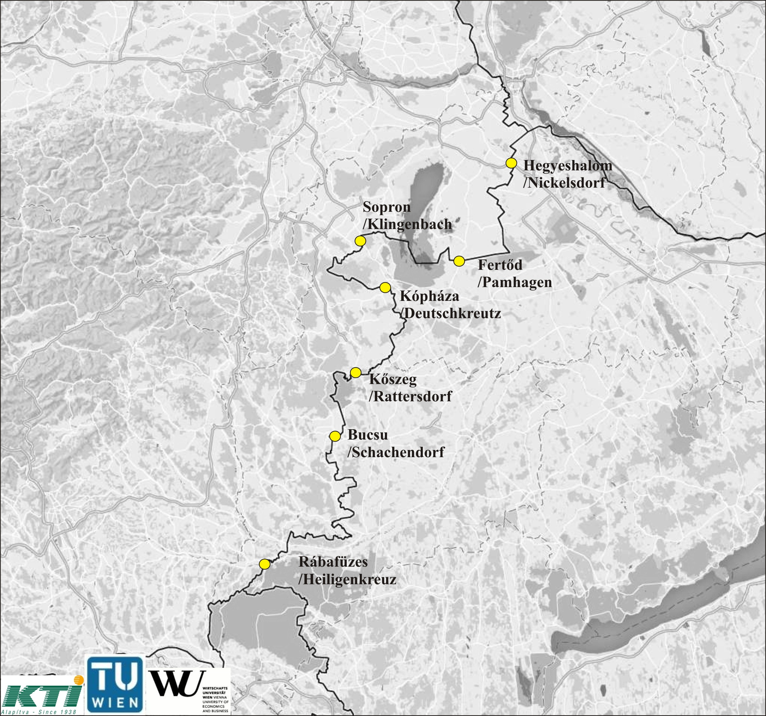
Preliminary suggestions for the extension of the public bus network
(passenger numbers were calculated for 2x3 hours
– morning and afternoon peak time – by the interviews )
[Szombathely–] Kőszeg–Oberpullendorf–Deutschkreutz–Sopron–Eisenstadt:
Kőszeg: 245 passengers/direction
Deutschkreutz: 297 pass./direction
Klingenbach: 1425 pass./direction
Szombathely–Oberwart–Friedberg:
768 passengers/direction
Szentgotthárd–Heiligenkreuz–Fürstenfeld:
230 passengers/direction

Slide 9
Occurring questions and problems
Who will perform the service?
Is cabotage possible?
Hungary: the transborder traffic can also be ordered as a public service
  How does it work in Austria?
  Fares (tariffs structure, discounts)
    Rate of transport price subsidies?
Co-operation of the regional services
  Managing of differences in mileages
  Creation of an integrated schedule

Slide 10
Thanks for your attention!
Questions?

