Slide 1
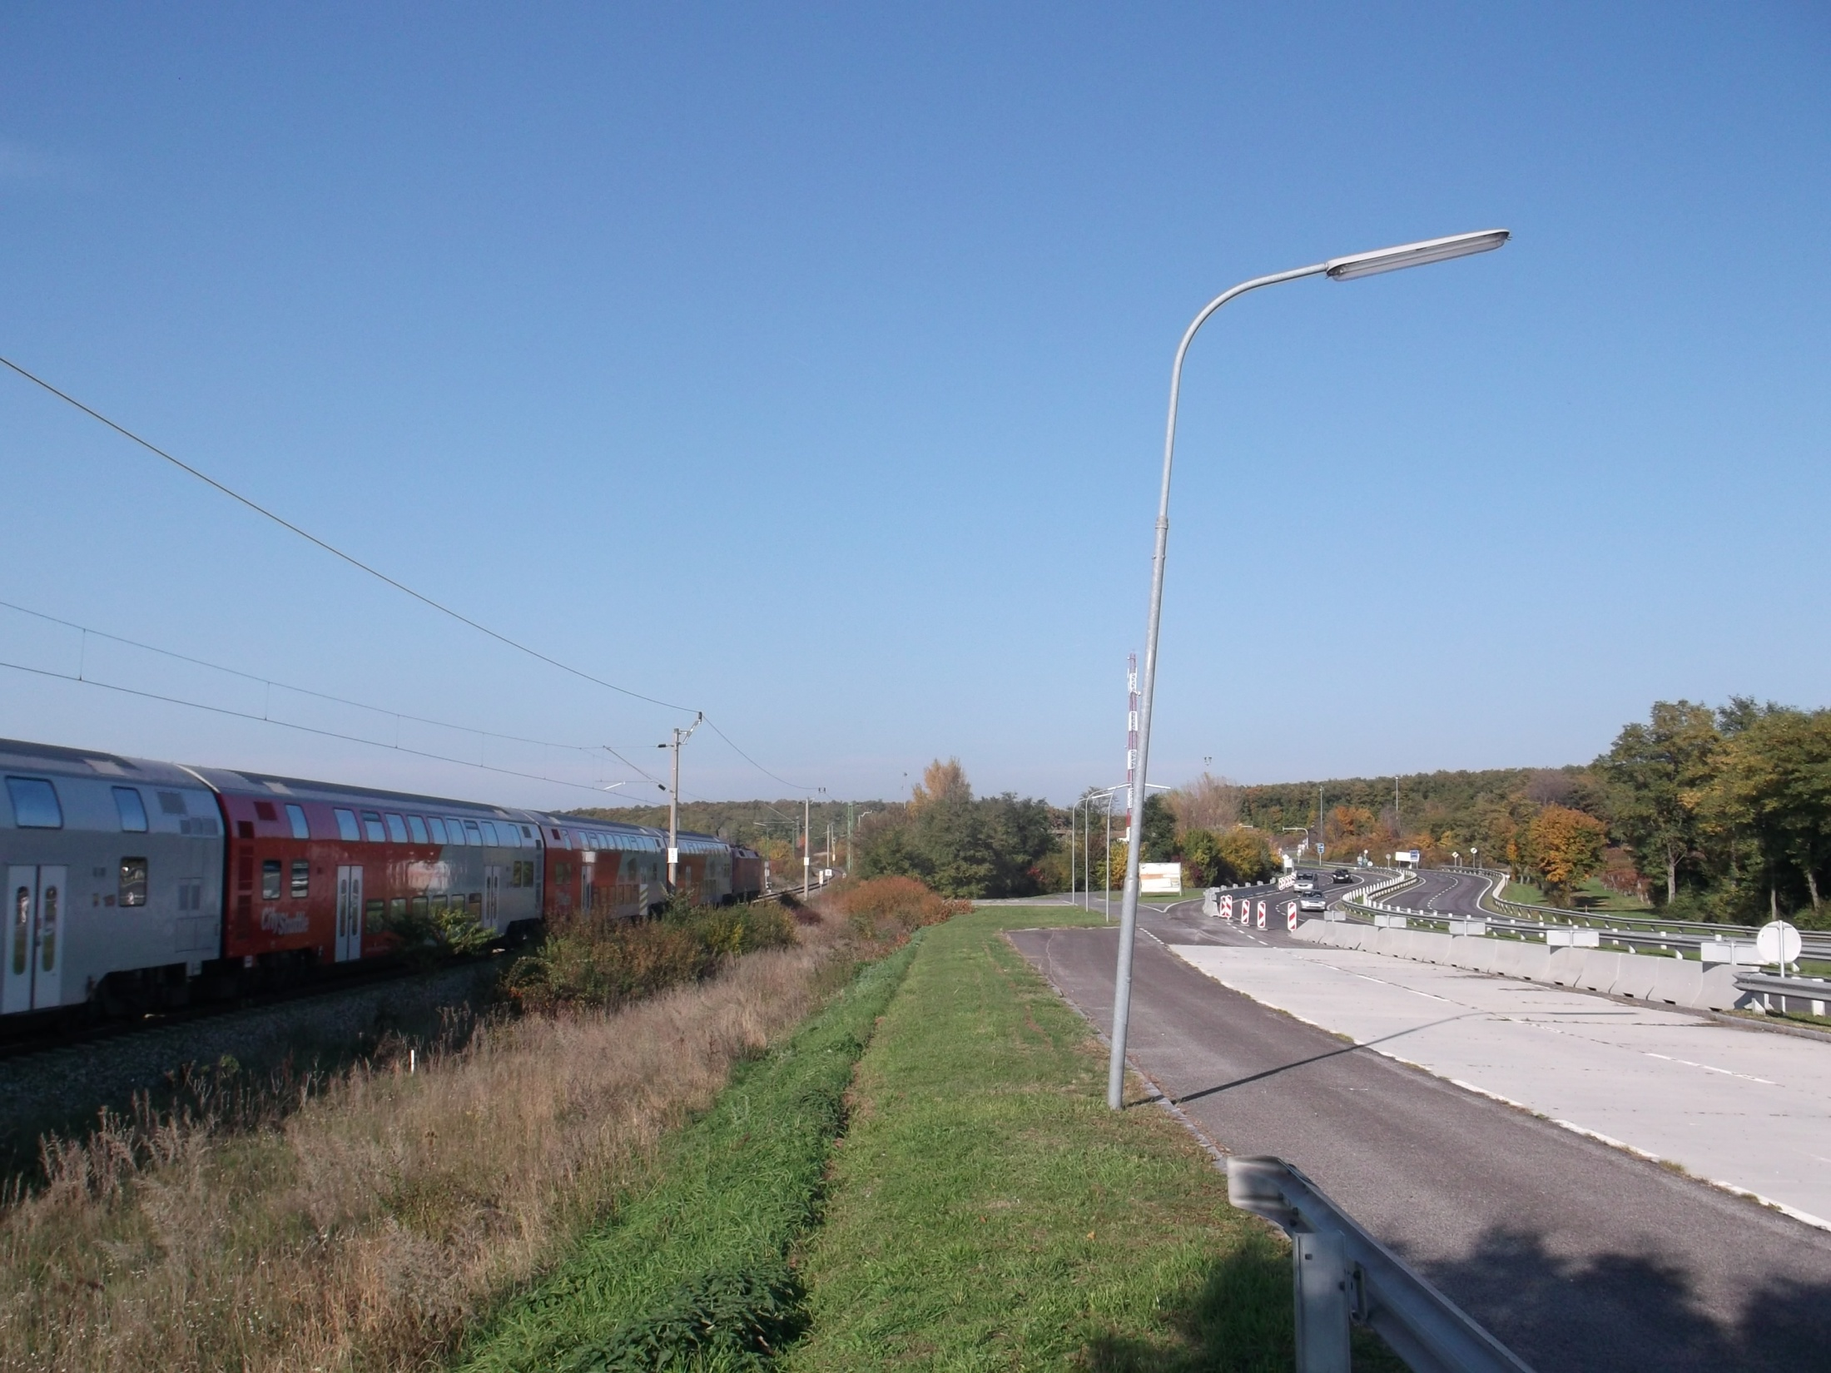

Results of the road survey (October 2013)
            EMAH - Eco-mobility in the Austro-Hungarian border region
            Álmos VIRÁG, project leader
            Endréné TREPPER, senior researcher
            Viktor SERBÁN, junior researcher
            András NÉMETH, intern

Slide 2
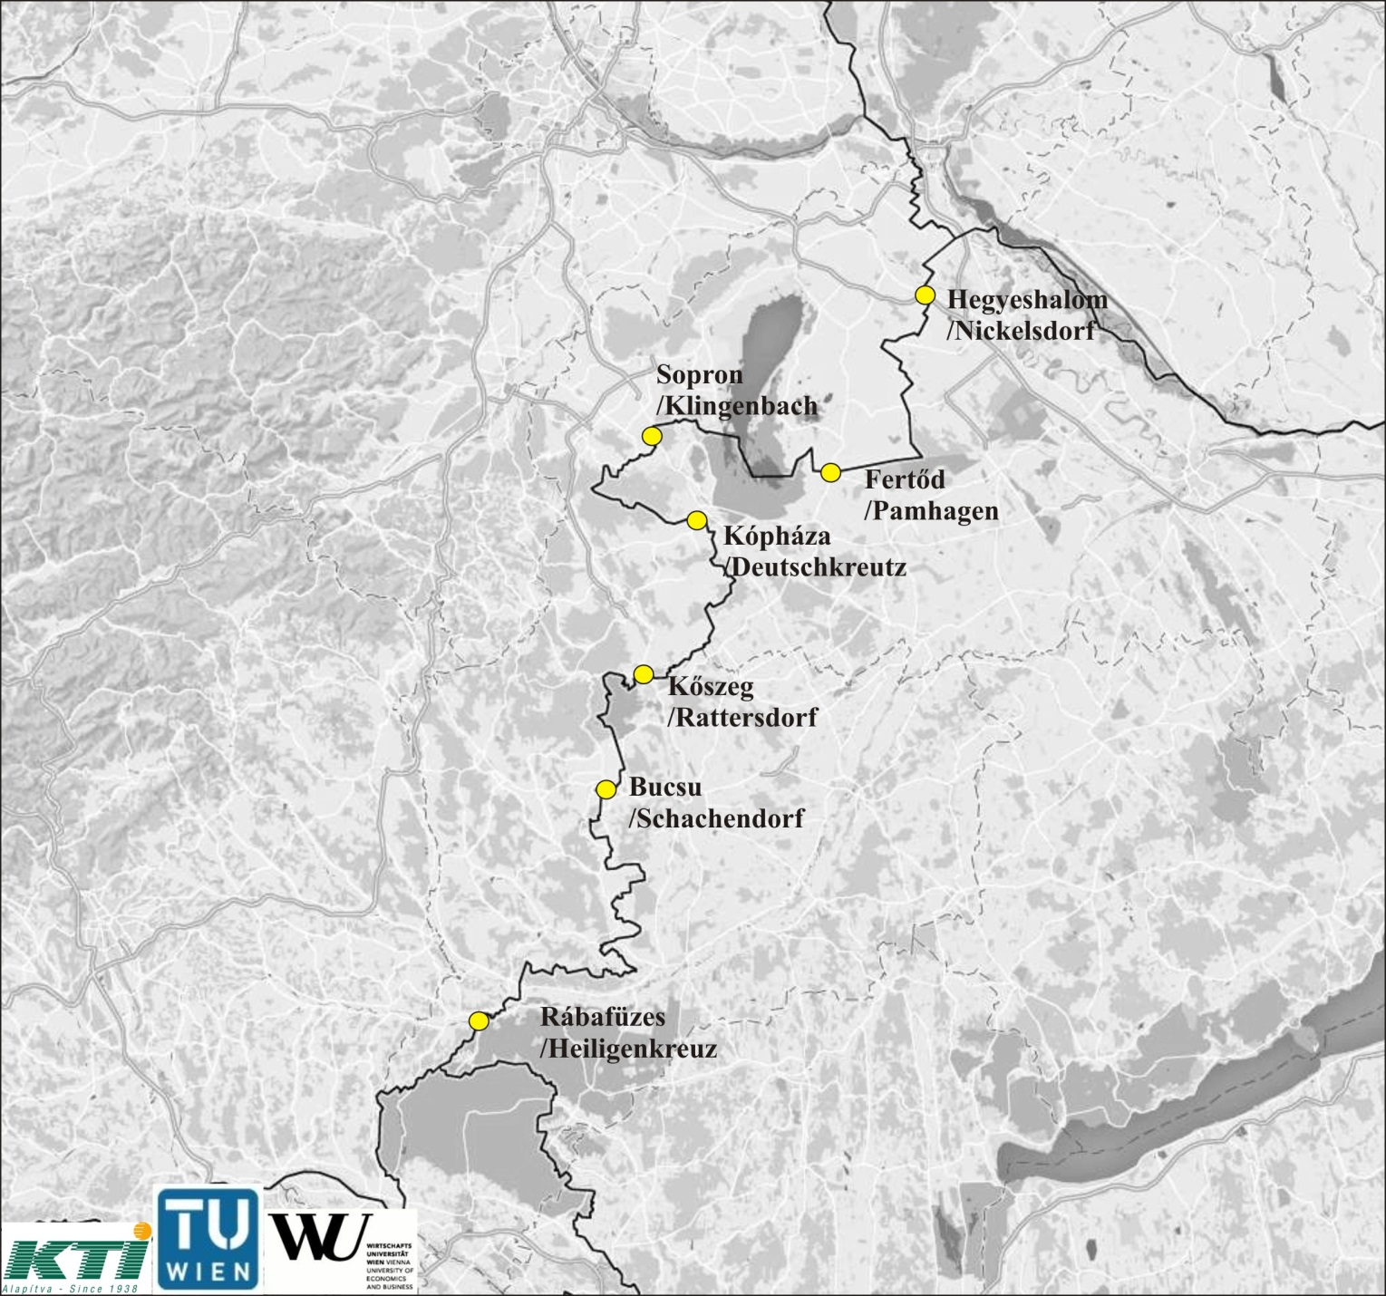
Surveyed border crossing points
Tuesday, 15.10.2013
Friday, 18.10.2013
Sunday, 20.10.2013

Slide 3
Results of the cross-sectional traffic count
(number of vehicles with GVM under 3.5 t)
BORDER CROSSING POINT | 15.10. TUESDAY |  |  |  | 18.10. FRIDAY |  |  |  | 20.10. SUNDAY
 | HU | AT | oth. | ∑ | HU | AT | oth. | ∑ | HU | AT | oth. | ∑
Sopron - Klingenbach | 8 071 | 4 186 | 709 | 12 966 | 8 717 | 4 978 | 856 | 14 551 | 1 929 | 3 123 | 652 | 5 704
Hegyesh. – Nickelsdorf | 3 001 | 967 | 208 | 4 176 | 3 046 | 978 | 210 | 4 234 | 610 | 546 | 231 | 1 387
Kőszeg – Rattersdorf | 2 376 | 712 | 431 | 3 519 | 2 387 | 815 | 327 | 3 529 | 1 124 | 621 | 69 | 1 814
Rábaf. – Heiligenkreuz | 1 267 | 764 | 660 | 2 691 | 1 714 | 946 | 576 | 3 236 | 622 | 543 | 228 | 1 393
Fertőd – Pamhagen | 2 221 | 594 | 67 | 2 882 | 2 462 | 679 | 96 | 3 237 | 506 | 381 | 128 | 1 015
Bucsu – Schachendorf | 1 754 | 565 | 249 | 2 568 | 2 071 | 822 | 250 | 3 143 | 596 | 386 | 87 | 1 069
Kóph. - Deutschkreutz | 1 231 | 1 054 | 334 | 2 619 | 1 214 | 1 140 | 257 | 2 611 | 417 | 732 | 60 | 1 209
TOTAL | 19 921 | 8 842 | 2 658 | 31 421 | 21 611 | 10 358 | 2 572 | 34 541 | 5 804 | 6 332 | 1 455 | 13 591

Slide 4
Sopron  Klingenbach: hourly traffic volume

Slide 5
Klingenbach  Sopron: hourly traffic volume

Slide 6
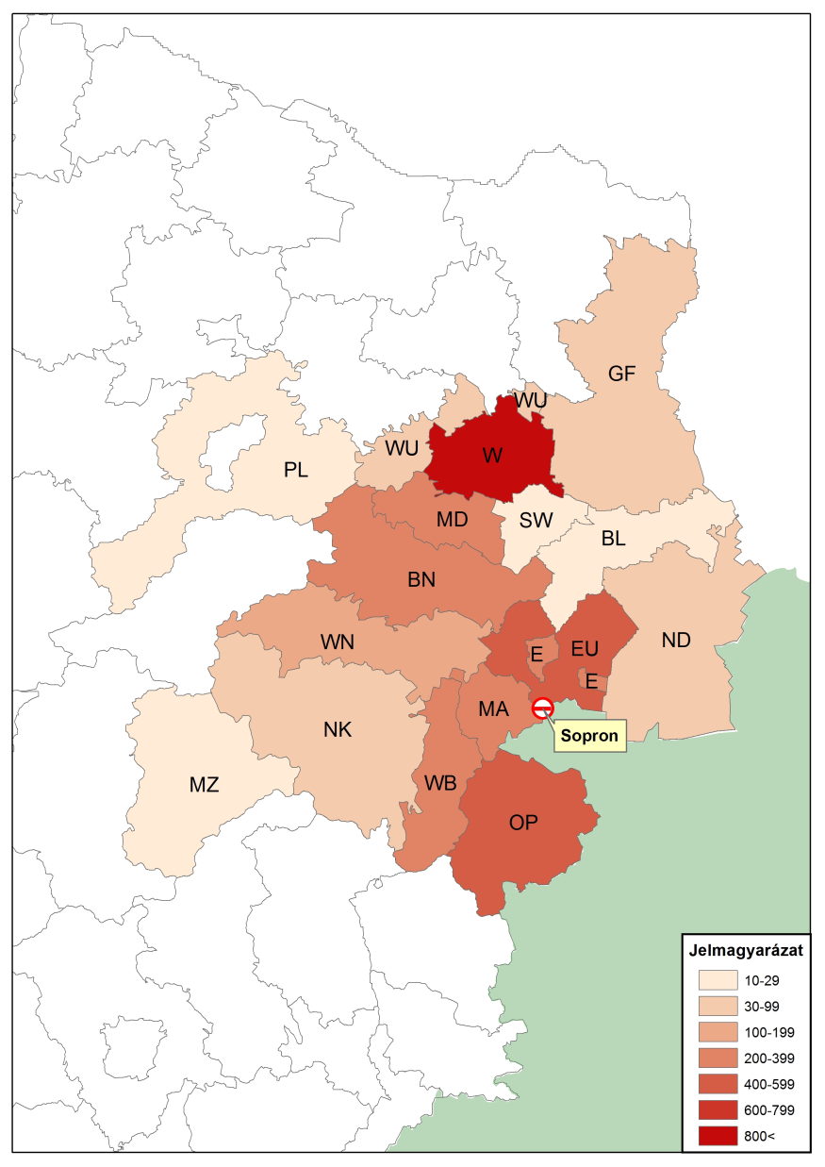
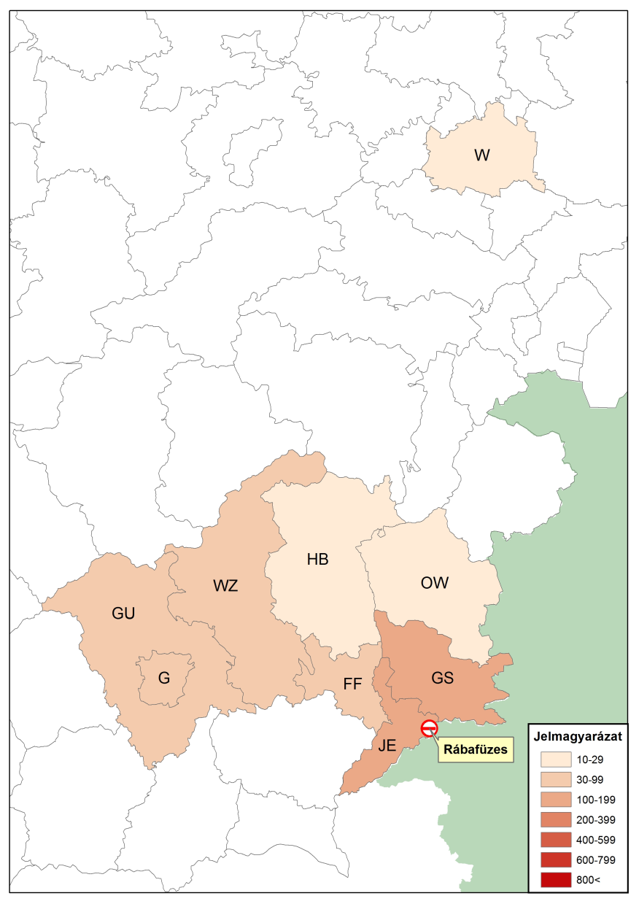
Distribution of the Austrian vehicles by administrative districts shown on their registration plates

Slide 7
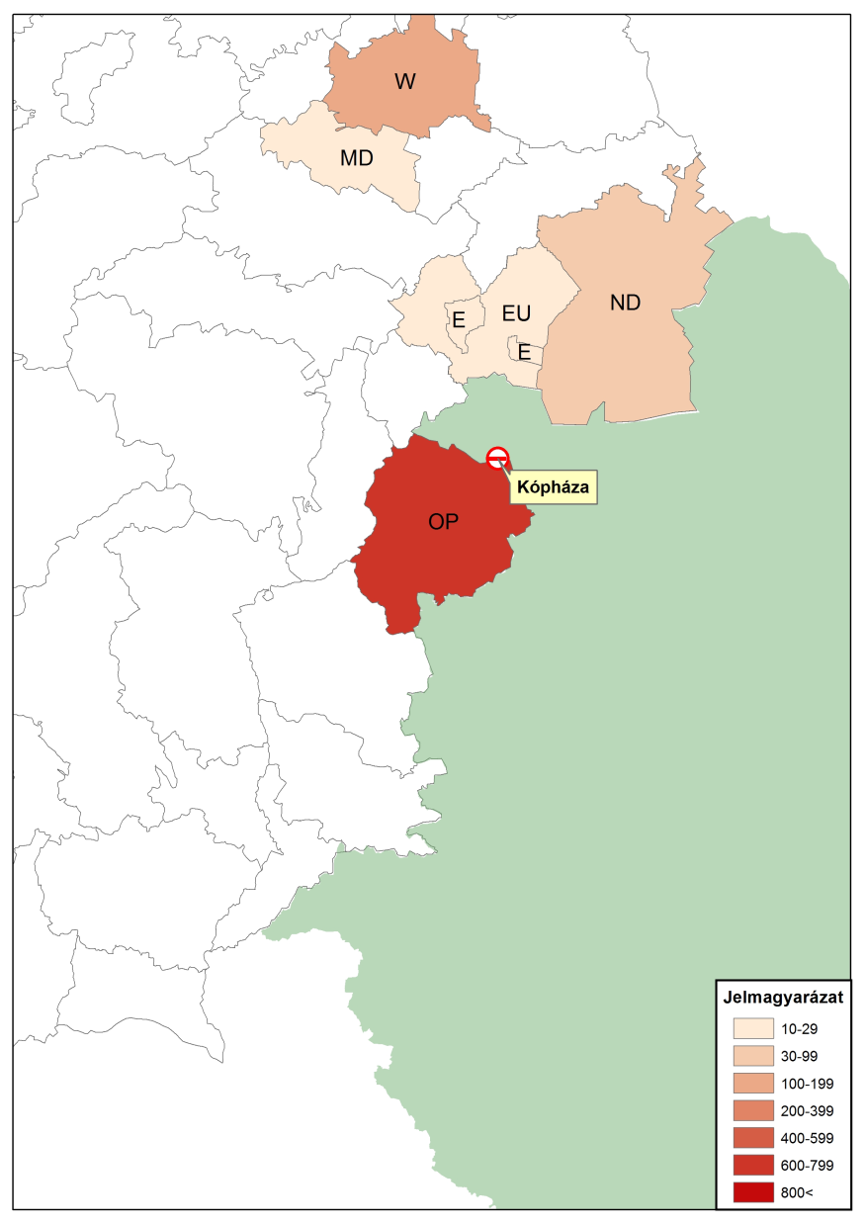
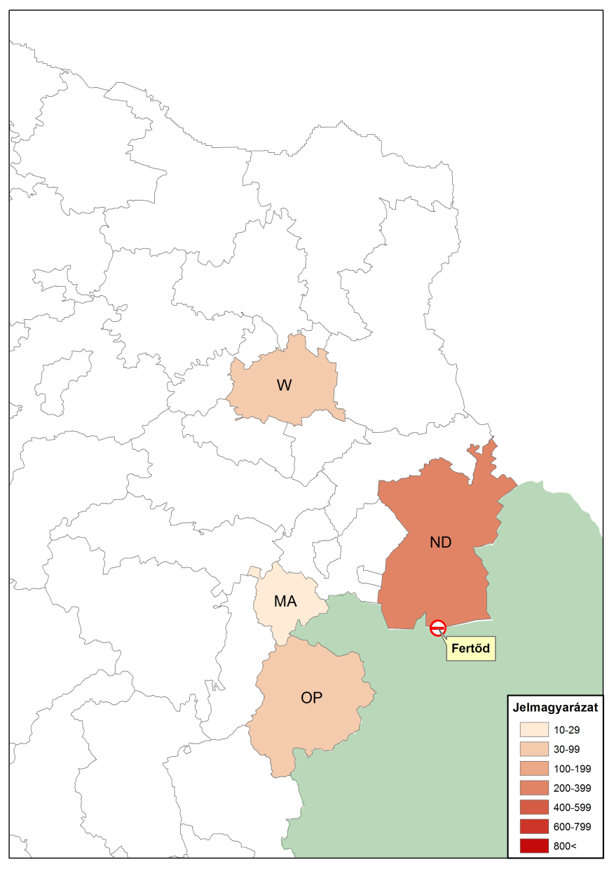
Distribution of the Austrian vehicles by administrative districts shown on their registration plates

Slide 8
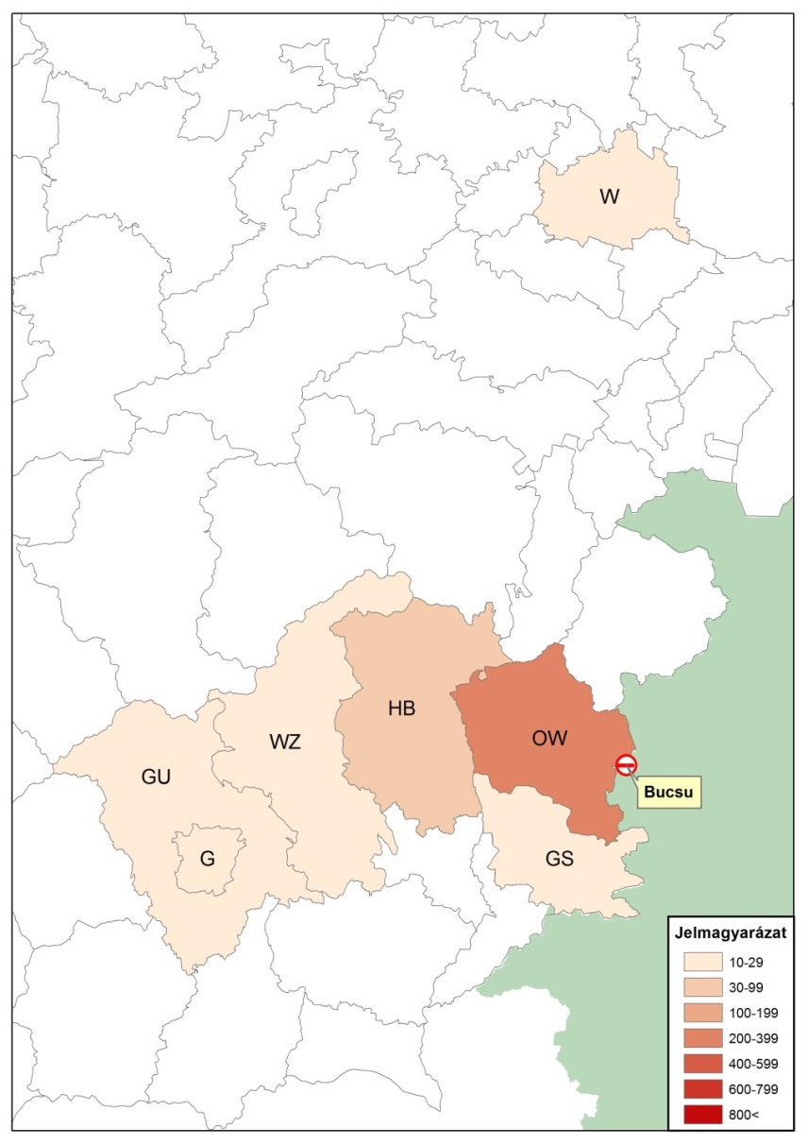
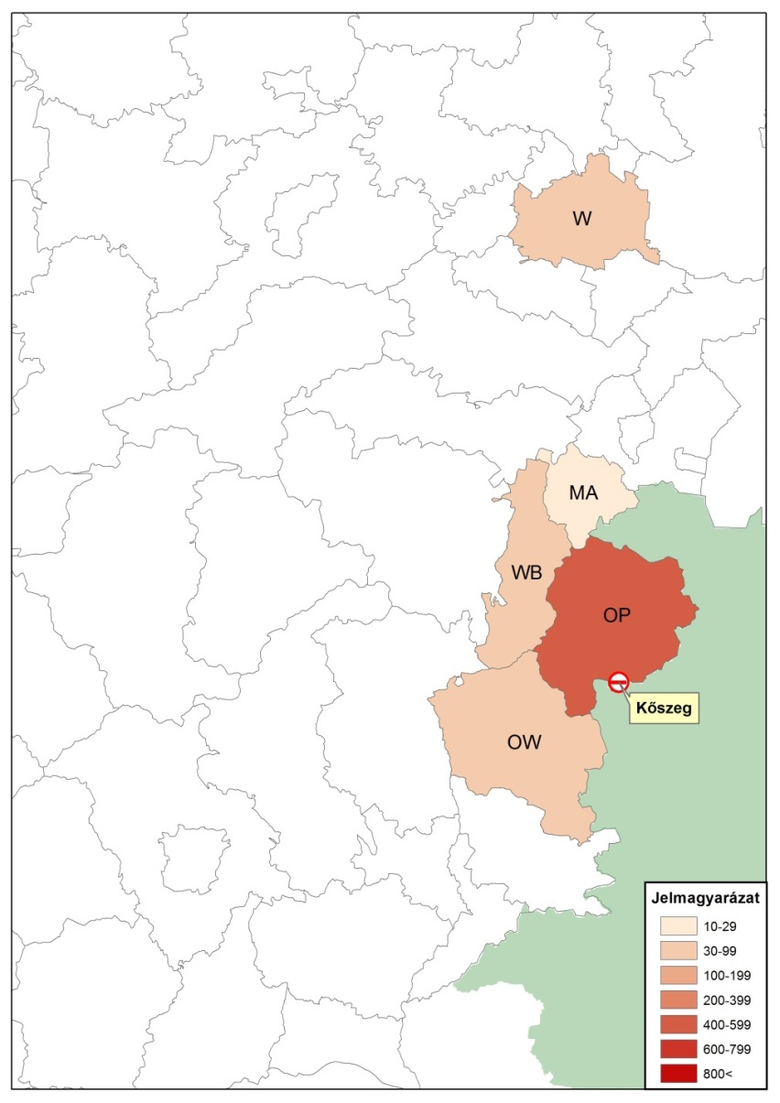
Distribution of the Austrian vehicles by administrative districts shown on their registration plates

Slide 9
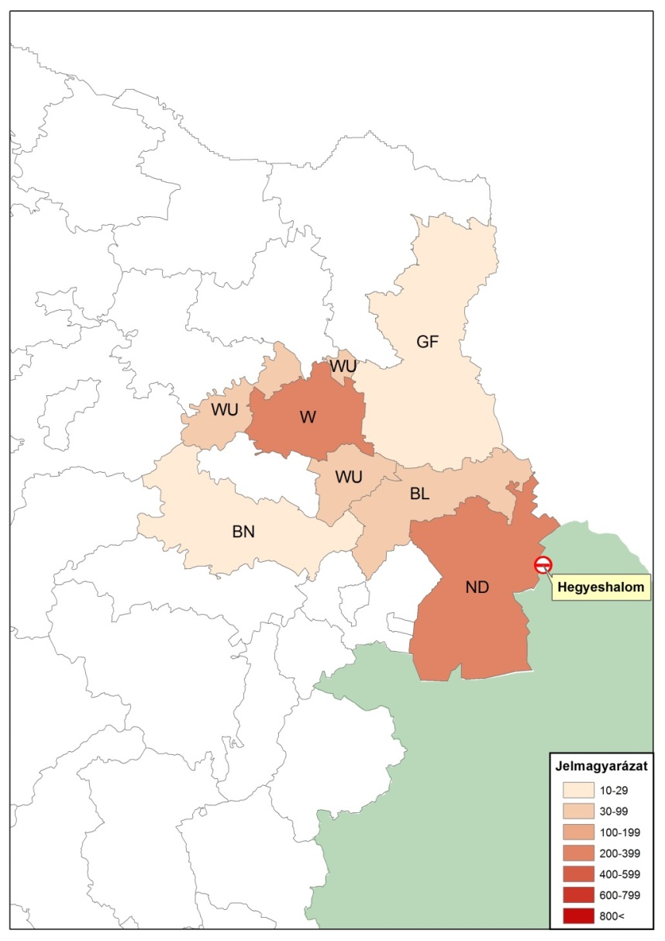
Distribution of the Austrian vehicles by administrative districts shown on their registration plates

Slide 10
Presentation of the survey of individual traffic behaviour
(Video)

Slide 11
General information (number of surveyed vehicles)
BORDER CROSSING POINT | 15.10. TUESDAY | 18.10. FRIDAY | 20.10. SUNDAY | TOTAL
Bucsu - Schachendorf | 119 | 140 | 42 | 301
Fertőd - Pamhagen | 213 | 200 | 30 | 443
Hegyeshalom - Nickelsdorf | 144 | 132 | 66 | 342
Kópháza - Deutschkreutz | 111 | 59 | 36 | 206
Kőszeg - Rattersdorf | 131 | 101 | 48 | 280
Rábafüzes - Heiligenkreuz | 176 | 227 | 71 | 474
Sopron - Klingenbach | 231 | 218 | 130 | 579
TOTAL | 1 125 | 1 077 | 423 | 2 625
BORDER CROSSING POINT | 15.10. TUESDAY | NUMBER OF CARS DURING THE INTERVIEWS | SAMPLING RATE
Bucsu - Schachendorf | 119 | 684 | 17,4%
Fertőd - Pamhagen | 213 | 883 | 24,12%
Hegyeshalom - Nickelsdorf | 144 | 1 204 | 11,96%
Kópháza - Deutschkreutz | 111 | 668 | 16,62%
Kőszeg - Rattersdorf | 131 | 1 014 | 12,92%
Rábafüzes - Heiligenkreuz | 176 | 587 | 29,98%
Sopron - Klingenbach | 231 | 3 507 | 6,59%
TOTAL | 1 125 | 8 547 | 13,16%

Slide 12
General information (number of surveyed vehicles)

Slide 13
General information (number of surveyed vehicles)

Slide 14
Reason of travel – 1.

Slide 15
Reason of travel – 2.
weekends weekdays

Slide 16
Status of passengers

Slide 17
Distribution of employees by sectors
Investigations of the regularly weekday commuters

Slide 18
Distribution of employees by company size
Investigations of the regularly weekday commuters

Slide 19
Distribution of employees by the frequency of travels
Investigations of the regularly weekday commuters

Slide 20
Reasons for using cars
Investigations of the regularly weekday commuters

Slide 21
Comments of interviewed passengers
Remarks relating to road transport (50%)
Road network
Quality of road surfaces
Establishment of new border crossings
Removing speed limits around at the border crossing points
Remarks related to the public transport (50%)
Cross-border, scheduled bus services
missing; development proposals (relations)
Railway transport
Improvement of the existing level of service
Expansion of the supply of scheduled trains (number of trains, night traffic)
Reduction of tariff levels
Development proposals (elimination of forced changes, new relations)

Slide 22
Access to public transport

Slide 23
Thanks for your attention!
Questions?

