Slide 1
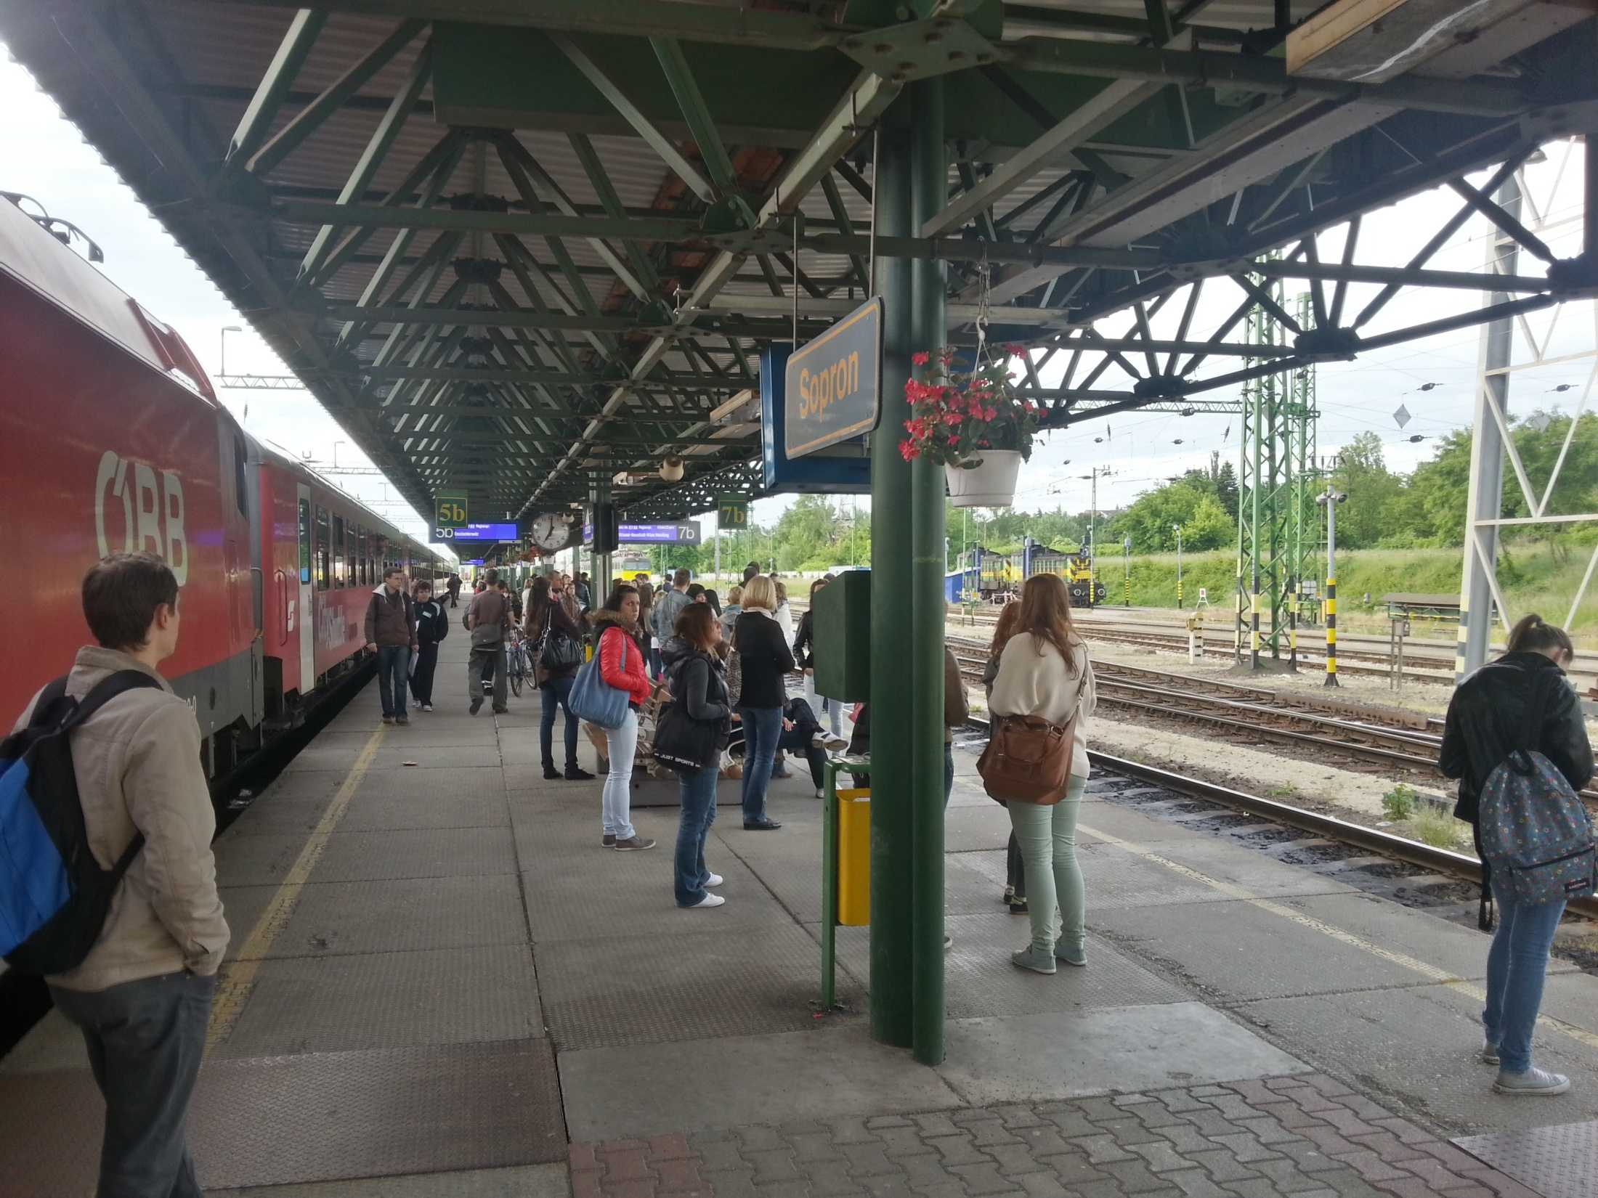

Results of the railway traffic survey
(May-July 2013)
            EMAH Eco-mobility in the Austro-Hungarian border region
            Álmos VIRÁG, project leader
            Endréné TREPPER, senior researcher
            Viktor SERBÁN, junior researcher
            András NÉMETH, intern

Slide 2
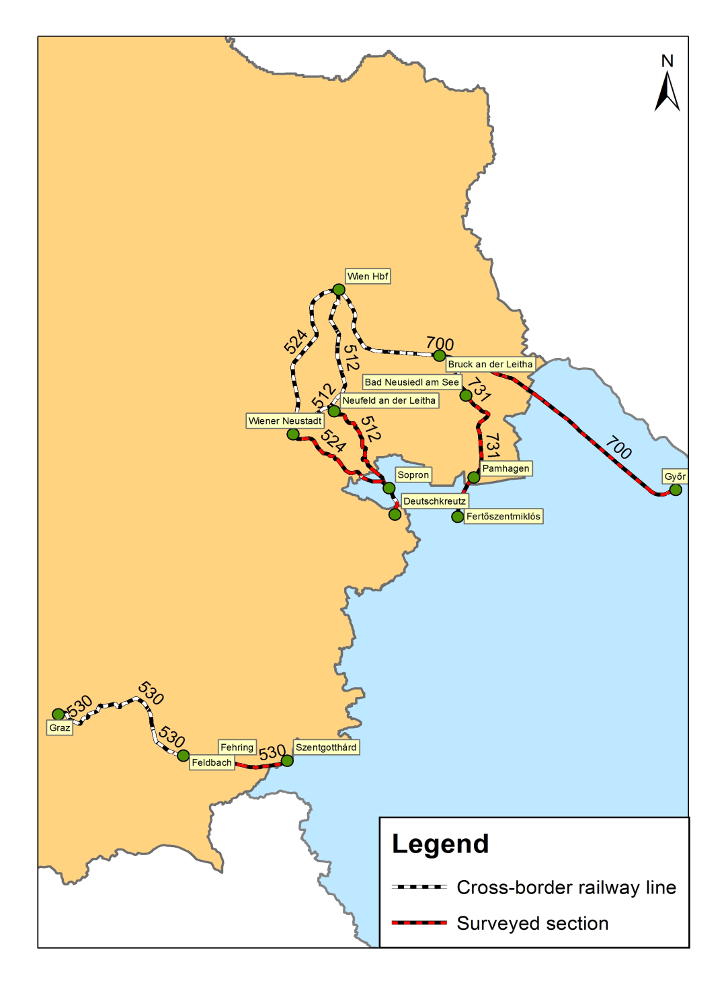
Survey characteristics
Railway line no. | Surveyed section | Survey time
 |  | WEEKDAY (Friday & Tuesday) | WEEKEND (Sunday)
512 | Deutschkreutz – Sopron – Neufeld / Leitha | 5:14 - 9:52 | -
 |  | 13:37 - 19:52 | 13:37 - 20:52
524 | Deutschkreutz – Sopron – Wiener Neustadt | 4:46 - 10:42 | -
 |  | 13:47 - 20:18 | 14:46 - 20:42
530 | Szentgotthárd – Fehring – Feldbach | 6:19 - 9:47 | -
 |  | 13:00 - 20:02 | 14:06 - 21:47
700 | Győr - Hegyeshalom – Bruck / Leitha | 4:48 - 10:10 | -
 |  | 13:48 - 21:10 | 13:48 - 21:10
731 | Fertőszentm. – Pamhagen – Bad Neusiedl / See | 6:44 - 8:42 | -
 |  | 12:19 - 17:15 | 12:19 - 17:15

Slide 3
524
[Wien –] Wiener Neustadt – Sopron – Deutschkreutz
Wr. Neustadt – Deutschkreutz
Deutschkreutz – Wr. Neustadt
Part of the suburban traffic of Wien (and Wiener Neustadt):
- monotonous decreasing traffic volume towards Austro-Hungarian border
Sopron is the 2nd busiest train station
Mattersburg: minor centre in Burgenland

Slide 4
512
Wien – Ebenfurth – Sopron – Deutschkreutz
Ebenfurth – Deutschkreutz
Deutschkreutz – Ebenfurth
Part of the suburban traffic of Wien:
- monotonous decreasing traffic volume towards Austro-Hungarian border
Deutschkreutz: similar traffic volume with Sopron
Wulkaprodersdorf: traffic junction (change towards Eisenstadt)

Slide 5
700
Wien – Bruck an der Leitha – Hegyeshalom – Győr
Bruck/L. – Mosonmagyaróvár
Mosonmagyaróvár – Bruck/L.
Part of the suburban traffic of Wien - and also Győr:
- slightly decreasing traffic volume towards the border (from both ways!)
Hegyeshalom: bigger passenger traffic, partly due to the changes between suburban trains
Parndorf: minor centre (many jobs)

Slide 6
530
[Graz –] Fehring – Szentgotthárd
Fehring – Szentgotthárd
Szentgotthárd – Fehring
Slightly reducing traffic volume towards Austro-Hungarian border
Fehring: traffic junction (change to Graz, Hartberg and to Wr. Neustadt)
Presently negligible role of suburban traffic of Graz (that is more important from Fehring)

Slide 7
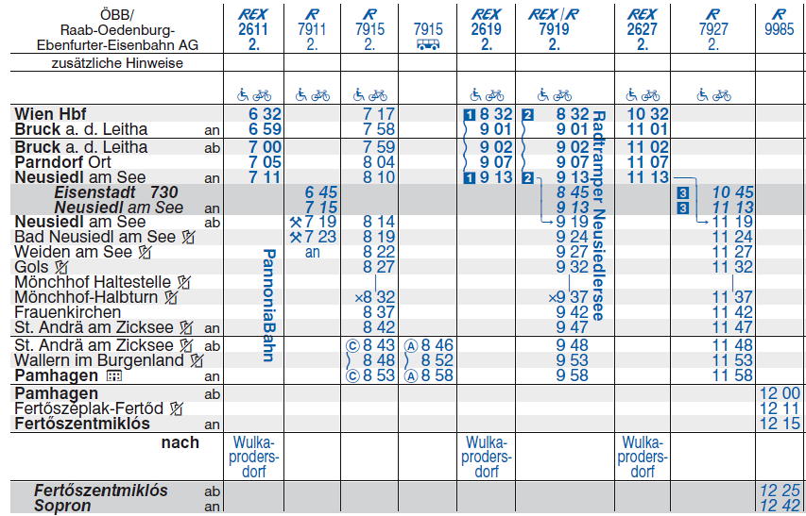
731
[Wien –] Neusiedl am See – Pamhagen – Fertőszentmiklós
Bad Neusiedl am See – Fertőszentmiklós
Fertőszentmiklós –
Bad Neusiedl am See
Austrian part: role of suburban traffic of Wien (and Neusiedl am See):
- strongly decreasing traffic volume towards the Austro-Hungarian border
- usually less than 10% (!) across the border
At present, cross-border traffic has minor role

Slide 8
Comparison of the results of cross-sectional traffic count
(May and July 2013)
Cross-border train traffic survey
 | Investigated trains [pc.] | Passengers [pers.] |  | Cross-border travellers [pers.]
24.05. (Friday) | 94 | 7113 |  | 2514
26.05. (Sunday) | 39 | 2151 |  | 657
28.05. (Tuesday) | 97 | 7344 |  | 2741
SPRING TOTAL | 230 | 16608 |  | 5912
12.07. (Friday) | 95 | 6462 | -9,15% | 2582 | 2,70%
14.07. (Sunday) | 36 | 1840 | -14,46% | 662 | 0,76%
16.07. (Tuesday) | 96 | 6785 | -7,61% | 2405 | -12,26%
SUMMER TOTAL | 227 | 15087 | -9,16% | 5649 | -4,45%

Slide 9
Changes in passenger numbers
 |  | Investi-gated trains [pc.] |  | Passengers total [pers.] | Avg. number of boardings per train [pers.] |  | Cross-border travellers total [pers.] | Avg. number of cross-border travellers p. train [pers.] |  | Rate of cross-border travellers
524 | MAY | 83 |  | 5604 | 68 |  | 2260 | 27 |  | 40%
 | JULY | 92 |  | 6346 | 69 |  | 2224 | 24 |  | 35%
 | DIFFERENCE |  |  | 13% | 2% |  | -2% | -11% |  | -5%
512 | MAY | 51 |  | 4067 | 80 |  | 1591 | 31 |  | 39%
 | JULY | 57 |  | 4067 | 71 |  | 1692 | 30 |  | 42%
 | DIFFERENCE |  |  | 0% | -11% |  | 6% | -5% |  | 3%
700 | MAY | 38 |  | 4698 | 124 |  | 1570 | 41 |  | 33%
 | JULY | 38 |  | 3963 | 104 |  | 1422 | 37 |  | 36%
 | DIFFERENCE |  |  | -16% | -16% |  | -9% | -9% |  | 3%
530 | MAY | 42 |  | 1098 | 26 |  | 387 | 9 |  | 35%
 | JULY | 40 |  | 752 | 19 |  | 371 | 9 |  | 49%
 | DIFFERENCE |  |  | -32% | -28% |  | -4% | 1% |  | 14%

Slide 10
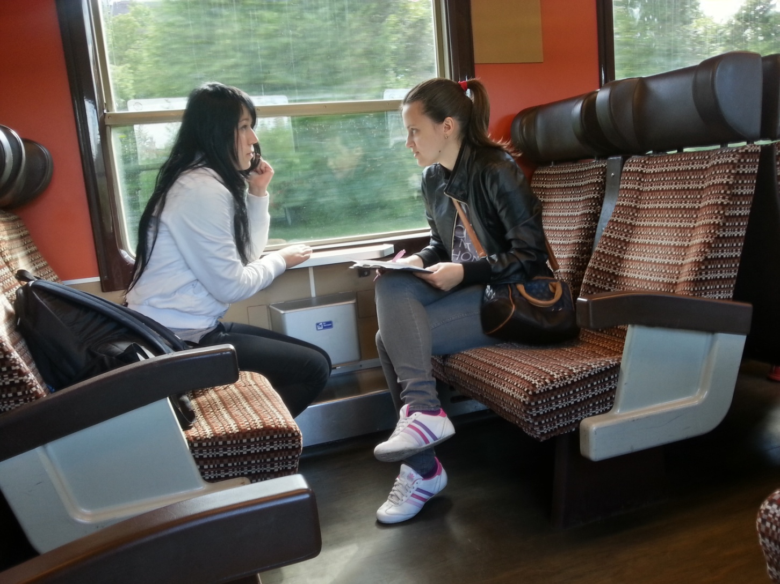
Results of the survey of travel behaviour

Slide 11
General information
Number of interviewed passengers
Line | Friday (24 May) | Sunday (26 May) | Tuesday (28 May) | Σ | Sampling rate |  | Line | Friday (12 July) | Sunday (14 July) | Tuesday (16 July) | Σ | Sampling rate
512 | 153 | 43 | 235 | 431 | 11% |  | 512 | 144 | 40 | 174 | 358 | 9%
524 | 232 | 55 | 316 | 603 | 11% |  | 524 | 281 | 66 | 247 | 594 | 9%
530 | 113 | 65 | 98 | 276 | 25% |  | 530 | 76 | 55 | 64 | 195 | 26%
700 | 144 | 67 | 92 | 303 | 6% |  | 700 | 107 | 51 | 86 | 244 | 6%
731 | 19 | 12 | 13 | 44 | 4% |  | - | - | - | - | - | -
Σ | 661 | 242 | 754 | 1657 | 10% |  | Σ | 608 | 212 | 571 | 1391 | 9%
Number of interviewed CROSS-BORDER passengers
Line | Friday (24 May) | Sunday (26 May) | Tuesday (28 May) | Σ | Sampling rate |  | Line | Friday (12 July) | Sunday (14 July) | Tuesday (16 July) | Σ | Sampling rate
512 | 120 | 40 | 204 | 364 | 23% |  | 512 | 129 | 25 | 156 | 310 | 18%
524 | 197 | 43 | 229 | 469 | 21% |  | 524 | 260 | 64 | 240 | 564 | 25%
530 | 79 | 56 | 70 | 205 | 53% |  | 530 | 76 | 55 | 64 | 195 | 53%
700 | 109 | 33 | 72 | 214 | 14% |  | 700 | 106 | 50 | 86 | 242 | 18%
731 | 9 | 2 | 9 | 20 | 19% |  | - | - | - | - | - | -
Σ | 514 | 174 | 584 | 1272 | 22% |  | Σ | 571 | 194 | 546 | 1311 | 23%

Slide 12
Reason of travel
(May 2013)
(July 2013)
School-related travels decrease significantly
Major increase in tourism/free time activity and visits
Slight changes in healthcare, administration, work-related travels

Slide 13
Status of passengers
(May 2013)
(July 2013)
Share of students disappearing ◻ bigger proportion of workers
„Others” increasing: probably more pensioners (relation with the purposes of travel)

Slide 14
Access to car
(May 2013)
(July 2013)
CAR AVAILABILITY | answers | percent | answers | percent
YES | 448 | 54,4% | 442 | 64,1%
NO | 318 | 38,6% | 235 | 34,1%
no answer | 57 | 6,9% | 13 | 1,9%
TOTAL | 823 |  | 690
Sample: daily commuters
Rate of passengers without car access reduced (less students)

Slide 15
Reasons of using public transport (train) service
(July 2013)
(July 2013)
Very similar distribution compared with the results of the spring survey
Passengers with car access replied similarly
Most important factors: (reasonable) price, (better) comfort, effective time-spending
Eco-friendliness was considered to be more important by passengers with car access

Slide 16
Overall satisfaction, main remarks
SATISFACTION WITH THE CURRENT TIMETABLE | responses | Percent
YES | 600 | 72,9%
NO | 221 | 26,9%
No answer | 2 | 0,2%
TOTAL | 823 | 100,0%
Overall satisfaction with train schedule:
Some recommendations…
  Generally: more frequent trains, less delays, improved comfort,
  Wi-Fi, snack/coffee machine, cleaner stations and restrooms, more information (especially on Internet),
  better connections with public transport
  512: more frequent trains in the evening (off-peak, especially on Saturdays)
  524: REX to Wien at 8:00; other trains with larger capacity
  530: fewer stops to Graz
  700: direct trains again (between Wien and Győr)

Slide 17
Thanks for your attention!
Questions?

