Slide 1
WU@School
Introducing WU
A Presentation of the Studentinformation
Notes:
Welcome to our WU@School Info Session!
My name is … and I‘m studying …
Today, I will present WU‘s Bachelor‘s programs, explain how the selection procedure works and tell you what it‘s like to study at WU.
If you have questions, please post them in the chat. I‘ll be happy to answer them after my presentation.

Slide 2

Welcome to WU!
Notes:
WU is the only university of economics and business in Austria, and one of the best universities of its kind in Europe.
WU has about 21,000 students from over 100 countries
WU has 2,800 employees who teach, work, and do research
Many students remain connected to their university even after graduation. We have a network of 55,000 alumni from 120 countries.
WU offers its faculty, researchers, and students an international network of about 240 partner universities worldwide.
Our faculty and researchers are among the best in their fields. This is a direct advantage for our students, because the latest research findings are immediately incorporated into WU’s teaching.
Students can choose from a broad variety of specializations and free electives.
WU also offers many events for the interested public (talks, discussions, …)
WU’s campus is climate-neutral and barrier-free

Slide 3
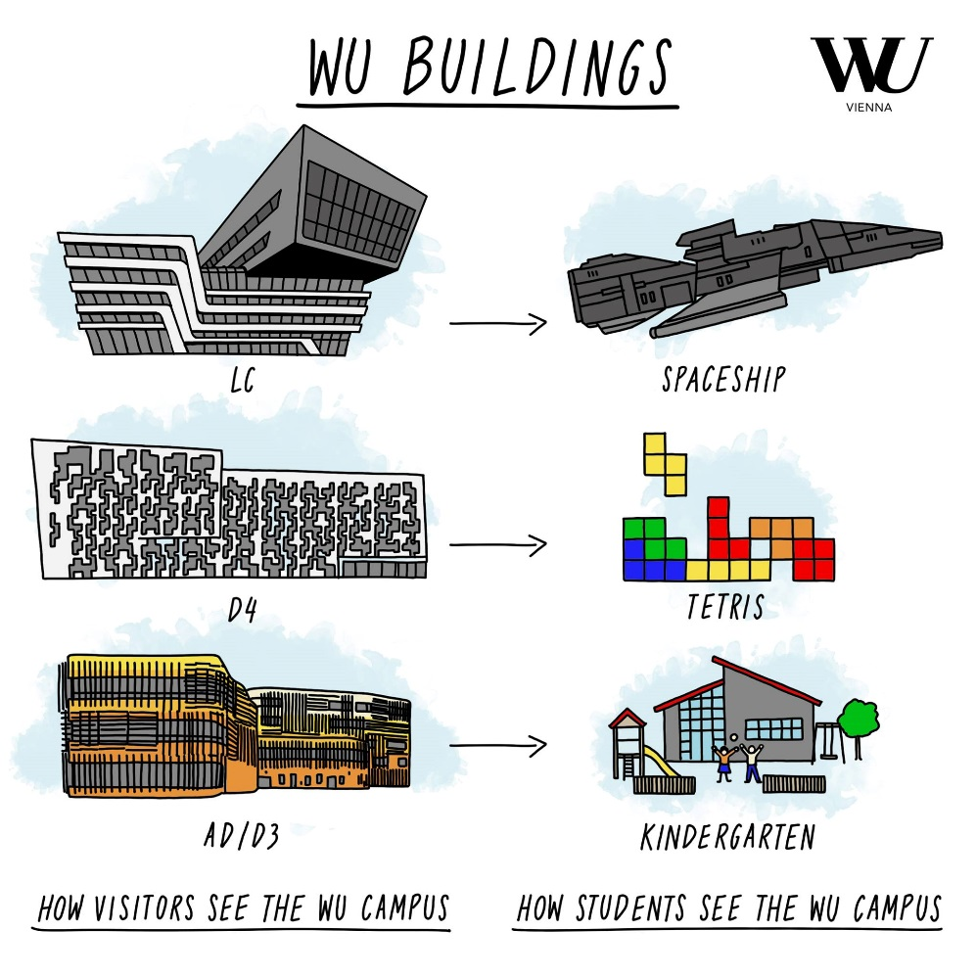
Campus WU
Notes:
(Explain graphic)
What do the buildings look like?
What do the students think about the individual buildings?

Slide 4

From School to University
What to Expect
freedom ≠ free time
self-directed learning
theory and practice
large amounts of information
multiple-choice exams
eLearning
specializations
Notes:
Studying at a university is very different from going to school:
It may be difficult to get used to student life. There are also wrong ideas and clichés about studying and student life, like: students have lots of free time, they get up late and rarely go to class, but when they do, they have intellectually stimulating conversations, afterwards they go to a party, etc.
Unfortunately, reality is different! You have to study a lot and pass difficult exams.
Especially at the beginning of your studies, your courses will be held in large auditoriums (e.g.: in the Audimax with 650 fellow students) and you have to pass multiple-choice exams.
Challenges:
freedom ≠ free time: As a student, you enjoy a certain amount of freedom. However, this is not the same as free time. Nobody will tell you when to go to class and when to study.
You have to take responsibility for that and manage your time wisely.
Self-directed learning: You decide for yourself whether you attend a class or study on your own, and when you take your exams.
Theory vs. practice: Especially at the beginning of your studies, you will learn a lot about economic theory. This might be new to you, but there are two good reasons:
A thorough understanding of the theory will help you understand the wider context of business and economics.
At the beginning of their studies, students’ knowledge may vary widely. Some may know a lot about business and economics already, while others may hardly know anything at all. In our introductory courses, we make sure that everyone learns the basics of business and economics, so that everyone’s on an equal footing.
large amounts of information: The workload is much higher than in school. (By the way, study groups are helpful for learning.)
Multiple-choice exams: Especially at the beginning of your studies, there are many multiple-choice exams. It sounds easy at first, but you have to prepare well for them!
E-learning: At WU, we use Canvas – our e-learning platform. There you can find a list of recommended books, mock exams, course materials, and videos.
They help you prepare for exams and test your knowledge before you actually take the exam.
Specializations: Unlike in school, not all students learn the same things at university. There are electives and specializations that you can choose according to your own interests.
The transition from school to university is a big leap, but you can do it! ☺

Slide 5






What you will need
Interest in economics, business & law
Curiosity, motivation, goal orientation and perseverance
Organizational skills
analytisches Denken und Affinität zu Zahlen
Good understanding of numbers and figures
Intercultural and social skills
Proactive attitude
Notes:
What skills do university students need?
Interest in economics, business & law: You should have an interest in topics related to business and economics. This does not mean that you already need to know a lot about it (many students do not take economics-related subjects in school), but that you have a basic interest in these topics and are willing to deal with economic issues in your studies.
Curiosity: You should have the desire to learn something new.
Motivation and goal orientation: Our bachelor’s programs take at least 3 years. It’s important that you are motivated and that you decide to enroll in a program because you are interested in it and not because someone expects or persuades you to do so. It is also helpful to think about your goals. Why do you want to study and what do you want to achieve? For example, your goal might be to do an interesting master's program afterwards or to get a good job. Or, your goal might simply be to better understand business and economics, and to figure out what you’d like to do after your studies.
Perseverance: Perseverance is a necessary trait for successful students. At some point, you may fail an exam and things don't turn out the way you hoped.
Most students go through difficult phases. Don’t give up. Try again until you succeed. You can do it!
Organizational skills: If you decide to study at university, you need good organizational skills to keep up with your courses, not miss any deadlines and prepare for exams ahead of time.
Good understanding of numbers and figures: You don't have to be a math genius to study at WU, but it is helpful to have a good understanding of numbers and figures.
Intercultural and social skills: WU is an international and diverse university. We therefore value intercultural and social competence. Intercultural competence is the ability to get along with people who have different cultural backgrounds. Social competence means being able to work well with others, present ideas and listen to others' ideas, and work and cooperate in heterogeneous groups.
Proactive attitude: It is especially important that you show initiative. You start your studies with a few hundred or a thousand students. No one will take you by the hand and guide you through your studies. No one will tell you what to do, when to study and when to take an exam. It is important to take responsibility for yourself and your academic progress. It’s important to ask questions and reach out to students and teachers.
If you keep this in mind, you're sure to get off to a great start!

Slide 6
WU Programs
Study Options
6 sem.
Doctoral program Business Law
Doctoral /PhD programs
in the fields of business, economics, social sciences
4-5
sem.
Master‘s program Business Law
(in German)
Master‘s programs
Various programs in the fields of business, economics, social sciences
(7 in German, 9 in English)
6
semesters
Bachelor‘s program
Business Law
(BL)
in German
Bachelor‘s program
Business, Economics and Social Sciences (BESS)
in German
Choose 1 major:
Bachelor‘s Program
Business and Economics
(BBE)
in English
Business Administration
International Business Administration
Economics
Economy – Environment – Politics
Information Systems
CBK
Common Body of Knowledge (CBK)
Core Courses
STEOP
Introductory and Orientation Phase (STEOP)
Introductory and Orientation Phase
Notes:
WU offers 3 Bachelor‘s programs, 16 master‘s programs and several doctoral and PhD programs.
We will take a closer look at what you can study at WU and how the application process and the admission process work in a moment.
WU offers 3 bachelor programs, which we will look at individually.
After completing the Bachelor's degree, 16 Master's programs are available: 7 German and 9 English.
After that, you can continue your academic career with a doctoral or PhD program.
But now back to our bachelor's programs.

Slide 7






Our Bachelor‘s Programs
BESS (WISO) | BL (WIRE) | BBE
solid knowledge in business and economics 5 majors many specializations | law focus, supplemented by business skills specialization options | comprehensive, international program in business and economics with a strong analytical focus many specializations + free electives
2.703 places Program start: winter and summer semester | 870 places Program start: winter and summer semester | 240 places Program start: winter semester only
Program
Places & Program Start
duration: 6 semester, 180 ECTS-Credits
academic degree: Bachelor of Science (WU) or Bachelor of Laws, LL.B. (WU)
Notes:
WU offers three 3 different bachelor's programs.
(Kurz die einzelnen Programme umreißen und Infos zur Anzahl d. Studienplätze sowie möglichen Studienstart geben)

Slide 8
Business, Economics & Social Sciences
BESS (WISO)
Notes:
Let's turn our attention to WU's largest bachelor's program: Business, Economics and Social Sciences, or BESS (WISO) for short.

Slide 9
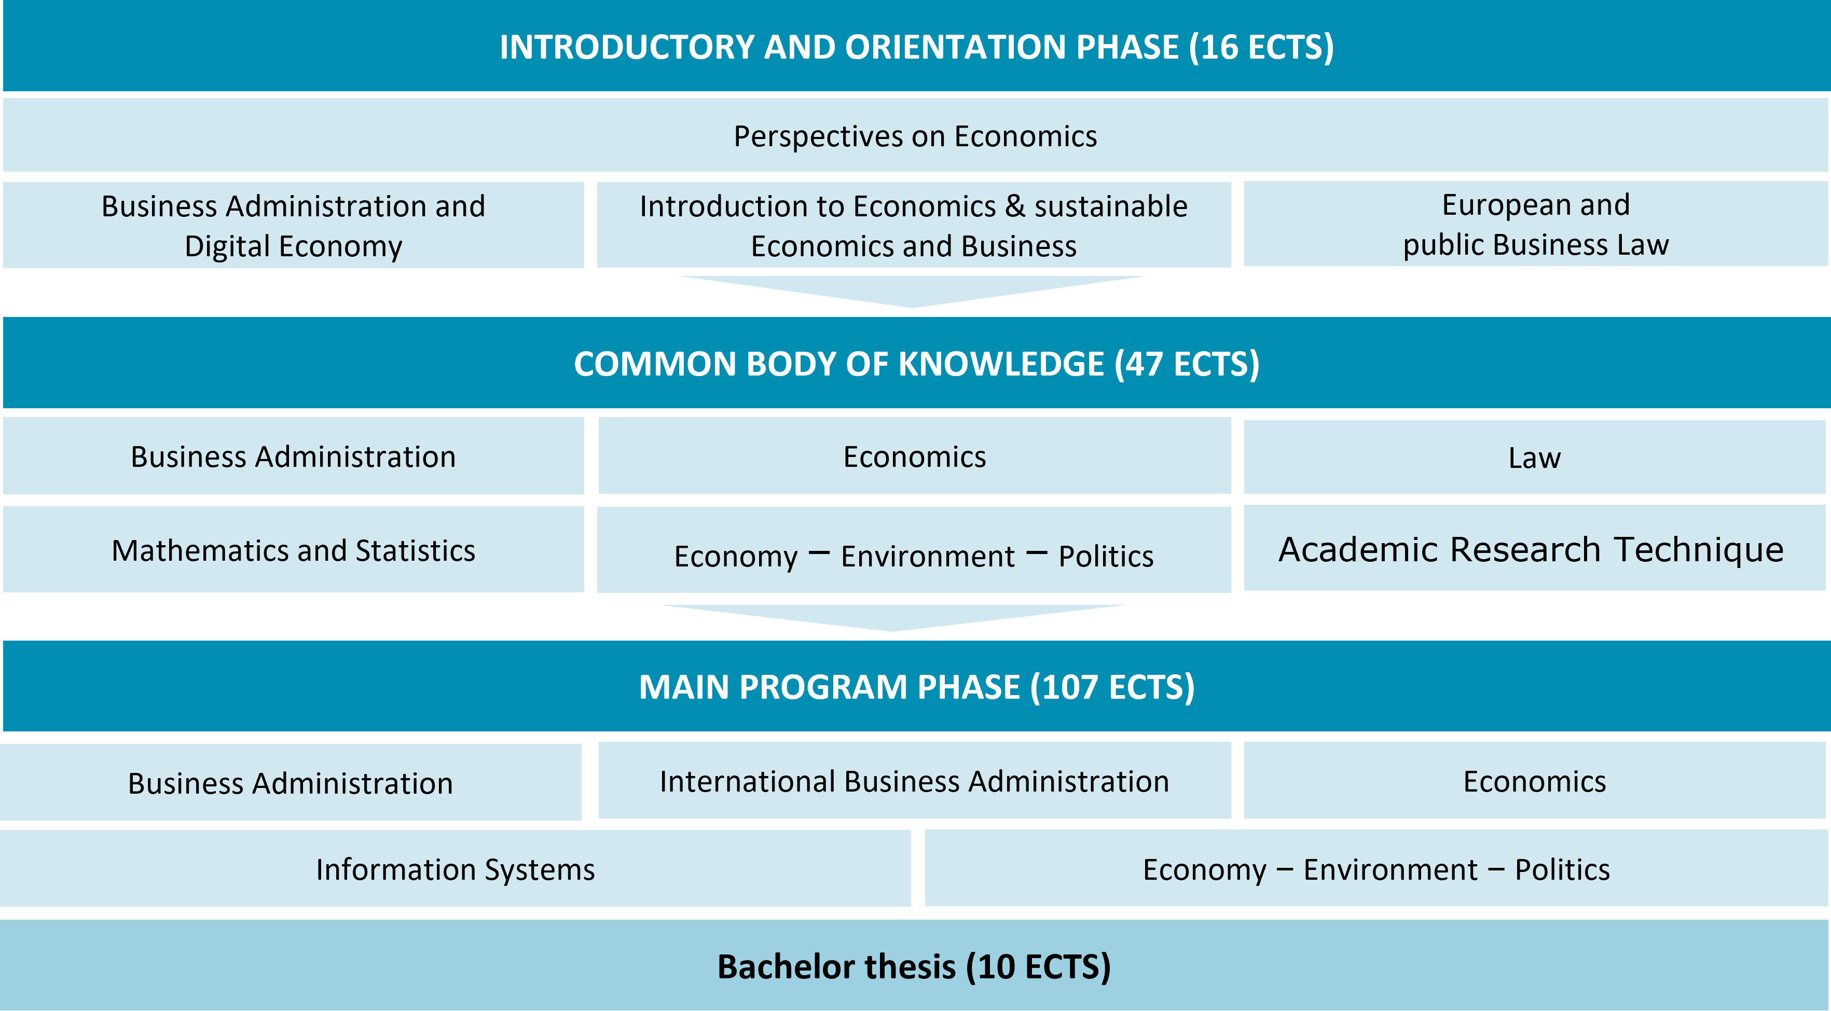
Business, Economics and Social Sciences:
Structure
Notes:
The Bachelor's program lasts 6 semesters and comprises of 180 ECTS credits.
ECTS stands for European Credit Transfer and Accumulation System – ECTS. 1 ECTS point stands for 25 hours of work for the student.
The workload of an academic year is calculated for a full-time student with 60 ECTS points. This is 30 ECTS points per semester.
The Bachelor's program is divided into three sections: the Introductory and Orientation Phase (STEOP), the Common Body of Knowledge (CBK) and the Main Program Phase.
The course begins with the introductory and orientation phase, which provides a first insight into the subject areas – as the name suggests: an introduction and also an orientation – is this the right program for me?
This is followed by the Common Body of Knowledge, which lasts about 1.5 semesters. Then comes the main program phase with about 4 semesters and then you already have your first academic degree in your pocket!
STEOP comprises the following 3 courses (LVs):
Business Administration and Digital Economy (6 ECTS)
Introduction to Economics and Sustainable Economics and Business (6 ECTS)
European and Public Business Law (4 ECTS)
You need to pass these 3 courses before you can register for any follow-up courses later in your studies.
CBK
The CBK comprises eight basic courses in the fields of business administration, economics, law, mathematics/statistics, socioeconomics and business communication.
The CBK is identical for all students, regardless of the major they subsequently choose
Info:
in STEOP (4 tries per exam across curricula, i.e. overall, if you study e.B. WISO and WIRE)
later in the studies you can retake an exam 4 times (across curricula)

Slide 10





WISO: Wahl eines Studienzweigs
Business Administration
Internationale Business Administration
Double Degree möglich (Kanada oder Portugal)
Information Systems
Economy – Environment - Politics
Economics
Notes:
In the main course of study, you can either choose one major, some students choose more than one, that’s possible too.
BA: All sub-areas of a company – financing, human resources, organization, marketing, management
IBA: International Focus – Foreign Languages, Experience Abroad, Prepares Students for a Career in an International Context
IS: the main focus here is on new information technologies and their application in companies
Economics: goes beyond the focus of a single entrepreneur, here it is all about the entire economy and the analysis of social and economic relationships
Economy, Environment, Politics: It is about the understanding of economics in relation to the major societal challenges of our time, such as global inequality, poverty, social cohesion or the climate crisis.

Slide 11

Business, Economics and Social Sciences:
Job Opportunities
Business Administration
Int. Business Administration
Economics
marketing
human resources
production
controlling
finance
profit or nonprofit
start-ups
…
international & intercultural business
controlling
marketing
supply chain management
strategic consulting
…
economic research
political consulting
public administration
banking
international organizations
…
Information
Systems
Economy, Environment, Politics
IT Management
management Consulting
software development
innovative business process design
project management
…
science
business
NGO's
public institutions
sustainability consulting
CSR
…
Notes:
With a BESS degree, you have a wide range of job opportunities in business and administration, non-profit companies, in the areas of marketing, controlling and finance, HR management and much more.
WU graduates have good job prospects and are in great demand on the job market – an average graduates only need 7 applications and 2 job interviews to find their first job.
QUALIFICATION PROFILE
Theoretically and methodically sound business education
Analytical skills
Solid language skills
Competence to act and solve problems
Social skills
Intercultural competence
IBA: Experience abroad
… or you can follow up with a master‘s program.

Slide 12
Business Law
(WIRE)
Notes:
WIRE
A sound law education, supplemented by business skills: "Jus plus business/economics".
The program is designed in such a way that the associated Master program in Business Law follows suit.
Around 70% of our Bachelor's graduates also complete our Master's program.
However, you could continue your studies with any Master program at WU or at any another university in Austria or abroad.

Slide 13
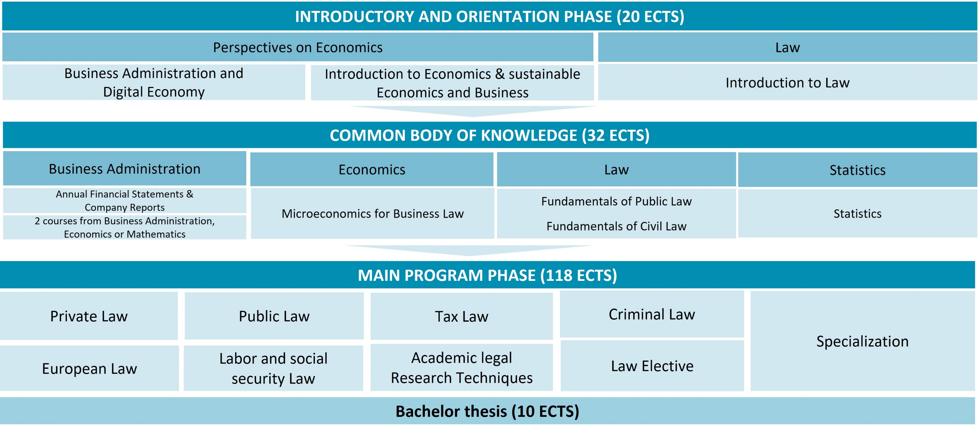
Business Law:
Structure
Notes:
STEOP
The introductory and orientation phase in WIRE comprises 3 courses with a total of 20 ECTS.
Business Administration & Digital Economy (6 ECTS)
Introduction to Economics & sustainable Economics and Business (6 ECTS)
Introduction to Law (8 ECTS)
If you have passed all exams of the STEOP, you can take courses from the CBK. The CBK comprises 4 subjects (Business Administration, Economics, Law, Statistics) and 7 courses. After the CBK, you’ll take courses in legal subjects: European law, private law, public law, tax law, criminal law, labor and social security law as well as academic legal research techniques. In addition, you can choose a law elective, e.g.: International Tax Law, Parliamentary Law, Financial Market Supervision Law, etc. and a specialization worth 20 ECTS. At the end of your studies, you have’ll to write a Bachelor's thesis in a legal subject.
There are no free electives in the Bachelor's program in Business Law.

Slide 14







Business Law:
Career Prospects
Typical career paths of
Bachelor graduates
Master graduates have unrestricted access to core legal professions
Legal or Human Resources departments of large corporations
Magistracy
Consulting
Lawyer
Banks, insurance companies
Notary
Tax consulting and auditing
Notes:
After completing your bachelor's degree, you can work in a variety of professions.
If you also complete a master's degree, you will have access to the core legal professions such as magistracy, lawyer or notary.

Slide 15
Business and Economics

Slide 16
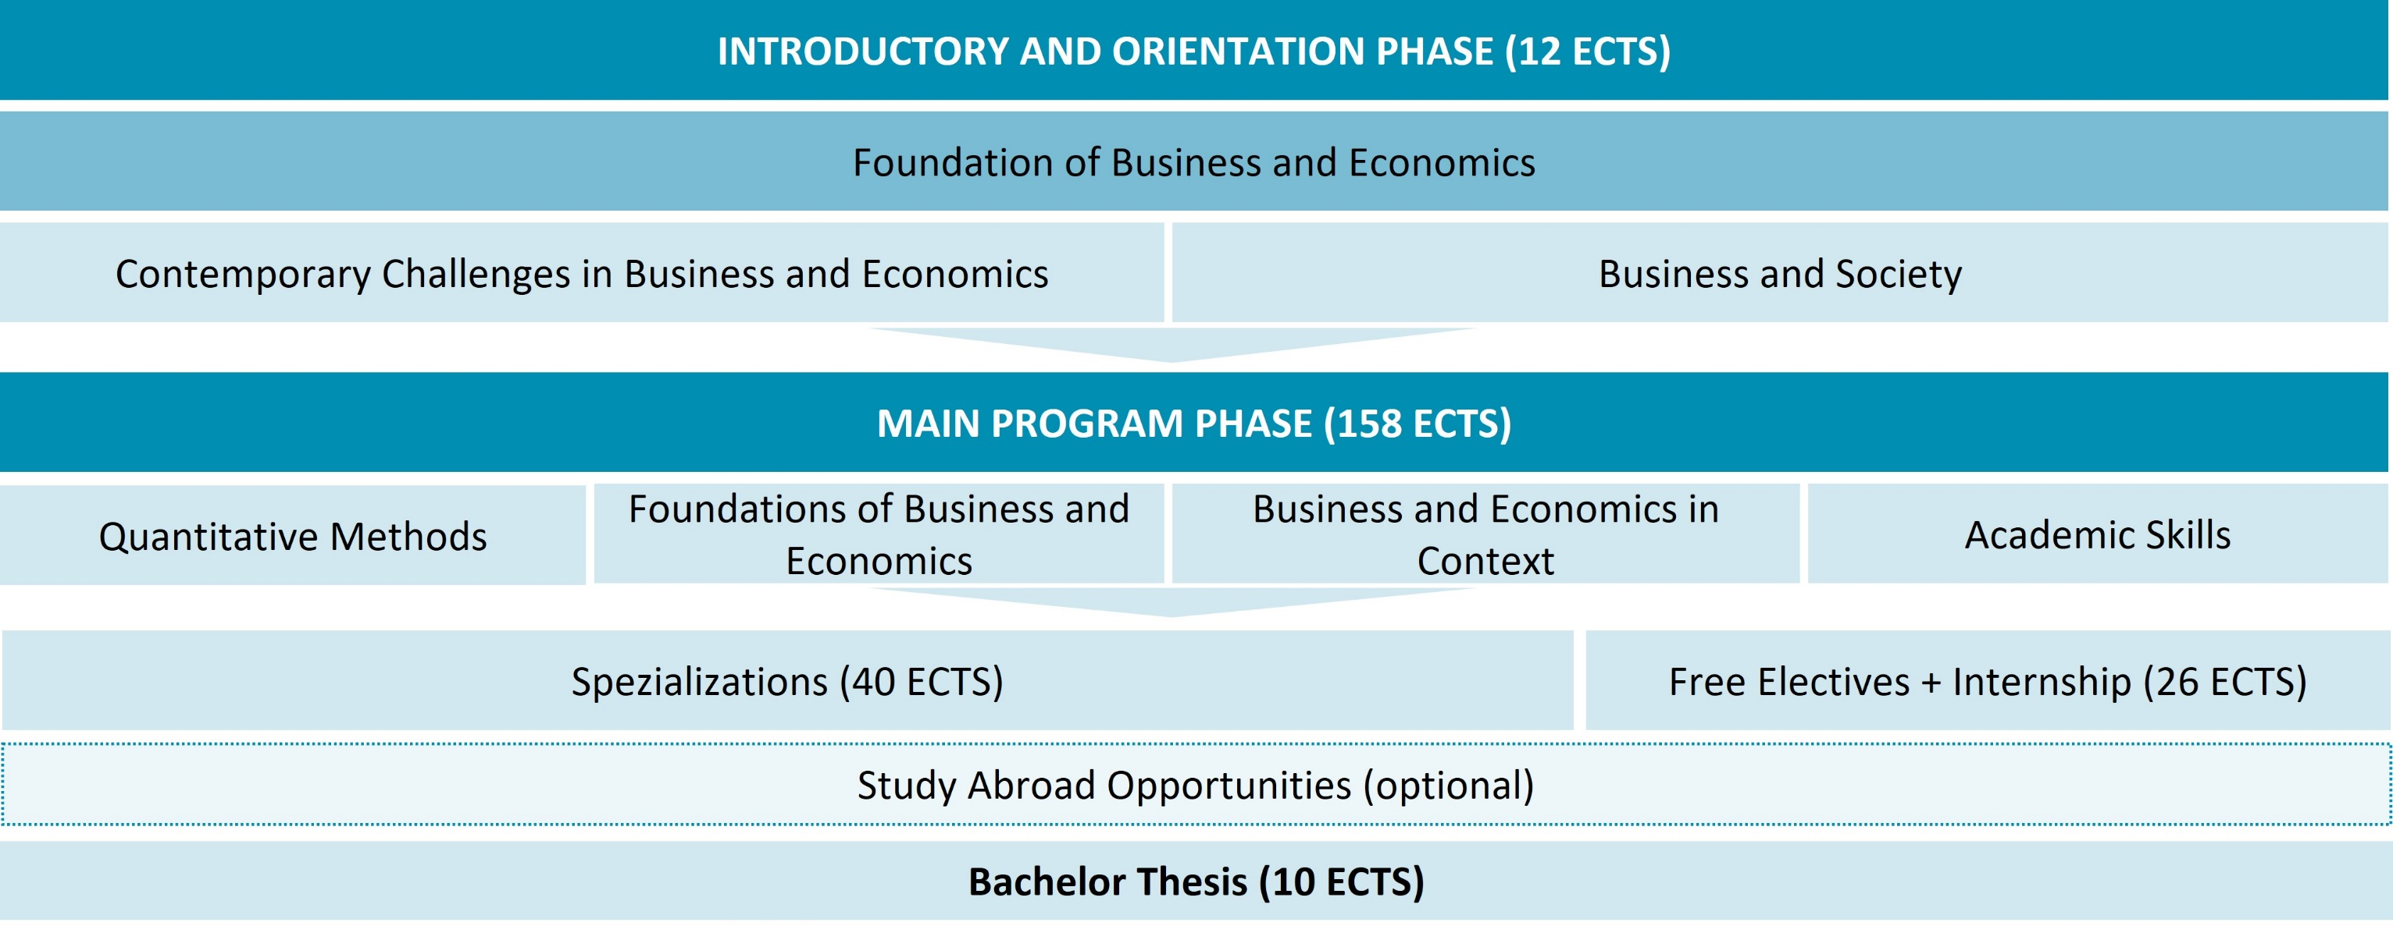
Business & Economics: Structure
Notes:
The English-language BBE program has a slightly different structure.
In the 1st semester you start with the Introductory and Orientation Phase. This includes the two courses Contemporary Challenges in Business and Economics and Business and Society. This is followed by the Main Program Phase with the Core Courses.
From the 2nd semester you can already start with the free electives, from the 3rd semester with the specializations, as soon as you meet the requirements.
From day one, you will be working closely together with your peers in an interactive setting. Group projects, discussions, and presentations will strengthen your interpersonal and communication skills. A lot of BBE students also go abroad for a semester to get international experience. Selected students also have the opportunity to add a year in Australia to their bachelor’s program and earn a double degree from Queensland University of Technology.

Slide 17

Business & Economics:
Sharpen Your Profile
choose 2-4 specializations from over 20 offers
Specializations
International
semester
(optional)
)
Internship
(optional)
Free Electives
at WU or another university
at one of our many partner universities
to gain professional experience
Notes:
In the BBE program you have many opportunities to set your own priorities. Here, too, there is an introductory phase that is intended to provide all students with a basic knowledge. After that, it is important to design the program freely.
There are more than 20 specializations, e.B. International Business, Entrepreneurship and Innovation, Data Science.
In BBE, you also have 26 ECTS credits available for free electives that you can take at WU or another university in Austria or abroad.
Specializations: e.g. International Business, International Business Communication, Strategy and Data, International Accounting and Controlling, Business Mathematics, Economics, European and International Economic Law, Supply Chain Management and Operations
Internship: minimum 6 weeks, full-time, tasks should be related to your studies, for each week 1 ECTS can be earned, max 8 ECTS can be recognized
Exchange semester: around 1000 incoming and outgoing exchange students per year

Slide 18

Business & Economics:
Career Prospects
BBE graduates have access to the same occupational fields as BESS (WISO) graduates.
Business & Economics has only been offered since 2018.
Therefore there are only a few graduates.
international marketing
private sector
Public administration
controlling & finance
Most BBE graduates continue their studies with a master's program - either at WU or at a renowned university abroad.
human
resources
Non-profit sector
Research institutes
Master‘s
program
Notes:
With a bachelor's degree in BBE you can work in the same professional fields as students with a degree in Business, Economics and Social Sciences.
However, since BBE has a strong international focus, the program prepares you for an international career in companies and organizations - both in the profit and non-profit sector.
However, the majority of our BBE students do not start working directly after their bachelor's degree, but continue their studies.
Either BBE graduates stay at WU (which offers several English-taught Master's programs) or they continue their studies at a renowned university abroad (e.g. London School of Economics, HEC Paris, Oxford, INSEAD ...).

Slide 19


We Are Looking for Prospective Students Who …
are motivated and enthusiastic
enjoy to work autonomously and responsibly
have very good English skills
are interested to analyze and interpret data to
understand real-world findings
are pro-active and like to participate in in-classroom discussions and group assignments
are interested in what’s happening globally in
business and economics
are active members of the BBE community
are aiming at an international master’s program
are seeking a position in an international environment
are ready to go the extra mile

Slide 20
Selection Procedure

Slide 21


Selection procedure
online registration
https://bach.wu.ac.at/start/vi +
payment of the registration fee (€ 50)
March – May
2026
NO
selection procedure
selection procedure
Everybody who has registered and meets the formal requirements will be admitted.
Possibility of subsequent registration
(In case of registration for a similar program at another university).
Step I:
online-self-assessment
Step II:
BBE: written exam on Campus
BESS: written exam on Campus
BL: written exam on Campus
Admission
(if you pass the selection procedure and meet all formal admission requirements)
Notes:
Each bachelor‘s program (BESS, BL and BBE) has its own selection procedure
held once a year in spring; for intake in the following academic year (winter or summer semester; BBE: program starts in the winter semester only)
Online Registration for each of the three selection procedures: March - May, 2025
registration fee (€ 50); in exchange, students will get a voucher for the WU shop at the beginning of their studies
Decision if the selection procedure will start: end of May 2025
admission procedure
Step 1: March 1 – June 1
Online-self-assessment
Step 2:
BBE: written exam (Messe Prater)
BESS: written exam (Messe Prater)
BL: written exam on Campus

Slide 22


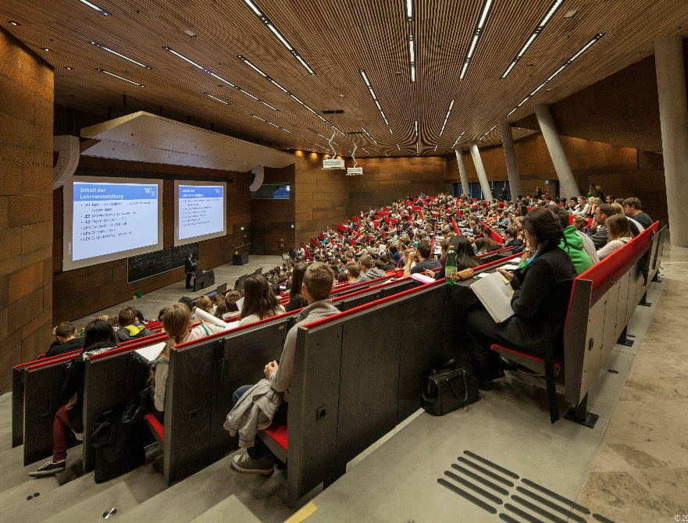
Studying at WU
Completing the Admissions Process After Having Passed the Entrance Exam
Admission appointment during enrollment period & payment of tuition fees/ÖH Student Union dues
Attend our „Welcome Days“ – orientation for new students
BESS+BL (WISO+WIRE): beginning of September 2025
BBE: end of September 2025
Notes:
General enrollment period: mid of July until the beginning of September
Required steps for admission:
Submission of application for admission by presenting the required original documents in person or via postal mail
Personal enrollment at the Study Service Center
Payment of Students’ Union dues / tuition fees
The standard tuition fee is € 363.36 per semester. The tuition fee for Non-EU and Non-EEA Citizens is € 726.72 per semester. Many students get a tuition fee waiver (depending on their citizenship and other factors).
Membership to the Austrian National Union of Students (ÖH) is compulsory for all degree program and non-degree program students and costs € 22.70 per semester.
At the beginning of the semester there are the Welcome Days! Here you get a lot of important information about the start of your studies. You will receive information about this in good time by e-mail.

Slide 23
Good to Know

Slide 24
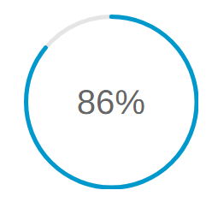
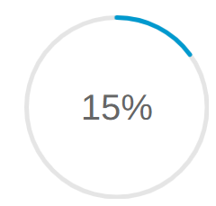




Hard Work in the First Year Pays Off!
88%
15%
More than 30 ECTS credits
in the first year of study
Less than 30 ECTS credits
in the first year of study
Only about 12 out of 100 students drop out, 88 successfully complete their studies!
Approximately 85 students drop out, only 15 graduate!
Notes:
We surveyed how the first study year affects the overall success of the Bachelor's degree program and have come to the following conclusion:
Out of 100 students who have completed more than 30 ECTS credits in their first year of study, only 12 drop out. 88 finish their studies.
Procrastination has a negative effect on your academic progress. Out of 100 students who have completed less than 30 ECTS credits in the 1st year, the vast majority, 85, drop out.
Only 15 complete their studies!
We recommend therefore: Work hard right from the start!

Slide 25





About WU
3
International accreditations
240
Partner universities worldwide
~21k
Students from
more than 100 countries
High-quality courses & excellent teaching
Modern and innovative campus
Numerous elective and specialization options
Excellent career opportunities
Notes:
WU is one of the best business universities in Europe, with around 21,000 students, a wide range of courses, excellent teaching, and an international university on a state-of-the-art and beautiful campus. WU is often envied for its campus directly next to the Green Prater in Vienna, which was planned by international architectural firms.

Slide 26

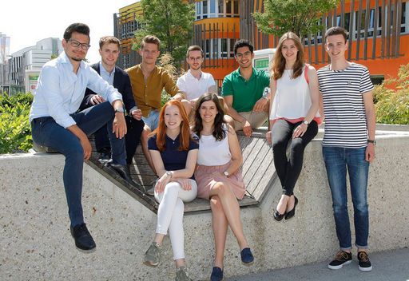


Support Programs
Starting@WU
WU Top League
Student Counselling
BeAble
Notes:
WU offers various support programs that support you during your studies:
Starting@WU (for BESS and BL only)
Higher-level students supervise first-year students and offer:
Orientation during your studies
Social activities
Project Communities
TOP LEAGUE
With individual support and many events, the support program aims at committed and qualified students with:
Coaching
Top League Meetings
Sponsor Meetings
Prerequisite:
Excellent Matura success
STUDENT COUNSELLING
With the Student Counselling Program, WU supports its students:
when they have problems
with individual consultations
with moderated group discussions
through workshops
BEABLE
Support for students with physical/mental impairments, chronic illnesses and/or reading and writing difficulties
Change of the examination mode
Writing assistant for exams
Assistance with administrative steps
e.g. Course and Exam Registration
Support with the services of the self-service terminals
general advice and orientation

Slide 27
Additional offers
ZBP Career Center
Entrepreneurship Center
Canvas
Learning Management System
Language Ressource Center
International Office
Volunteering@WU
Notes:
WU ZBP CAREER CENTER
The WU ZBP Career Center is the go-to address for answers to any questions students may have about their résumé, applying for jobs, and career opportunities with a WU degree.
WU ENTREPRENEURSHIP CENTER
The entrepreneurship center offers free consultations, workshops, programs and events for people interested in starting a business.
It’s also a great place to meet inspiring and like-minded people.
CANVAS
This is WU’s new learning platform. Here students can find learning materials an mock exams for their studies.
LANGUAGE LEARNING CENTER
Here students can take language courses, participate in a tandem learning program or learn a language on their own.
INTERNATIONAL OFFICE
The IO supports students who are interested in spending a semester abroad at one of our partner universities.
VOLUNTEERING@WU
Students can volunteer their time and help make equal opportunities a reality. As a learning buddy, music buddy, or sports buddy, they support disadvantaged children and teenagers in their education and become a role model for them.

Slide 28
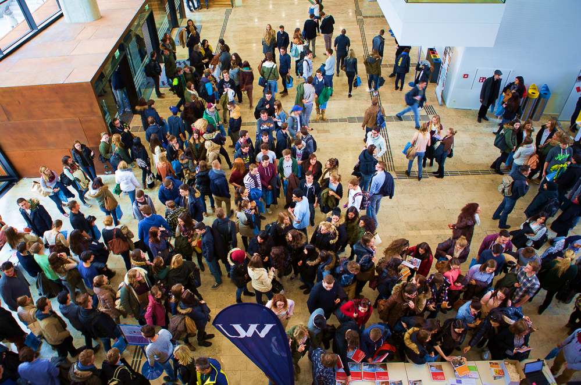
WU Bachelor‘s Day
March 13th, 2026
mehr Infos auf
wu.ac.at/events

Slide 29


WU Study Information
You ask, we answer. Study counseling made simple (and) professional!
WU Studieninformation
im Study Service Center
T +43-1-313 36-3500
studieninfo@wu.ac.at
www.wu.ac.at
Notes:
If you have any questions, please contact our Study Information!

Slide 30
Study Service Center
Important Departments
For questions concerning the following
topics please contact:
Study Information
studieninfo@wu.ac.at | +43-1-31336-3500 | Website
Admissions
studienzulassung@wu.ac.at | +43-1-31336-3501| Website
Examination Office
pruefungsorganisation@wu.ac.at | +43-1-31336-3502 | Website
Study Regulations
studienrecht@wu.ac.at | +43-1-31336-3506 | Website
Credit Transfer
anerkennung@wu.ac.at | +43-1-31336-3504 | Website
Opening hours + availability via phone
 | 9-12 a.m. | 2-5 p.m. | Phone
Mo. | Credit Transfer, Admissions, Study Information |  | 9-12 a.m.
Di. |  | Examination Office, Study Information | 9-12 a.m.
Mi. |  | Admissions, Study Information | 9-12 a.m. 14-17 p.m.
Do. | Examination Office, Study Information |  | 9-12 a.m.

Slide 31

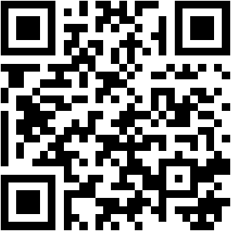
Thank you for your Feedback!
Please scan me!

