Slide 1
Money, Credit, and Finance
Economics Master‘s Program
WU Vienna
Guido Schäfer
June 2018

Slide 2
Instructors
Hon.Prof. Dr. Aurel Schubert
Director General Statistics, European Central Bank
Ao.Univ. Prof. Dr. Guido Schäfer
Department of Economics, WU Vienna

Slide 3
Structure and Contents
Oct- Dec.: Monetary Policy and the Financial Sector (Schäfer)
Lectures, discussions and assignments based upon original research articles
Theoretical and empirical foundations
Weekly sessions
January: One-day Workshop with Prof. Schubert and a prominent guest speaker
Focus on current policy topic
Students present their own research projects
Topics in earlier years:
European Banking Union, unconventional monetary policy and inflation,…
Previous guest speakers:
Prof. Hans Helmut Kotz, former board member, Deutsche Bundesbank
Jürgen Stark, former Chief Economist, European Central Bank
Michael Bordo, Board of Governors Professor of Economics and Distinguished Professor of Economics, Rutgers University

Slide 4
Topics
Economics of the monetary and financial sector
E.g., economic foundations of money and banking, optimal monetary policy, liquidity trap, inflation and deflation, effects of unconventional monetary policies, financial intermediation, moral hazard and regulation, …
Current topics in monetary and regulatory policy
World Financial Crisis, Crisis in the Eurozone, European Banking Union, Too-Big-To-Fail, Macroprudential Regulation, Secular Stagnation, Cryptocurrencies …
World Financial Crisis as a Watershed Event!
Revolution versus Evolution in Economic Policy and Research!?

Slide 5
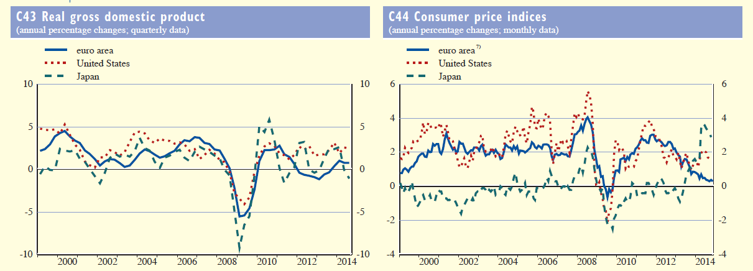
Has Inflation Targeting become obsolete?
Source: ECB Monthly Bulletin

Slide 6
Will Bitcoin Replace the Dollar?
www.finanzen.at

Slide 7
Learning process
Language of Instruction: English
Students work through research articles before class
Lectures and discussions in class about key concepts
Students prepare their own research projects for the Workshop
Students get broader perspective and deeper understanding of a current policy topic at the Workshop
Grading
Essays about papers, class participation
Student Project presented at Workshop

Slide 8
Job prospects
About 20 percent of our graduates work in the financial sector!
Good preparation for jobs in central banks, regulatory agencies, finance ministries, banks, insurance companies, investment firms,…

