Slide 1
Master Program in Economics
Course on Spatial Economics
Instructors
Philipp Piribauer,
Franziska Disslbacher,
Mathias Moser,
Tamás Krisztin
Notes:
<number>
05/30/2018

Slide 2
Spatial economics
a field that evolved at the interface between economics and geography
that applies economic theories and geographic concepts, and uses spatial econometric tools
to understand spatial differences in economic processes such as
economic growth and development
at different levels of geographic resolution
Economics
economic
theories
Geography
geographic concepts
spatial econometric tools
<number>
Notes:
<number>

Slide 3
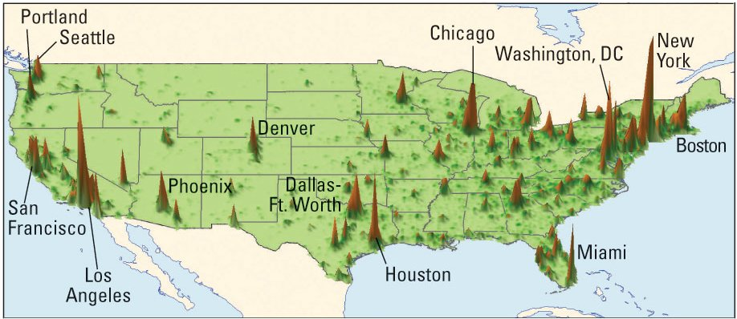
Some stylized facts
Notes: the height on this map indicates economic output produced at that location; measured in terms of grp per square km of land
economic output is not randomly distributed
neighbourhood matters
<number>
Notes:
<number>

Slide 4
Overview
Objectives | The main objective of the course is to expose you to the state of art in spatial economics with emphasis on spatial econometric methods and regional economic growth
Structure of the course | Phase 1: Lectures (Friday units) Lab tutorials with small homeworks (Thursday units) Phase 2: Class projects in team work Final exam
Prerequisites | No formal prerequisites, but a good knowledge in econometric methods is recommended.
<number>
Notes:
<number>
05/30/2018

Slide 5
Course outline
Fri, Oct 12 16:00-19:00 | Welcome and organization, introduction and motivation Lecture Basic mathematical and statistical tools
Thu, Oct 18 13:00-16:00 | Tutorial Introduction R/Applied data analysis
Fri, Oct 19 16:00-19:00 | Lecture Introduction to spatial data analysis Empirics of regional economic growth and convergence Class project Groups & Topics
Thu, Oct 25 15:00-18:00 | Tutorial Discussion Homework I Applied spatial data analysis Class Project Topics: Coaching Session
<number>
Notes:
Spatial Economics, WS 2012/2013
<number>
05/30/2018

Slide 6
Course outline (ctd)
Fri, Nov 9 16:00-19:00 | Lecture Spatial econometric methods and techniques I
Thu, Nov 15 14:00-17:00 | Tutorial Discussion Homework II Spatial econometric toolbox I
Fri, Nov 16 16:00-19:00 | Lecture Spatial econometric methods and techniques II
Thu, Nov 22 14:00-17:00 | Tutorial Discussion Homework III Spatial econometric toolbox II
<number>
Notes:
<number>
05/30/2018

Slide 7
Course outline (ctd)
Fri, Nov 23 16:00-19:00 | Lecture Bayesian spatial econometric methods I
Thu, Nov 29 14:00-16:00 OPTIONAL: 16:00-17:00 | Tutorial Discussion Homework IV Spatial econometric toolbox III In-class hacking session Work on your class project under supervision
Fri, Nov 30 16:00-19:00 | Final exam
<number>
Notes:
<number>
05/30/2018

Slide 8
Course outline (ctd)
Thu, Dec 6 14:00-17:00 | Class project: Progress report
Thu, Dec 13 14:00-17:00 | Class project: Progress report
Thu, Dec 20 14:00-17:00 | “Open office” coaching session
Thu, Jan 10 14:00-17:00 | Putting it all together: Project presentation of the final results You should be ready to summarize your findings and defend and interpret the final model specification in both methodological and substantive terms.
Thu, Jan 17 14:00-17:00 | Putting it all together: Project presentation of the final results You should be ready to summarize your findings and defend and interpret the final model specification in both methodological and substantive terms.
<number>
Notes:
<number>
05/30/2018

Slide 9
Grading
Mode of assessment
Active participation and exercises (20%); class project (30%) and final exam (50%)
Grades
87.5-100% (very good: 1), 75.0-87.5% (good: 2), 62.5-75.0% (satisfactory: 3), 50-62.5% (sufficient: 4), 0-50% (fail: 5)
<number>
Notes:
05/30/2018
<number>

