Slide 1
Master Program in Economics
Course on Spatial Economics
Instructors
Manfred M. Fischer [lectures]
Philipp Piribauer [tutorials]

Slide 2
Overview
Prerequisites | No formal prerequisites, but a good knowledge in economic methods is recommended. If you are not familiar with the basic principles behind the linear regression model, it is recommended to study the first six chapters of the course on econometrics I, provided under http://www.uibk.ac.at/econometrics/skript.html
Objectives | The main objective of the course is to expose you to the state of art in spatial economics with emphasis on growth theory, spatial econometric methods and empirics
Specific features | The focus will be on spatial aspects. Considerable attention will be paid to gaining hands-on experience in the application of spatial econometric techniques in empirical practice, using LeSage’s MATLAB tools

Slide 3
Spatial economics
a field that evolved at the interface between economics and geography
that applies economic theories and geographic concepts, and uses spatial econometric tools
to understand spatial differences in economic processes such as
economic growth and development
at different levels of geographic resolution
Economics
economic
theories
Geography
geographic concepts
spatial econometric tools
Notes:
Spatial economics is a novel field that has evolved at the interface between economics and geography, a field that seeks to understand spatial differences in economic processes such as, economic growth and development.
In doing so, the field relies on economic theories and geographic concepts, and applies appropriate spatial econometric tools to study the processes at different levels of geographic resolution.

Slide 4
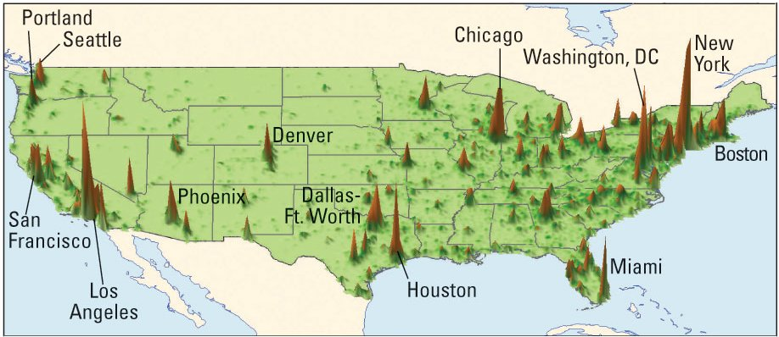
Some stylized facts
Notes: the height on this map indicates economic output (2005) produced at that location; measured in terms of grp per square km of land
economic output is not randomly distributed
neighbourhood matters
Notes:
In thinking about economic growth and development it is useful to take a brief look at a map that shows the distribution of income in the US. Income is measured here in terms of gross value added in 2005, generated per square kilometer of land.
A quick look at the map shows that income is not randomly distributed, but clustered around some locations of the country, mostly at the coasts in places like New York, Washington DC, Houston, and Los Angeles, but also in Chicago and some other places.
Evidently, prosperity does not come to every location at the same time. Neighbourhood matters. Being close to rich locations makes it very unlikely that a location will stay poor. To prosperous locations, proximity is a blessing, to poor locations a curse. This makes the distribution of income heavily location-dependent.
Spatial dependence can arise in a number of ways. Technology spillovers, labour and non-labour migration, commodity flows, and a host of other types of spatial interaction can tie the fortunes of neighbouring locations together.
But despite the general consensus that interactions or externalities are likely to be the major source of spatial dependence in regional growth processes, they typically have been modelled in a rather ad hoc manner without a strong relation to theory in most of the regional growth literature.
In contrast to the ad hoc approach, we suggest to base the analysis on an open economy extension of the standard neoclassical growth model.

Slide 5
Course outline
Thu, October 13 13:00-16:00 D4.0.144 | Welcome and organization, introduction and motivation Lecture Module 1 Geography, location and development
Fri, October 14 13:00-16:00 D4.0.144 | Tutorial Basic mathematical and statistical tools
Thu, October 20 13:00-16:00 D4.0.144 | Lecture Module 2 Theoretical models of economic growth
Fri, October 21 14:00-17:00 D4.0.144 | Tutorial Discussion Homework I Basic spatial econometric tools I
Notes:
Spatial Economics, WS 2012/2013

Slide 6
Course outline (ctd)
Fri, October 28 14:00-17:00 D4.0.144 | Tutorial Discussion Homework II Basic spatial econometric tools II
Thu, November 3 13:00-16:00 D4.0.144 | Lecture Module 3 Spatial econometric methods and techniques
Thu, November 10 13:00-16:00 D4.0.144 | Lecture Module 4 Empirics of economic growth and convergence
Fri, November 11 14:00-17:00 LC.-1.038 | Tutorial Discussion Homework III MATLAB Tutorial

Slide 7
Course outline (ctd)
Thu, November 17 13:00-16:00 D4.0.144 | Lecture Module 5 A spatial perspective on knowledge spillovers
Fri, November 18 14:00-17:00 TC.3.02 | Tutorial Discussion Homework IV Bayesian spatial econometric methods Class project Every participant is encouraged to carry out a small class project, either alone or as a small group. You may use your own data or one of the sample data sets provided.

Slide 8
Course outline (ctd)
Thu, December 15 13:00-16:00 D4.0.144 | Class project: Progress report
Fri, December 22 14:00-17:00 D4.0.144 | Class project: Progress report
Thu, January 12 13:00-16:00 D4.0.144 | Putting it all together: Project presentation of the final results You should be ready to summarize your findings and defend and interpret the final model specification in both methodological and substantive terms.
Thu, January 19 13:00-16:00 D4.0.144 | Putting it all together: Project presentation of the final results You should be ready to summarize your findings and defend and interpret the final model specification in both methodological and substantive terms.
Fri, January 20 14:00-15:30 D4.0.144 | Final exam

Slide 9
Outline of the lectures
Module 1 Geography, location and development
1.1 Geographic scales of development
1.2 A quick look at three prosperous places: Tokyo, USA and Western Europe
1.3 Some more places: Mumbai, China and East Asia
1.4 Place and prosperity
1.5 The spatial dimensions of development: density, distance and division
1.6 Agglomeration economies, factor mobility and falling transport costs
1.7 How much does geography matter today?
1.8 Closing remarks and selected readings
Module 2 Theoretical models of economic growth
2.1 Introduction
2.2 The basic Solow model
2.3 The Solow model with technological progress
2.4 The Mankiw-Romer-Weil model
2.5 The Spatial Mankiw-Romer-Weil model with technological interdependence
2.6 A Solow model with factor mobility
2.7 Endogenous growth models
2.8 Closing remarks and selected readings

Slide 10
Outline of the lectures (ctd)
Module 3 Spatial econometric methods and techniques
3.1 Introduction
3.2 Discrete representations of space and spatial data
3.3 Basic spatial regression relationships
3.4 Tests for spatial dependence in a regression model
3.5 The Spatial Durbin Model
3.6 The choice of spatial weights
3.7 Estimation of spatial regression models
3.8 Model interpretation: an empirical illustration
3.9 Closing remarks and selected readings
Module 4 Empirics of economic growth and convergence
4.1 Introduction
4.2 Metric of economic growth, units of observation and main concepts of convergence
4.3 The standard approach to beta convergence
4.4 Spatial income convergence models
4.5 Testing the Spatial Mankiw-Romer-Weil model
4.6 A distributional approach to convergence
4.7 Closing remarks and selected readings

Slide 11
Outlines of the lectures (ctd)
Module 5 A spatial perspective on knowledge spillovers
5.1 Introduction
5.2 Knowledge spillovers, patents and patent citations
5.3 The case-control matching approach: testing for geographic localization
5.4 Geographic and technological proximity matter: evidence from a spatial interaction modelling perspective
5.5 The impact of knowledge spillovers on regional total factor productivity
5.6 Closing remarks and selected readings
Course materials
There is no traditional course text. But the lecture slides and a limited number of readings are provided on the learn@wu platform.
Fischer M M, Wang J (2011): Spatial data analysis: Models, methods and techniques (Springer Briefs in Regional Science). Springer, Berlin, Heidelberg and New York (85 pp.)

Slide 12
Grading
Mode of assessment
Active participation (10%) based on weekly reading material; lab exercises (30%); class project (30%) and final exam (30%)
Grades
87.5-100% (very good: 1), 75.0-87.5% (good: 2), 62.5-75.0% (satisfactory: 3), 50-62.5% (sufficient: 4), 0-50% (fail: 5)

