Slide 1
In the Mood to Moot?
International and European Tax Moot Court 2023/24
Mag. Michael Gleiss

Slide 2
International and European Tax Moot Court
Since 2005
Organized by University of Leuven (Belgium) and International Bureau of Fiscal Documentation (IBFD)
Is the only international tax Moot Court
Participating universities from all over the world
Our Institute‘s teams won in:
2006
2007
2010
2015
2016
2017
2022
2023

Slide 3
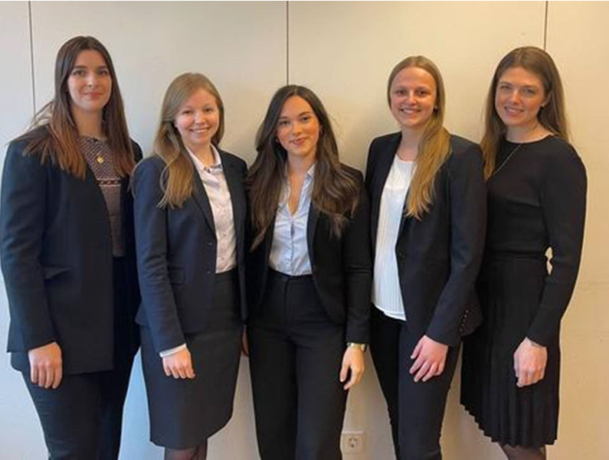
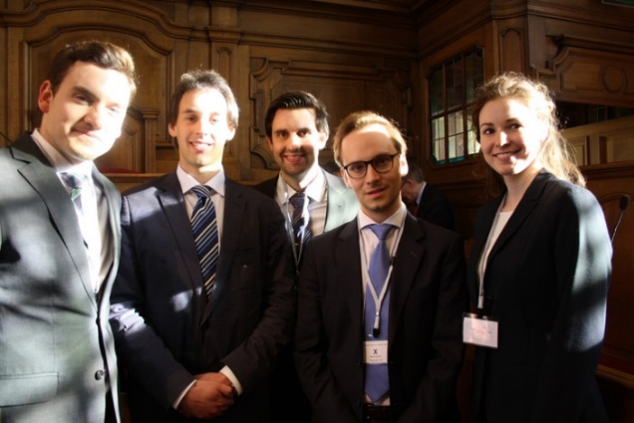
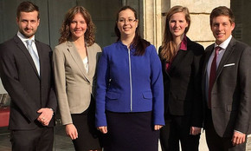
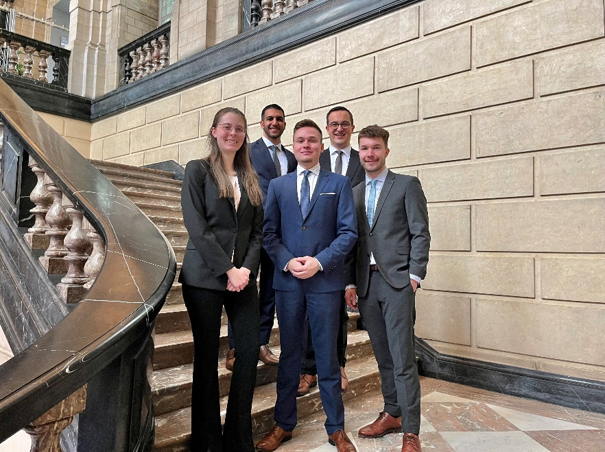
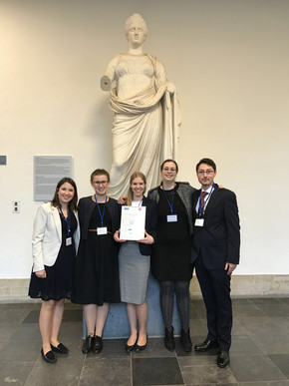
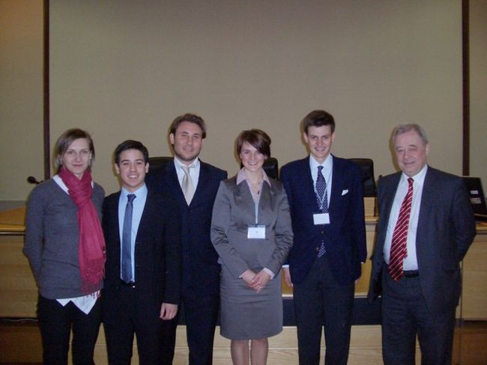
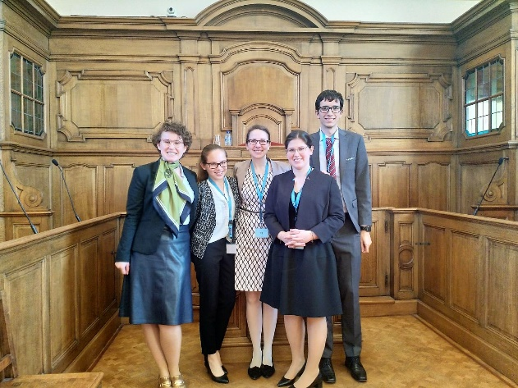
Our Teams

Slide 4
Activities on a Timeline
August/September 2023: start of general preparations
October 2023: publication of case
Until January 2024: writing the memorandum (2x 12.000 words)
January-March 2024: rehearsals for the pleadings & language training
March 2024: oral finals in Leuven (Belgium)
1st preliminary round (16 teams)
2nd preliminary round (6 teams)
final round (2 teams)

Slide 5
Why should I apply?
Get to know the international tax community!
Cultivate your tax knowledge and soft skills!
Have fun with your team!
Improve your legal English!
Use the Moot Court as a “Fachseminar” (WiRe) or “Masterthesis Seminar” (StRel)!
Write your Master Thesis about it!
But isn’t it a lot of work?
Yes, but it pays off!
That sounds great! Where can I apply?
www.wu.ac.at/taxlaw (Deadline: June 15th)
Info event: June 6, 4 pm, Institute (D3.2.243)

