Slide 1
The EUCOTAX experience
European and US Universities Cooperating on Taxes

Slide 2
The EUCOTAX experience
Think about
Your profile
Your skill set
Master thesis!
Academic approach to hands on topics
Close support from Institute‘s staff
Written in English
14 participating Universities!
Unique comparative approach
Networking and … “networking” abroad
EUCOTAX?!

Slide 3
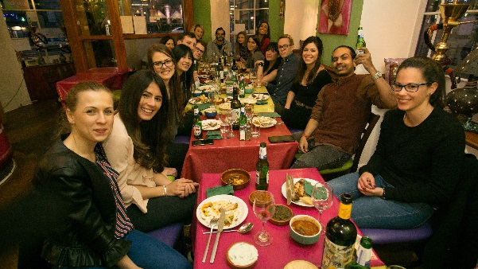
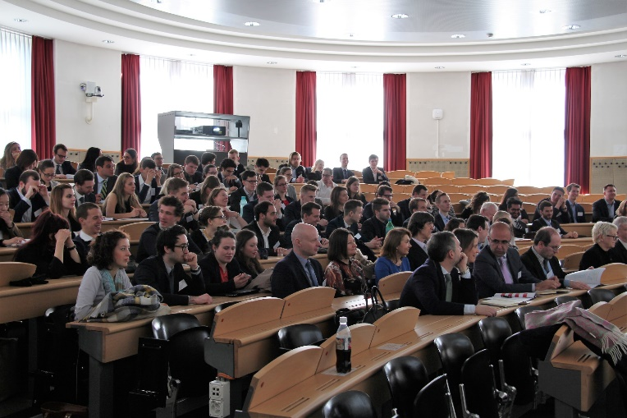
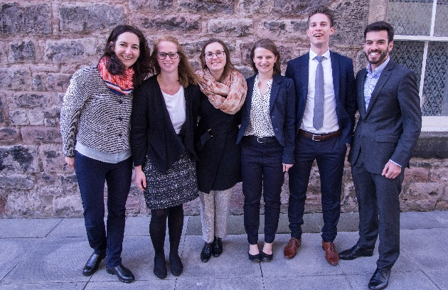
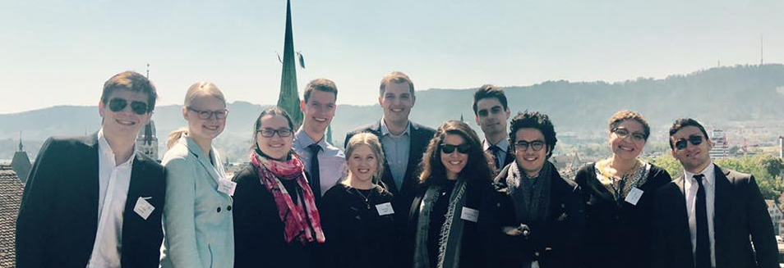
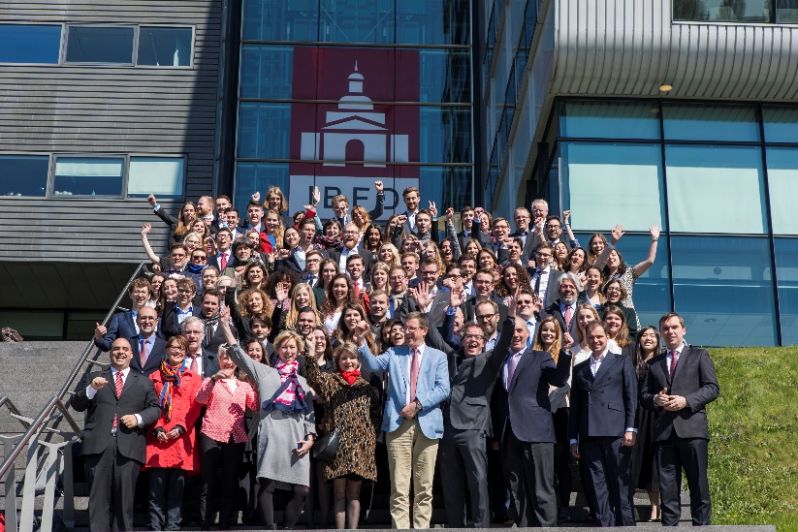
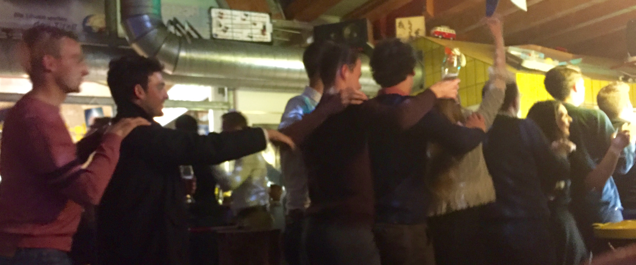
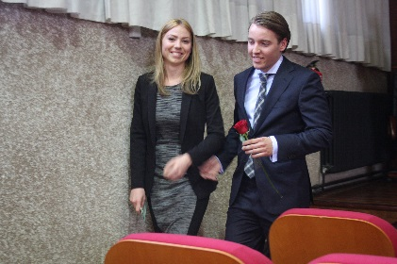
The EUCOTAX experience
Academic & hands on
Comparative
Networking & “networking”

Slide 4
„Taxation of Immovable Property“
Subtopic 1: Privately Held Immovable Property: Income and Wealth Taxes
Subtopic 2: Business Taxation and Income from Immovable Property
Subtopic 3: Taxation of Income from Immovable Property in Tax Treaty Law

Slide 5
„Legitimacy of tax rules“
Subtopic 4: Indirect Taxes on Immovable Property
Subtopic 5: Sticks and Carrots and Taxation of Immovable Property (Social Aspects of ESG Goals)
Subtopic 6: Sustainable Development Goals and Taxation of Immovable Property (Ecological As-pects of ESG Goals)

Slide 6
In practice
Masterthesis
Timeline highlights
Info-event: June 11, 5 pm
Insitute (D3.2.243)
Final draft: mid February 2025
EUCOTAX week in Osnabrück: April 2025
More info and application (deadline June 15)
https://www.wu.ac.at/en/taxlaw/teaching/eucotax/

Slide 7
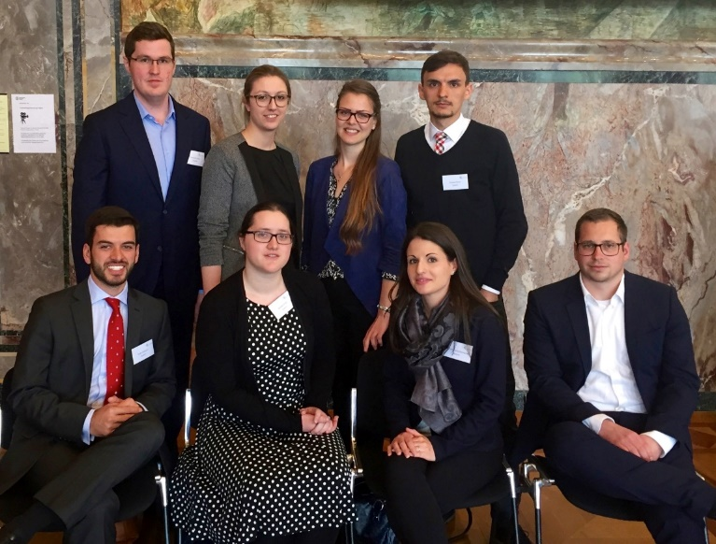
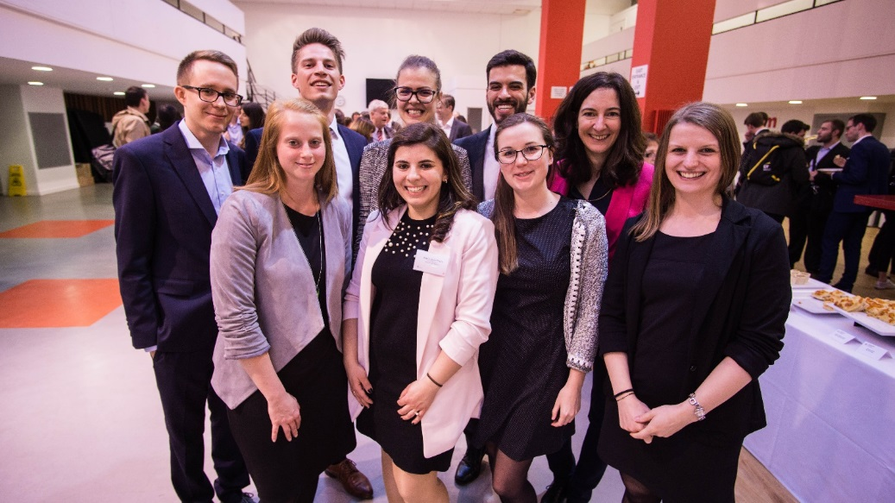
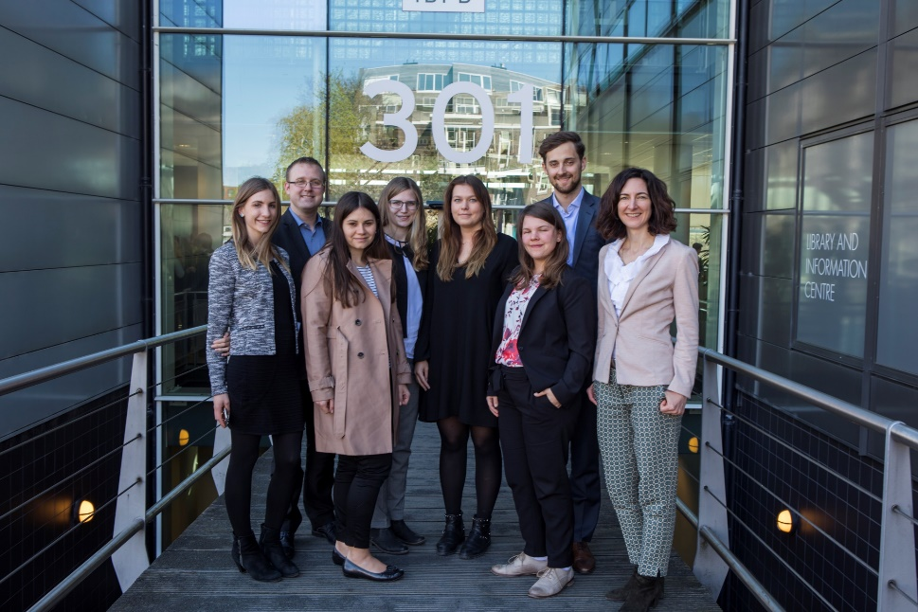
Any questions?
If you have any questions please contact us!!! ☺
markus.mittendorfer@wu.ac.at

