Slide 1
The EUCOTAX experience
European and US Universities Cooperating on Taxes

Slide 2
The EUCOTAX experience
Think about
Your profile
Your skill set
Master thesis!
Academic approach to hands on topics
Close support from Institute‘s staff
Written in English
14 participating Universities!
Unique comparative approach
Networking and … “networking” abroad
EUCOTAX?!

Slide 3
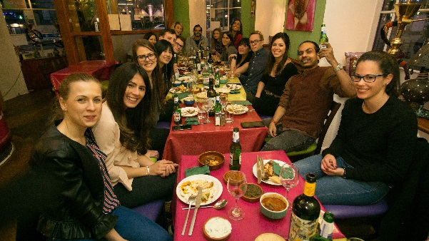
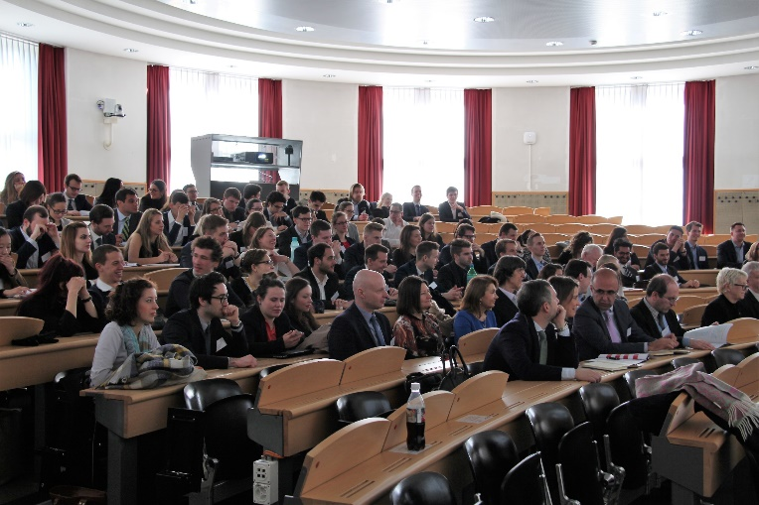
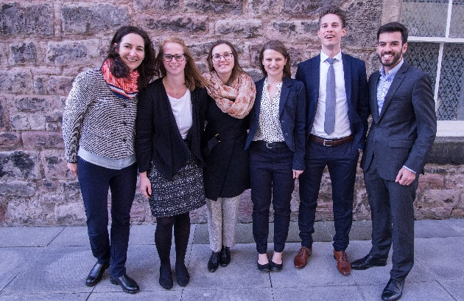
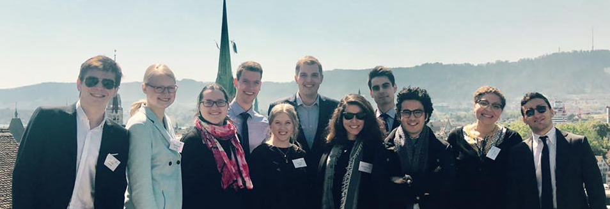
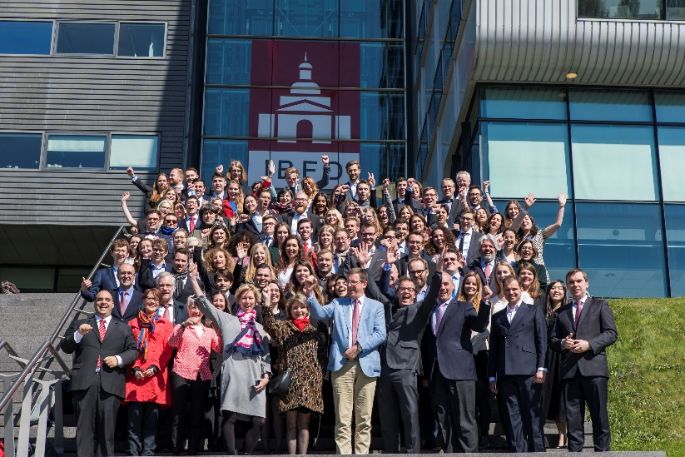
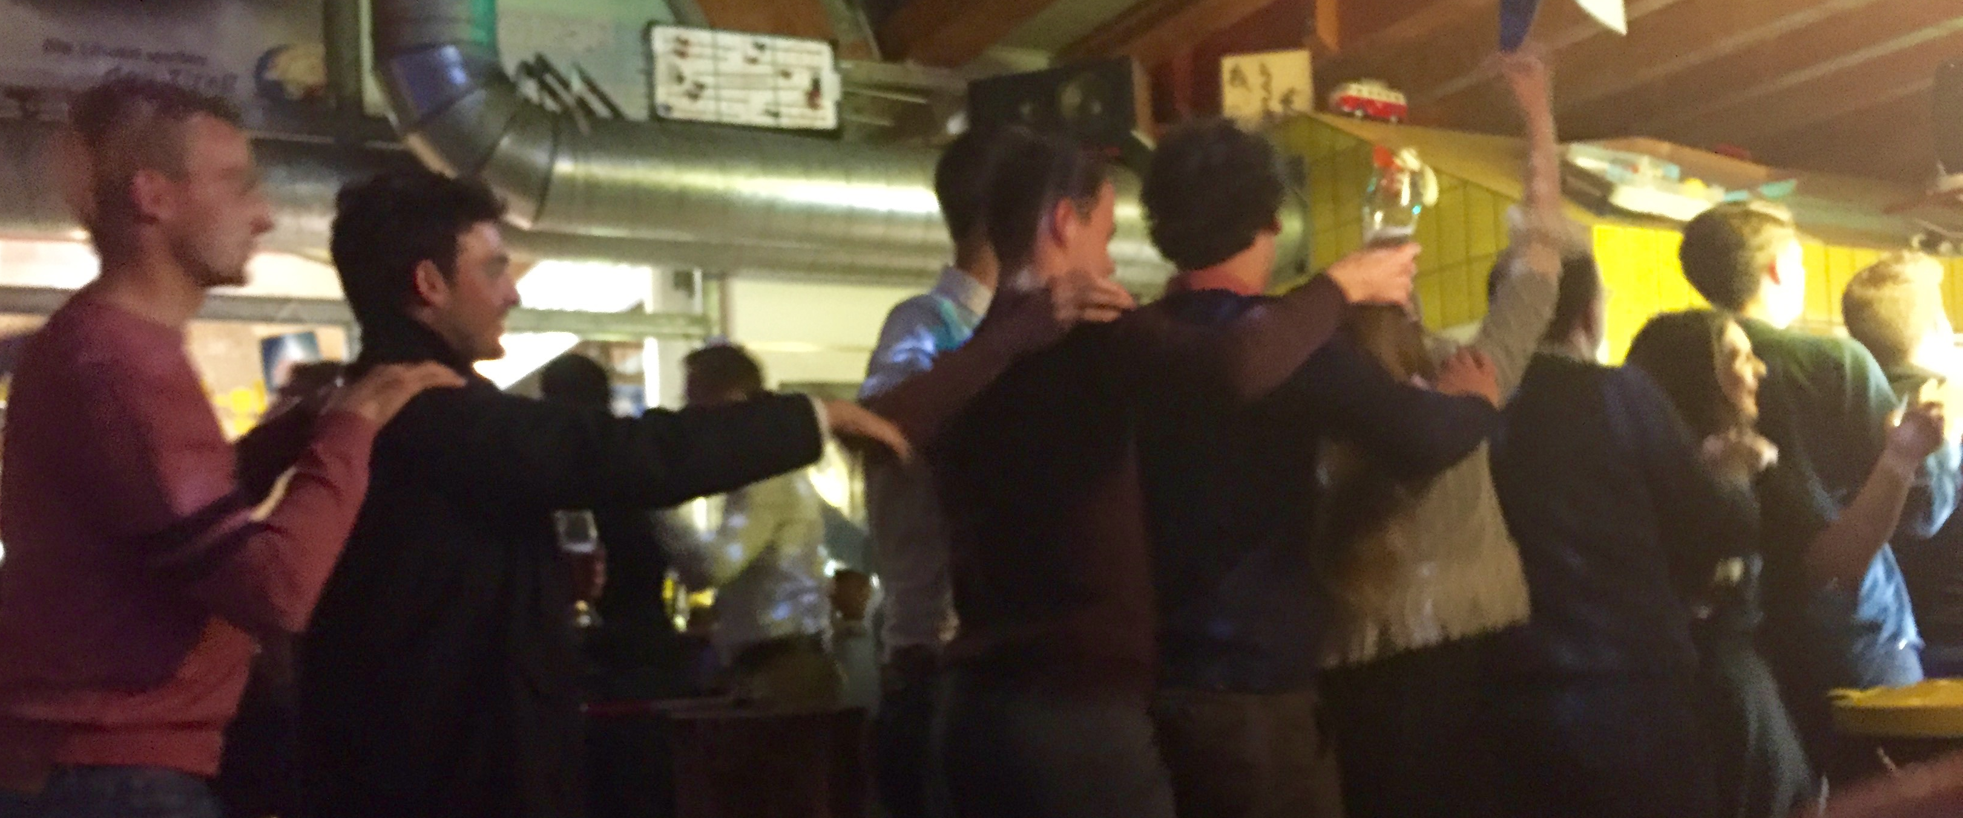
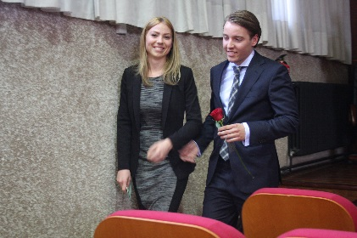
The EUCOTAX experience
Academic & hands on
Comparative
Networking & “networking”

Slide 4
„Tax Reforms between Success and Failure – From the Past through the Present towards the Future “
Subtopic 1: Tax Reforms in Relation to ‘No Taxation without Representation’
Subtopic 2: Tax Reforms in Relation to Federalism
Subtopic 3: Tax Reforms in Relation to Taxation of Income from Labor versus Taxation of Income from Capital and Net Wealth Taxation

Slide 5
„Legitimacy of tax rules“
Subtopic 4: Tax Reforms in Relation to Taxation of Business Income (Individual Entrepreneurs versus Corporations and their Shareholders and Multinationals)
Subtopic 5: Tax Reforms in Relation to the Non-Budgetary (Instrumental) Use of Taxation
Subtopic 6: Tax Reforms and National Sovereignty

Slide 6
In practice
Masterthesis
Timeline highlights
Info-event: June 6, 4 pm
Insitute (D3.2.243)
Final draft: mid February 2024
EUCOTAX week in Tilburg: April 2024
More info and application (deadline June 15)
https://www.wu.ac.at/en/taxlaw/teaching/eucotax/

Slide 7
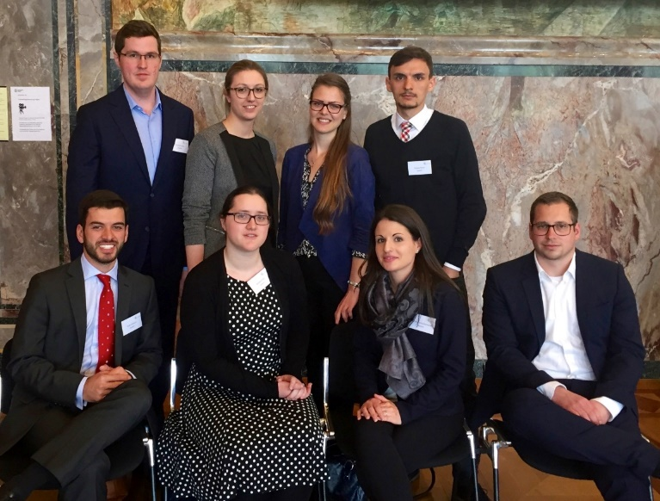
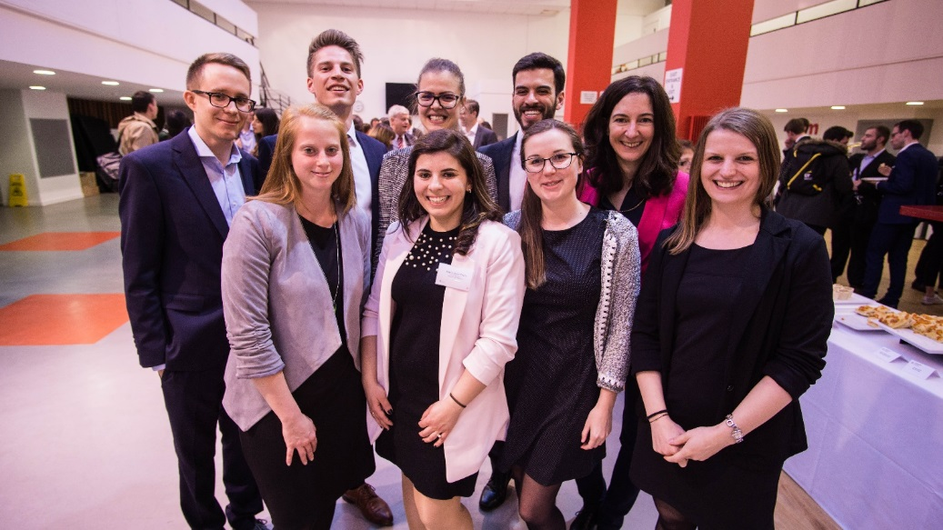
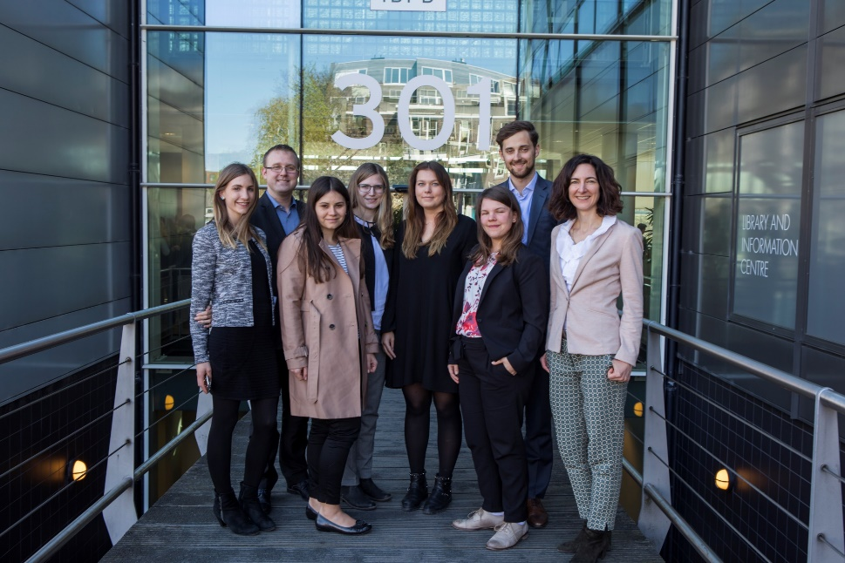
Any questions?
If you have any questions please contact us!!! ☺
markus.mittendorfer@wu.ac.at

