Slide 1
SBWL “Strategy and Organization”
Prof. Dr. Patricia Klarner
Institute for Organization Design
Department of Strategy & Innovation
May 2021
Notes:
Introduction .name, role
I have the pleasure to briefly introduce a brand new SBWL – will launch for the first time in winter term 2018;
Why did we launch this SBWL – because there are not many opportunities for BSc students to develop a comprehensive understanding of strategic and organizational challenges and how to address them.
Our SBWL fills this gap in the SBWL program and it provides you with state-of-the-art knowledge on strategic and organizional topics; at all the leading universities I worked at in Europe and the US, students always asked for courses that offer a comprehensive understanding of strategy and organizational topics but there were few courses offered - the same applies to WU; hence, we address the need and decided to launch this UNIQUE SBWL at the institute for organization design
Taught in English to prepare you for the international and national jobmarket – I will therefore present the highlights of our SBWL in English

Slide 2
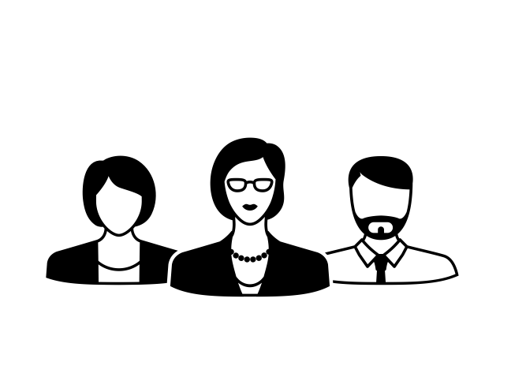
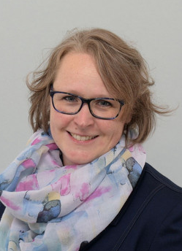
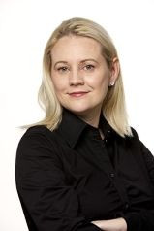
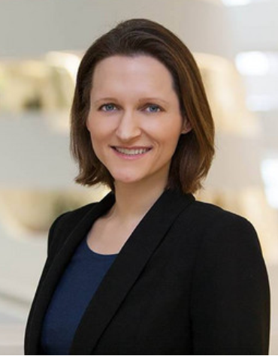
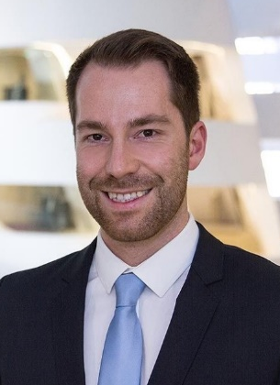
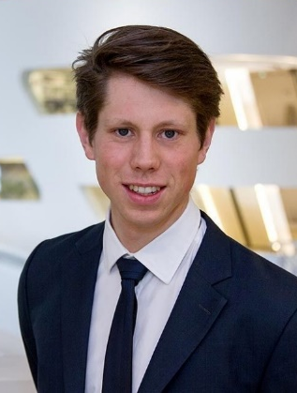
Who we are
Institute for Organization Design
Project Management
Institute Director
Univ. Prof. Dr. habil. Patricia Klarner
Prae Doc
Maximilian Weis
Prae Doc
Dieter Gutschi
Prae Doc
Philipp Benedikt Becker
Secretary
Hanna Schlipf
Head of Group
ao. Univ. Prof. Dr. Martina Huemann
Notes:
https://www2.deloitte.com/insights/us/en/focus/human-capital-trends/2017/organization-of-the-future.html

Slide 3
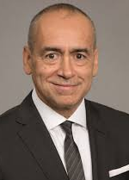
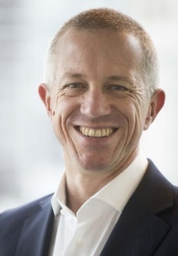
Why do Strategy & Organization Design matter?
“Organization design can make a significant improvement in performance, because it amplifies the alignment of the organization to its strategy and business model. It can improve speed to market and customer experience.”
Joe Echevarria, CEO of Deloitte (2011-2014)
“..while AI will help with some things like sorting data, the quality of thinking in decision making, in team-based interaction that creates value for people and firms, is still going to be a key part of how we do business.”
Anthony Healy, CEO of Bank of New Zealand (2014-2018)
“Just because you are CEO, don´t think you have landed. You must continually increase your learning, the way you think and the way you approach the organization. I´ve never forgotten that.”
Indra Nooyi, CEO of Pepsico (2006-2018)
Notes:
CEO = chief executive officer, highest-ranked executive at the consulting firm Deloitte – not enough to only study strategy or organization separately but you have to understand how to combine the two to increase firm performance
2nd quote: all this fuzz about artificial intelligence and roboters replacing humans in their jobs; if you complete our SBWL, you cannot be simply replaced by machines in your jobs later on; we will teach you what makes good and bad decisions and you can develop your decision making skills, learn to effectively work in a team
3rd quote: in our SBWL, you’ll learn the state-of-the-art knowledge about strategy and organization; this is a unique opportunity that not many Universities and business schools offer; we’ll also equip you with the skills to continually develop and grow, and increase your learning – and we discuss current issues that managers face
https://www.grovewell.com/wp-content/uploads/pub-org-design.pdf
https://www2.deloitte.com/content/dam/Deloitte/global/Documents/HumanCapital/gx-cons-hc-realizing-impact-organization-design.pdf
Pic: https://de.wikipedia.org/wiki/John_Browne#/media/File:Lord_John_Browne_at_the_L1_Energy_launch_New_York_(cropped).jpg
https://www.xerox.com/en-us/about/executive-leadership/board-of-directors/joseph-echevarria

Slide 4
Strategic Organization Design @ IOD
Notes:
IN order to work in strategic and organizational roles in your future careers, you need to understand these four dimensions of strategic organization design, and how they are connected – that’
* we will develop, discuss, and apply this model throughout the courses of the SBWL
* You will develop a comprehensive understanding of these important organizational dimensions and how the need to fit together
Strategy
Strategic dynamics & processes
Corporate governance and control
Executives’ role in strategic decision making
Structure
Organizational change and redesign
Top executives’ power and influence
Processes
Information exchange processes for innovation
Knowledge flows and organizational learning
People
Developing leadership talent
Retaining key talent

Slide 5
Do you want to be a change maker or a future consultant?
YOUR future work opportunities
OUR SBWL:
Our consultants help clients design organizations to reduce costs, drive growth, and strengthen both short-term performance and long-term organizational health.
Corporate strategy & development, organization design, organizational analysis, management consulting, organizational & change consulting, executive search & development, academia, … in a range of industries; in large firms and SMEs
Google´s success is linked to the effectiveness of its organizational structure and organizational culture in supporting excellence in innovation.
Many leaders are rethinking the design of their organizations. They recognize that organization design can be a powerful way to boost performance and keep up with ever-changing markets.
Several organizational changes were either agreed or carried out. Not only are they intended to focus on the core divisions, but also to optimize orientation to the strategy of a longer value-added chain towards more customer-specific products.
Notes:
With this comprehensive understanding, you’ll have plenty of career opportunities
Pic: https://careercodex.com/5-ways-make-recruitment-consultant-take-seriously/
Bildvorschlag – Frau+Mann: http://curtisprocessconsulting.com/wp-content/themes/cpc/images/slides/img-consulting.jpg
Bildvorschlag – Team: http://www.icird.org/wp-content/uploads/consulting.jpg
Google Statement: http://panmore.com/google-organizational-structure-organizational-culture
Voestalpine: https://www.zonebourse.com/VOESTALPINE-5176812/pdf/43351/Voestalpine_Rapport-annuel.pdf
- leading technology and capital goods group in Linz, Austria

Slide 6
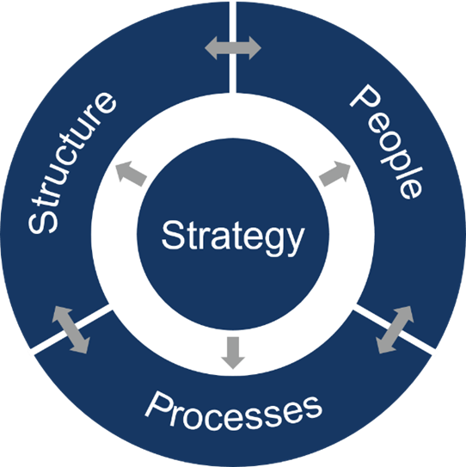
What we offer – Connect & develop together!
only
30
Students
Solid foundation for broad, international career prospects
Individual coaching
Analytical, problem-solving skills
Teamwork skills
Project management skills
Presentation & communication skills
Coaching
Notes:
COHORT!
Have the skills to develop the strategies for tomorrow`s organizations! Join the new SBWL “Strategy & Organization”.
Only SBWL focused on Strategy and Organization Design
Only 30 students per term
All courses held in English
International focus & highly interactive courses; team has broad international experience, having worked and lived in many European countries, but also i(e.g.,) n US and Asia- we’ll share this knowledge in our courses =A important if you want to puruse an international career but also if you want to work for an international firm in Austria
State-of-the-art: discussion of current managerial issues and challenges
Theory & praxis: Real-life case discussions and company assignments, student presentations of companies, guest speakers, discussion of company challenges / from the media / in class
Comprehensive perspective on strategy & organization
Coaching & feedback by IOD: The only SBWL with two FS courses (teamwork, coaching, & presentations instead of too much lecturing and written exams)
*pres and comm skills: really important to be good in English if you want to pursue an international career but also if you want to work for an Austrian firm that has clients all around the world

Slide 7
Course Overview
Course 1: Strategic Organization Design
1st term
Course 2: Organizational Change and Redesign
Course 3: Skills Development Workshop “Project Management”
2nd term
Course 4: Cases in Strategy & Organization
Course 5: Project Course “Strategy & Organization”
Notes:
Course 1-3 Foundation, discussion in class, team presentation, examples and guest speakers
Course 4+5 (Application Part) -> Coaching by IOD, company partner, unique customized approach to the needs of students

Slide 8
Set the ground and get the big picture…
Course 1: Strategic Organization Design
Dimensions of strategic organization design
What is strategy?
Organization structure and new forms of organizing
People in organizations
Process perspective
Interlinkages between dimensions of strategic organization design
Comprehensive organizational analysis
Discussion of company examples
Source: http://www.effectivemanagers.com/
Notes:
Pic: http://www.effectivemanagers.com/organization-design/
How are these dimenstions interlinked? How can we design effective, well-performing organizations?

Slide 9
… to change and make an impact!
Course 2: Organizational Change and Redesign
Introduction to organizational change and redesign
Drivers of change
Dimensions of change (strategy, structure, people, and processes)
Goals and outcomes of change processes
Change management and change leadership
The practitioner’s view: Guest lecture
Source: http://www.constructionworld.org/, May 2018
Notes:
Pic: http://www.constructionworld.org/top-10-construction-technology-trends-look/
Why do companies have to change their design?
What do they change
What are the results
How can you manage and lead change? – especially when it comes to implementing change, motivating employees to work extra hours for a change project
Also: in courses 1 and 2 there will be short team presentations and discussion of recent media examples

Slide 10
Develop your skills…
Course 3: Skills Development Workshop “Project Management”
Fundamentals & applications of concepts and processes of project management
The design elements of contemporary project organizations
The role of a project manager, project-owner, project team
Project management in action
Source: https://www.raconteur.net/business/agility-takes-the-lead-in-project-management
Notes:
Pic: https://www.raconteur.net/business/agility-takes-the-lead-in-project-management
Learn to manage projects, how to structure a project, how to work together as a team

Slide 11
… and apply them!
Course 4:
Cases in Strategy & Organization
Course 5:
Project Course “Strategy & Organization”
Discussion, analysis and presentation of real life company cases in teams
Projects based on current managerial issues of company partners (team projects)
Continuous coaching and feedback by IOD and company partners
Notes:
Pic: http://www.fullofficeservice.at/ueber-uns/team/
https://www.beewits.com/project-management-tools/

Slide 12
Course 5: Project Course
Strategy
Structure
Processes
People
e.g.: develop a growth strategy
e.g.: evaluate the option of an agile organizational structure
e.g.: optimize the strategic planning process
e.g.: develop a communication strategy to enable ongoing change
Innovative SMEs and international Corporates
e.g. OMV, UNIQA, REWE, Frequentis, Pollmann International, Wien Energie, Wiener Netze, Raiffeisenbank International

Slide 13
Student Voices
“Very motivational. It inspires me to give more though of future career decisions and engages my brain in a unique way that I haven´t experienced in other courses.”
“You can see that Prof. Klarner knows a lot about her field and has many experience to talk about. This makes the class a lot more interesting.“
“I like how the course combines multiple subjects and therefore offers a suitable specialization for students interested in consulting, finance, marketing or else.”
“The ‘Meet the CEO’ format were probably the best 2 hours at WU so far.”
“Prof. Klarner tries to get to know the students, which is uncommon but great, given the size of the class and the course being a specialization.“

Slide 14
What gets you on board?
Interest in strategic and organizational topics
Commitment and motivation
Team spirit
Independence and self-reliance
Required basic knowledge for students of the BBE program:
A good command of English
Required basic knowledge for all three bachelor programs (BW, IBW, WIRE)
STEOP & CBK (Fundamentals of Economics, Introduction to Business Administration, Statistics, Mathematics)
Required basic knowledge for students of the BBE program:
Quantitative Methods I&II, Business & Society, Foundations in Microeconomics)
IOD
Notes:
If you read the news about current company problems (ex: their performance drops, competitors steal their market share, they aren‘t innovative enough) – you should think „ that‘s interesting, why did that happen?“
Commitment: you have to work hard but we‘ll also coach you; we don‘t want freeriders in teams who don‘t commit and work
Independence: you‘ll get coaching and guidance, but we won‘t tell you how to solve a task
English: should be reasonably good but you don‘t have to be an expert, nor a native speaker

Slide 15
What you need to know!
Application
Registration for AG “Access to Specialization in Business Administration: Strategy and Organization” (Einstieg in die SBWL) in LPIS and
Application at the IOD:
fill out the SBWL Bewerbungsformular AND add your
CV
transcript of your records
motivation letter (you have to use the form "letter of motivation_SBWL_S&O")
Once you have successfully passed the admission process, your AG course will be graded with „successfully completed“. Afterwards you can register for the SBWL courses via the LPIS system.
Notes:
Don‘t forget that you can only register for the first 3 courses in the first term, and you have to register for the courses 4 & 5 in the subsequent term (hence, complete all 5 courses in 2 subsequent terms).

Slide 16
Ready to design the future?
I
O
D
- interesting, inspiring, international, interactive, innovative, intelligent
- organizational skills, opportunity-seeking, open-minded, outgoing
- design skills, driven by motivation, dedicated, develop profound knowledge
Notes:
What characterizes S&O members and the IOD community? – If you take the SBWL S&O, you will become part of the IOD community
Was zeichnet IOD aus?

Slide 17
We look forward to your applications!
Any questions left?
Ask them now or write to iod@wu.ac.at

