Slide 1
SBWL Digital Marketing

Slide 2
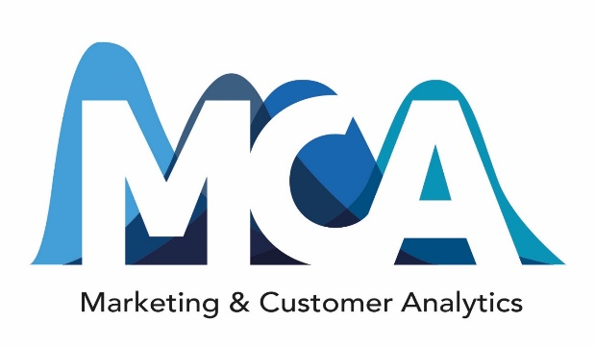

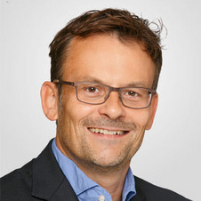
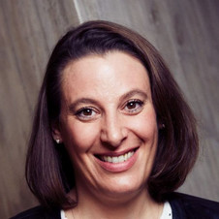
SBWL Digital Marketing The Makeup
SBWL Service & Digital Marketing
Digital Marketing
Thomas Reutterer
wu.ac.at/mca
Nadia Abou Nabout
wu.ac.at/imsm

Slide 3
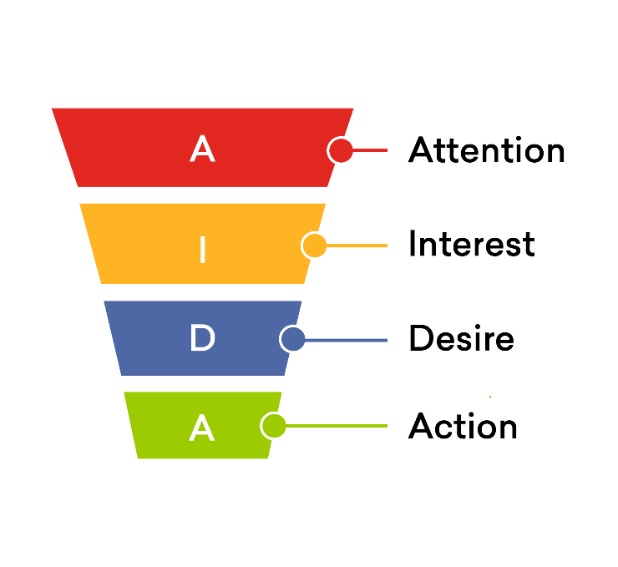
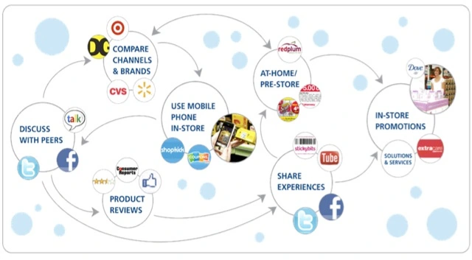
SBWL Digital Marketing The Content
Digital transformation of the marketing landscape:
Information technology and interactive online media change the way consumers collect information, make decisions, communicate with each other and with firms, …
„Classical“ marketing funnel:
Digital customer journey:
Luca Bruno / AP

Slide 4
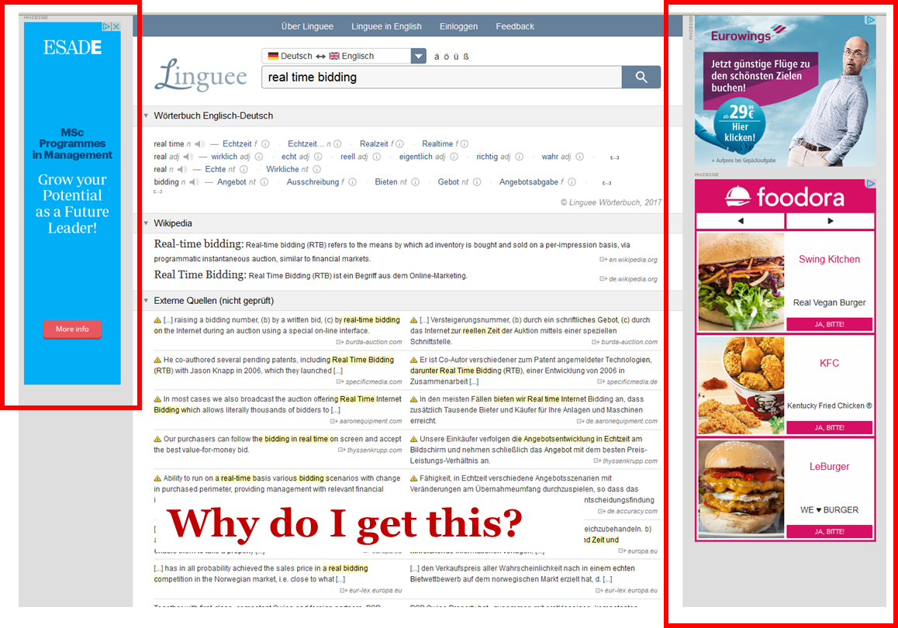
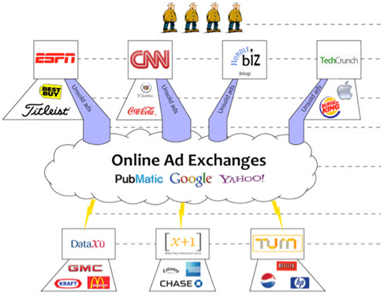
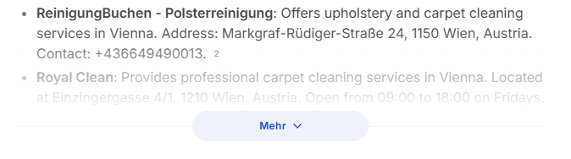
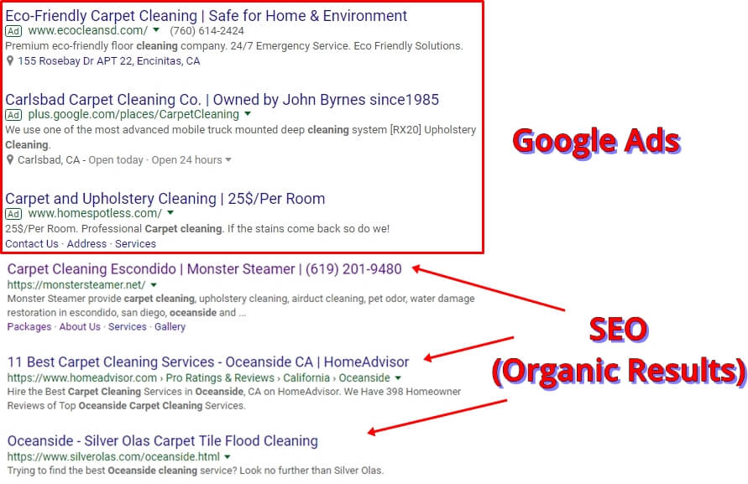
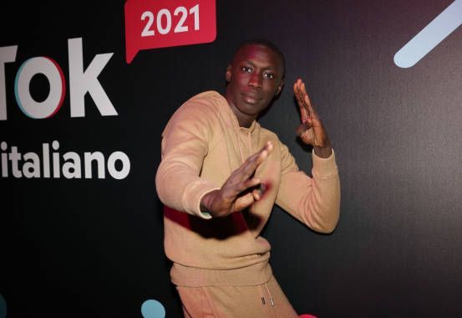
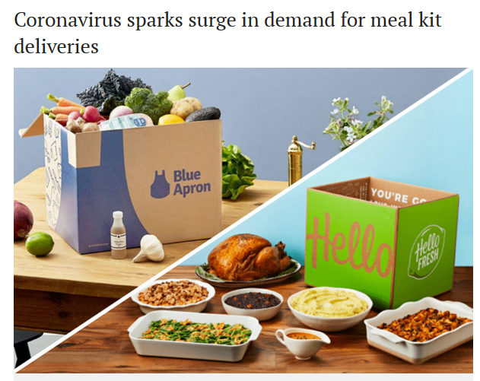


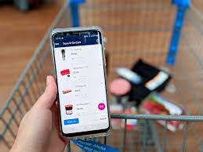
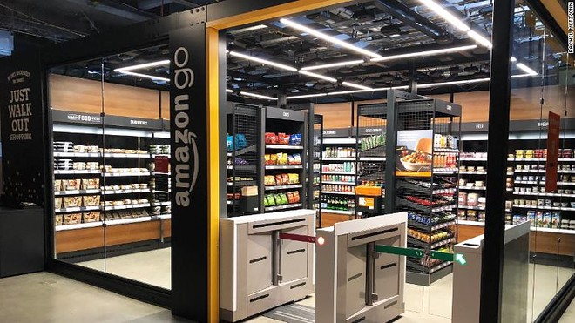
SBWL Digital Marketing Let me explain: Technology changed/s the face of marketing
Online ad displays
Real-time ad bidding
AI/ SEO/ SEA marketing
AI Search
Google Ads
SEO
(Organic Results)
Influencer marketing
Subscription services
Omni-channel
Notes:
PewDiePie >111mn YouTube followers

Slide 5
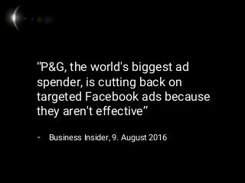
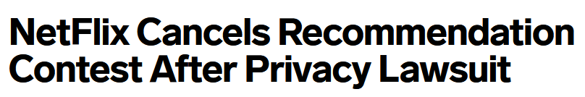
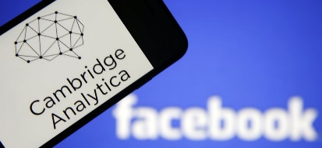



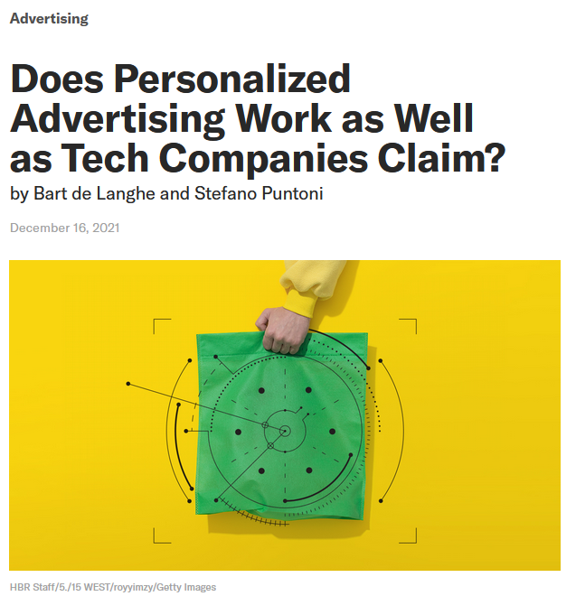

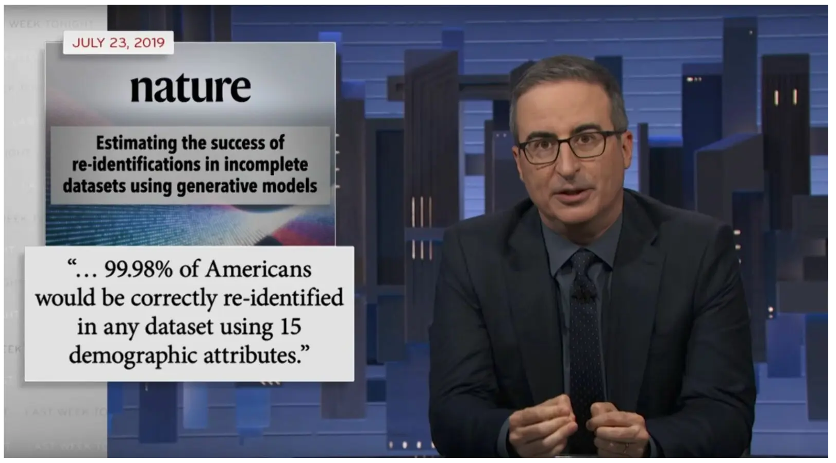
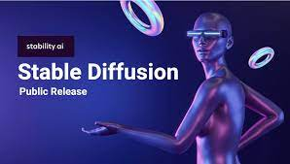
SBWL Digital Marketing … but there are also doubts about its effectiveness
Ethics, Privacy, AI Accountability Concerns:
John Oliver
Notes:
PewDiePie >110mn YouTube followers
Quellen: https://datatopics.worldbank.org/world-development-indicators/themes/economy.html, “Services, value added (% of GDP)” in 2018 [07.05.2021]
https://de.statista.com/statistik/daten/studie/295575/umfrage/beitrag-der-tourismus-und-freizeitwirtschaft-in-oesterreich-zum-bip/, Anteil des Tourismus in Österreich am BIP bis 2019 [07.05.2021]
https://de.statista.com/statistik/daten/studie/428467/umfrage/uebernachtungen-in-beherbergungsbetrieben-in-oesterreich/, Anzahl der Übernachtungen in Beherbergungsbetrieben in Österreich von 2009 bis 2019 (in Millionen) [07.05.2021]

Slide 6
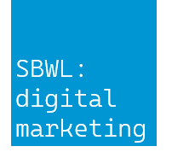
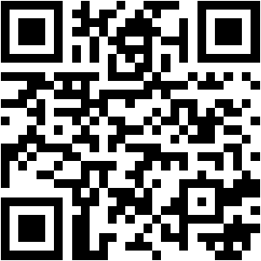
SBWL Digital Marketing The Offer
Our specialization addresses challenges in digital marketing and equips students with the skills needed to succeed in these business environments!
We offer research-driven course content to develop/strengthen your:
Management Skills: Solving marketing-related problems in a digitized economy
Analytical Skills: You acquire methodological know-how to support marketing-decision making (“quantitative intuition”)
Transfer Skills: Apply and implement this knowledge in real-world decision scenarios (digital marketing lab)

Slide 7
SBWL Digital Marketing The Structure
Future Managers in Digital Marketing
Modul 1
Thesis (optional)
Bachelor Thesis at MCA or IMSM
Thesis (optional)
We offer ...
Research-driven course content
Training in first-rate tools for business analytics
Support to translate skills into business practice
Collaborations with industry partners
Modul 1
Lab
C3: Digital Marketing Lab (2. term)
Lab
Modul 1
Modul 1
Electives
Course E1 (2. term): Elective 1
Course E2 (2. term): Elective 2
Electives
Modul 1
Modul 1
Course C1 (1. term): Digital Marketing
Course C2 (1. term): Marketing Analytics
Core
Course C2 (1. term): Marketing Analytics
Core
Marketing & Customer Analytics (MCA)
Interactive Marketing & Social Media (IMSM)

Slide 8
Required Courses

Slide 9
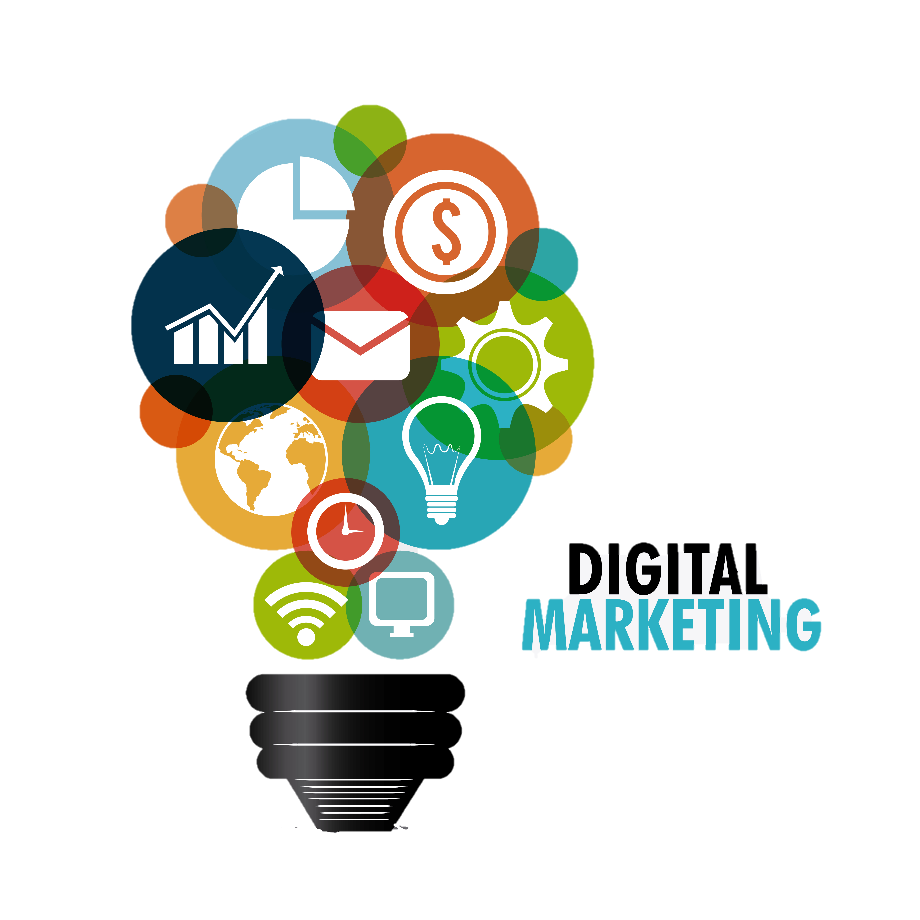
SBWL Digital Marketing Digital Marketing (Abou Nabout & Reisenbichler)
Tech and digital media are reshaping marketing
Learn to…
Manage customer-centricity in digital environments
Understand metrics that matter to manage the digital purchase funnel
Analyze, build, and improve digital campaigns using state-of-the-art tools
Apply your skills in the Digital Marketing Challenge!
Get up-to-date insights from our Practitioner’s Seminar Series, right after class!

Slide 10


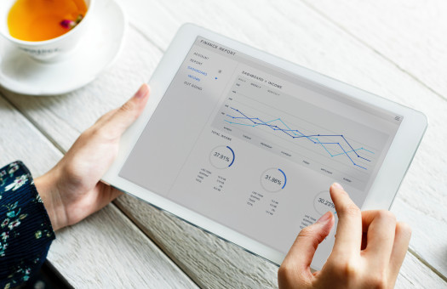

SBWL Digital Marketing Marketing Analytics (Dündar)
Turn data into applicable marketing insights
Strategically approach a problem
Explore and visualize your data
Analyze and test patterns in your data
Interpret and communicate your results
Applied to a real-world digital marketing case

Slide 11





SBWL Digital Marketing The Lab (Acun & Stromberg)
Opportunity to sharpen your transfer skills: Translate your acquired knowledge into concrete operational marketing plans!
You will work for one semester in close cooperation with our industry partners.
Former industry partners:
& clients

Slide 12
The Electives

Slide 13
SBWL Digital Marketing The Electives
Managing Customer Relationships
Generative AI Applications in Marketing
Online Content Analysis
Marketing Analytics Simulation
Social Media Strategy
Revolutionize Digital Marketing Techniques with AI & Smart Tools
Influencer Marketing Campaign Management
Notes:
CRM vrsl wieder ab WS26-27

Slide 14
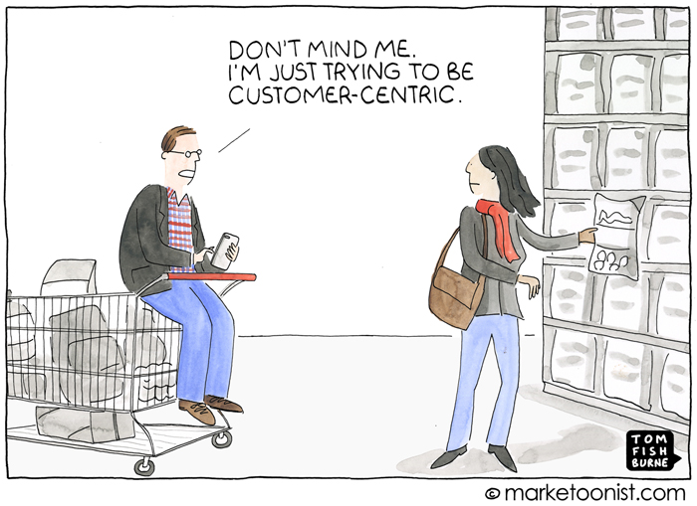
SBWL Digital Marketing The Electives: Managing Customer Relationships (Stromberg)
Customer centricity in a digital marketing context.
Build and shape the relationships with the right customers.
Who should we serve?
How long will they stay?
What makes them happy?
Why should we serve them?
When should we target them?
When should we NOT target them?

Slide 15

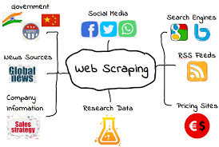
SBWL Digital Marketing The Electives: Online Content Analysis (Dan)
Automatic Segmentation
Feedback Analysis
Big Data – Dimensionality Reduction
Sentiment Analysis
Product Review Comparative Analysis
Summarization
Automation

Slide 16
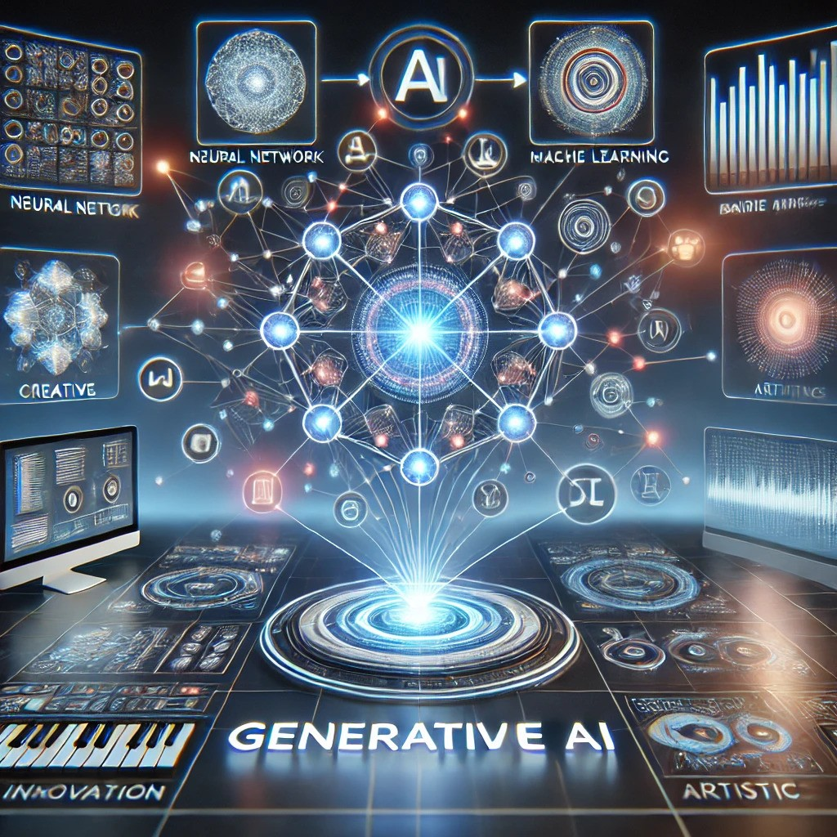
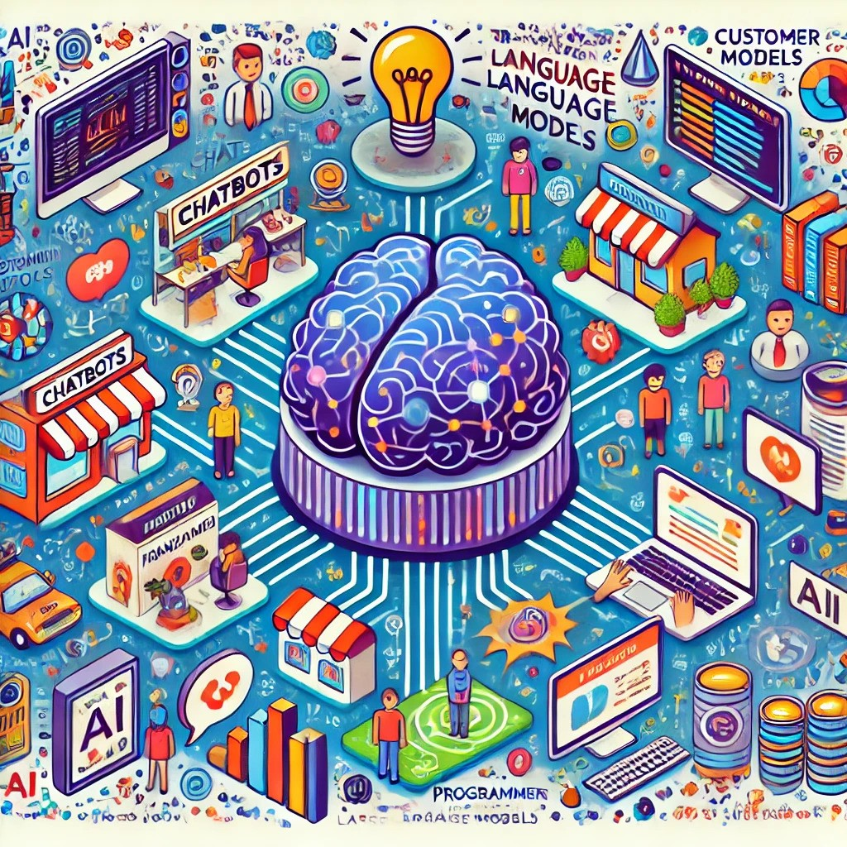
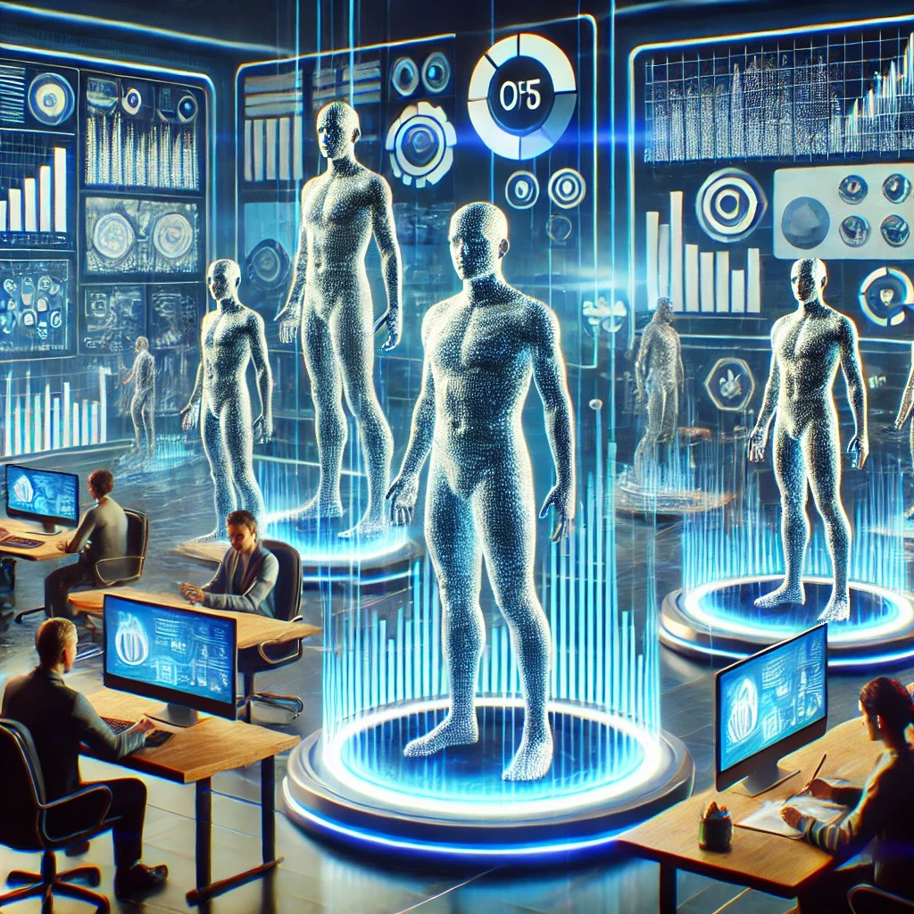
SBWL Digital Marketing The Electives: Generative AI Applications in Marketing (Chaudhuri)
Demystifying Gen AI
How does it work?
What are things it can and cannot do?
LLMs for daily tasks
Reading & Writing
Brainstorming
Analyzing data
Marketing applications
Market research & Gen AI
Automating customer interactions & monitoring

Slide 17

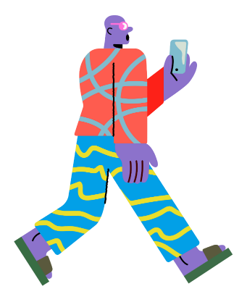


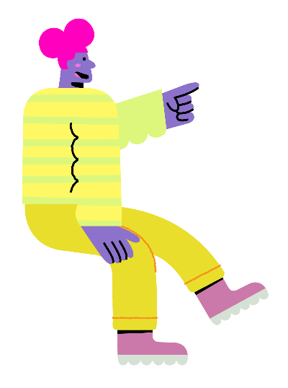











SBWL Digital Marketing The Electives: Social Media Strategy (Grzadziel)
objectives & KPIs
target groups
competitive analysis
content strategy
tracking and optimizing

Slide 18
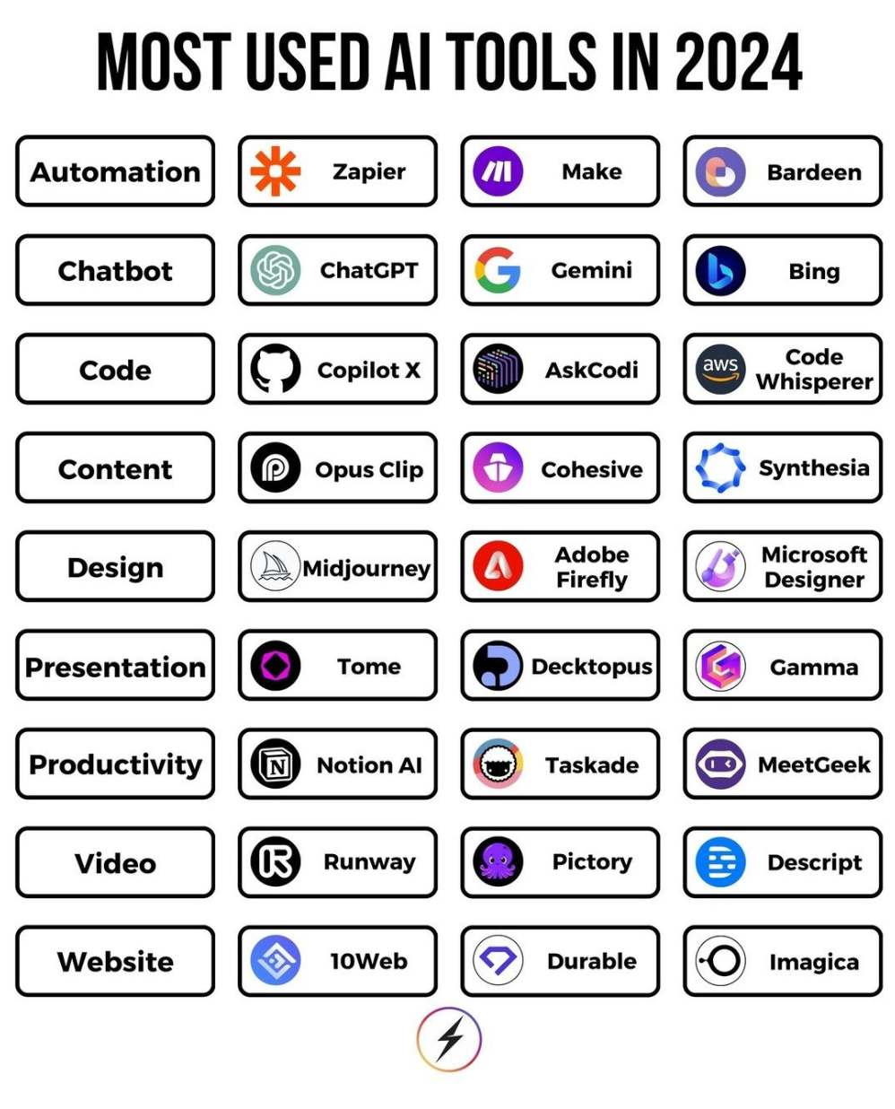
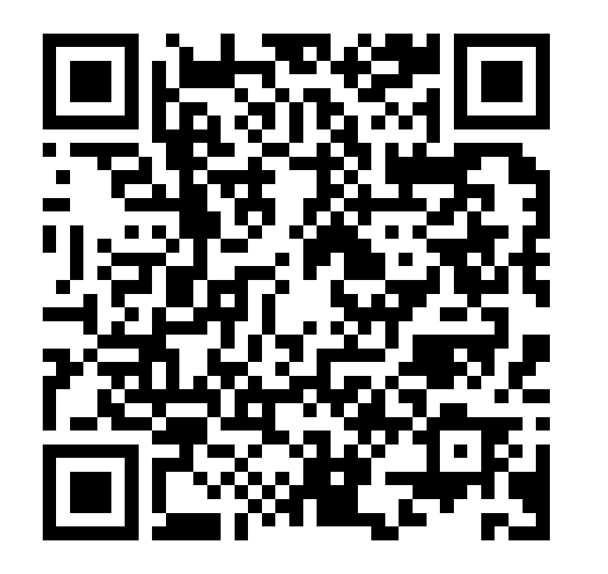
SBWL Digital Marketing The Electives: Revolutionize Digital Marketing Techniques with AI & Smart Tools (Wittmann)
What You’ll Discover
Transforming the classroom into a digital marketing agency where students take on roles fitting their individual skills and interests
Hands-on collaboration in real-world marketing projects with AI-driven tools.
Development of technical skills, essential teamwork and communication abilities.
Innovative Teaching Award Winner 2024
See what students are saying about
the course:

Slide 19


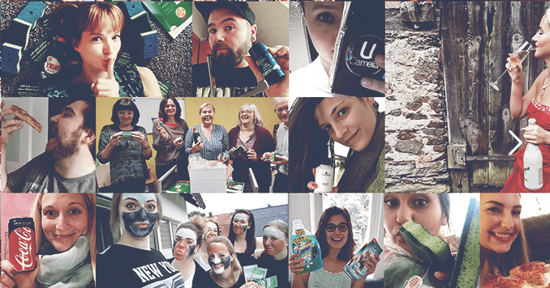
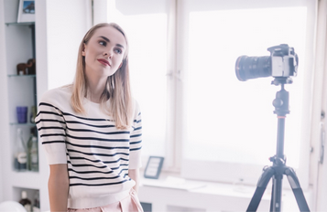




SBWL Digital Marketing The Electives: Influencer Marketing Campaign Management (Phieler)
In theory…
So…
What makes people talk?
How to utilize this?
How to set up influencer campaigns?
And integrate them to the marketing mix?

Slide 20
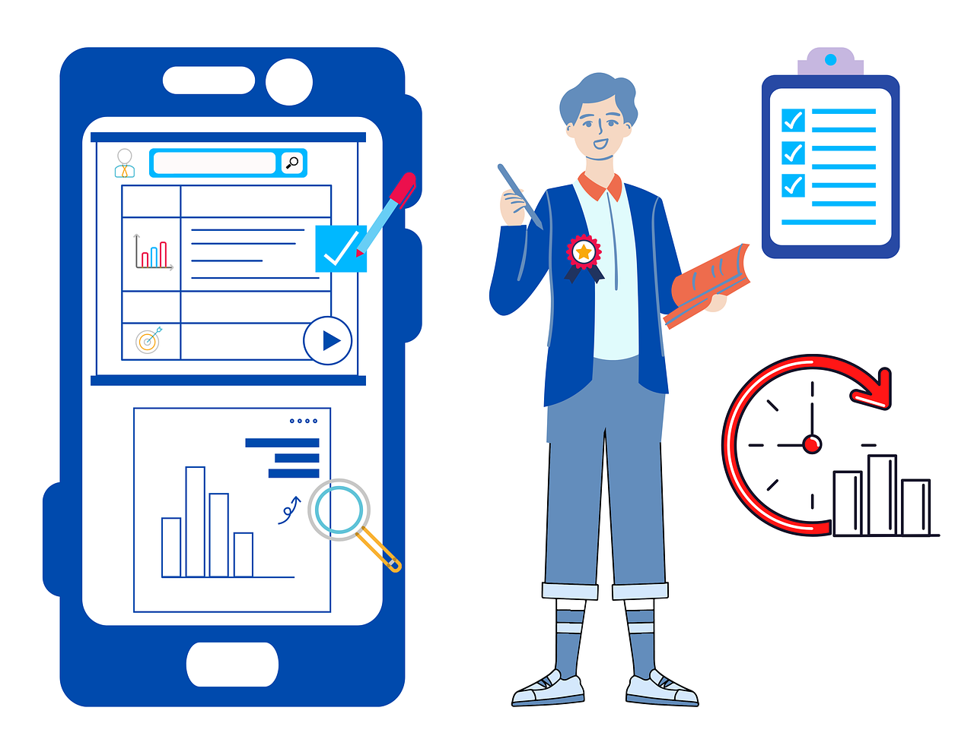
SBWL Digital Marketing The Electives: Marketing Analytics Simulation (Grzadziel)
Search Marketing Strategy
Acquisition & Awareness
Conversion & Retention
Growth & Sales

Slide 21
Enrichment Courses

Slide 22






SBWL Digital Marketing Marketing and Data Science (Reisenbichler)
Get in touch with Digital Marketing Practitioners
Exclusive talks and discussions with industry experts. Join after your Digital Marketing class!
Previous Talks in Marketing and Data Science:
How to Be Found Online
Gamification, Data & Sentiment in the Smart Driver Era
Measuring Digital Marketing Success
Artificial intelligence in marketing and creative practice
The success formula in digital marketing
Intro to customer analytics at jö Bonus Club

Slide 23
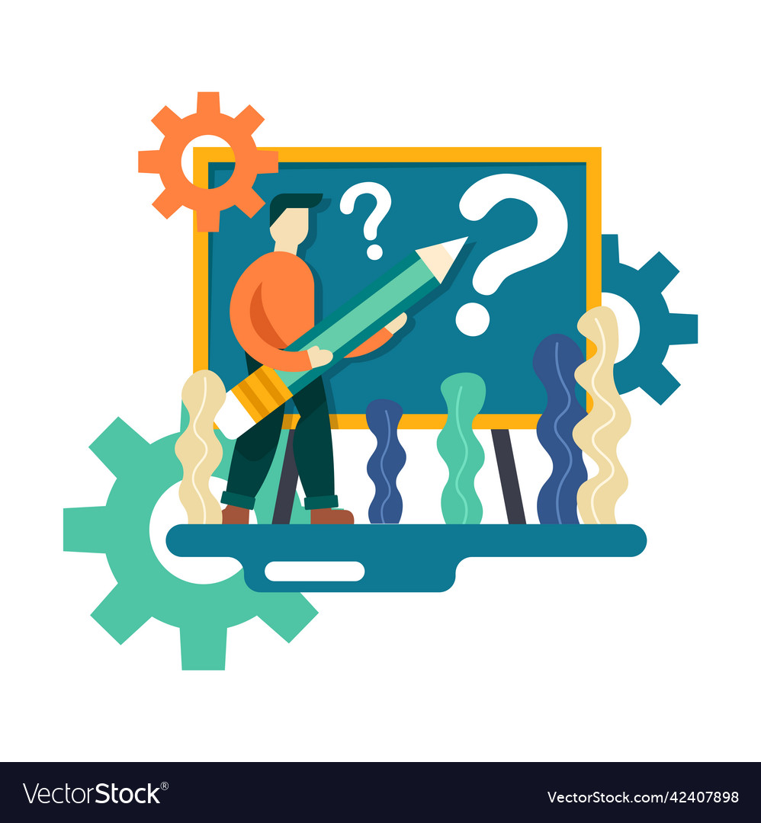
SBWL Digital Marketing Standards wissenschaftlichen Arbeitens & Zitierens (Rychly-Resetar)
Reflections about Science
Every-day vs scientific language
Scientific positions & perspectives
Social dimension of science
Organizing your Thesis
How to find thesis topic?
How to structure a thesis?
How to develop a research question?
Writing your Thesis
Searching for & citing literature
Time management
Managing writer's block
Visualizing complex content

Slide 24
The Impact

Slide 25
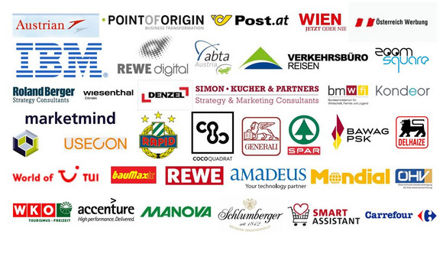












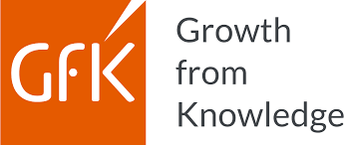


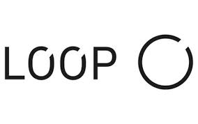




SBWL Digital Marketing The Impact
Corporate Partners
Spin-Offs & Start-Ups
Many of our graduates are founders, C-level executives in tech-startups, partners in consulting firms, …:
Sila Ada (Head of Data Analytics at Payla Financial Services)
Thomas Haller (Senior Partner at Simon-Kucher & Partners)
Nicolas March (CEO of Vathos AI Vision for Industrial Robots)
Michael Platzer (Co-Founder & CSO @ MOSTLY AI)
Holger Sicking (Head of Research & Data Analytics at Ö-Werbung)

Slide 26
Application Process

Slide 27
SBWL Digital Marketing The Action
Admission Process
Step 0
Obtain information about the program: (a) DM webpage, (b) MCA & IMSM institute sites (c) ÖH SBWL info & Messe, (d) LinkedIn posts, …
Step 1
Register at LPIS for course „Access to Specialization Digital Marketing“
Step 2
Complete submission form and digital marketing skills check on CANVAS „Access to Specialization Digital Marketing“
Step 3
We examine your application documents submitted via CANVAS & inform you shortly after about your admission using your WU email address
Notes:
Application Documents: 3 Skills + short motivation letter
Step 2: One day later than corresponding step 1: because learn often needs 1 day or so to get updated
Allgemeine Daten über Ihre Person
Personal data
Success in your previous courses (transcript of records)
Gradings: all gradings from STEOP and CBK (we consider 45 slots)
(currently) no entrance exam

Slide 28
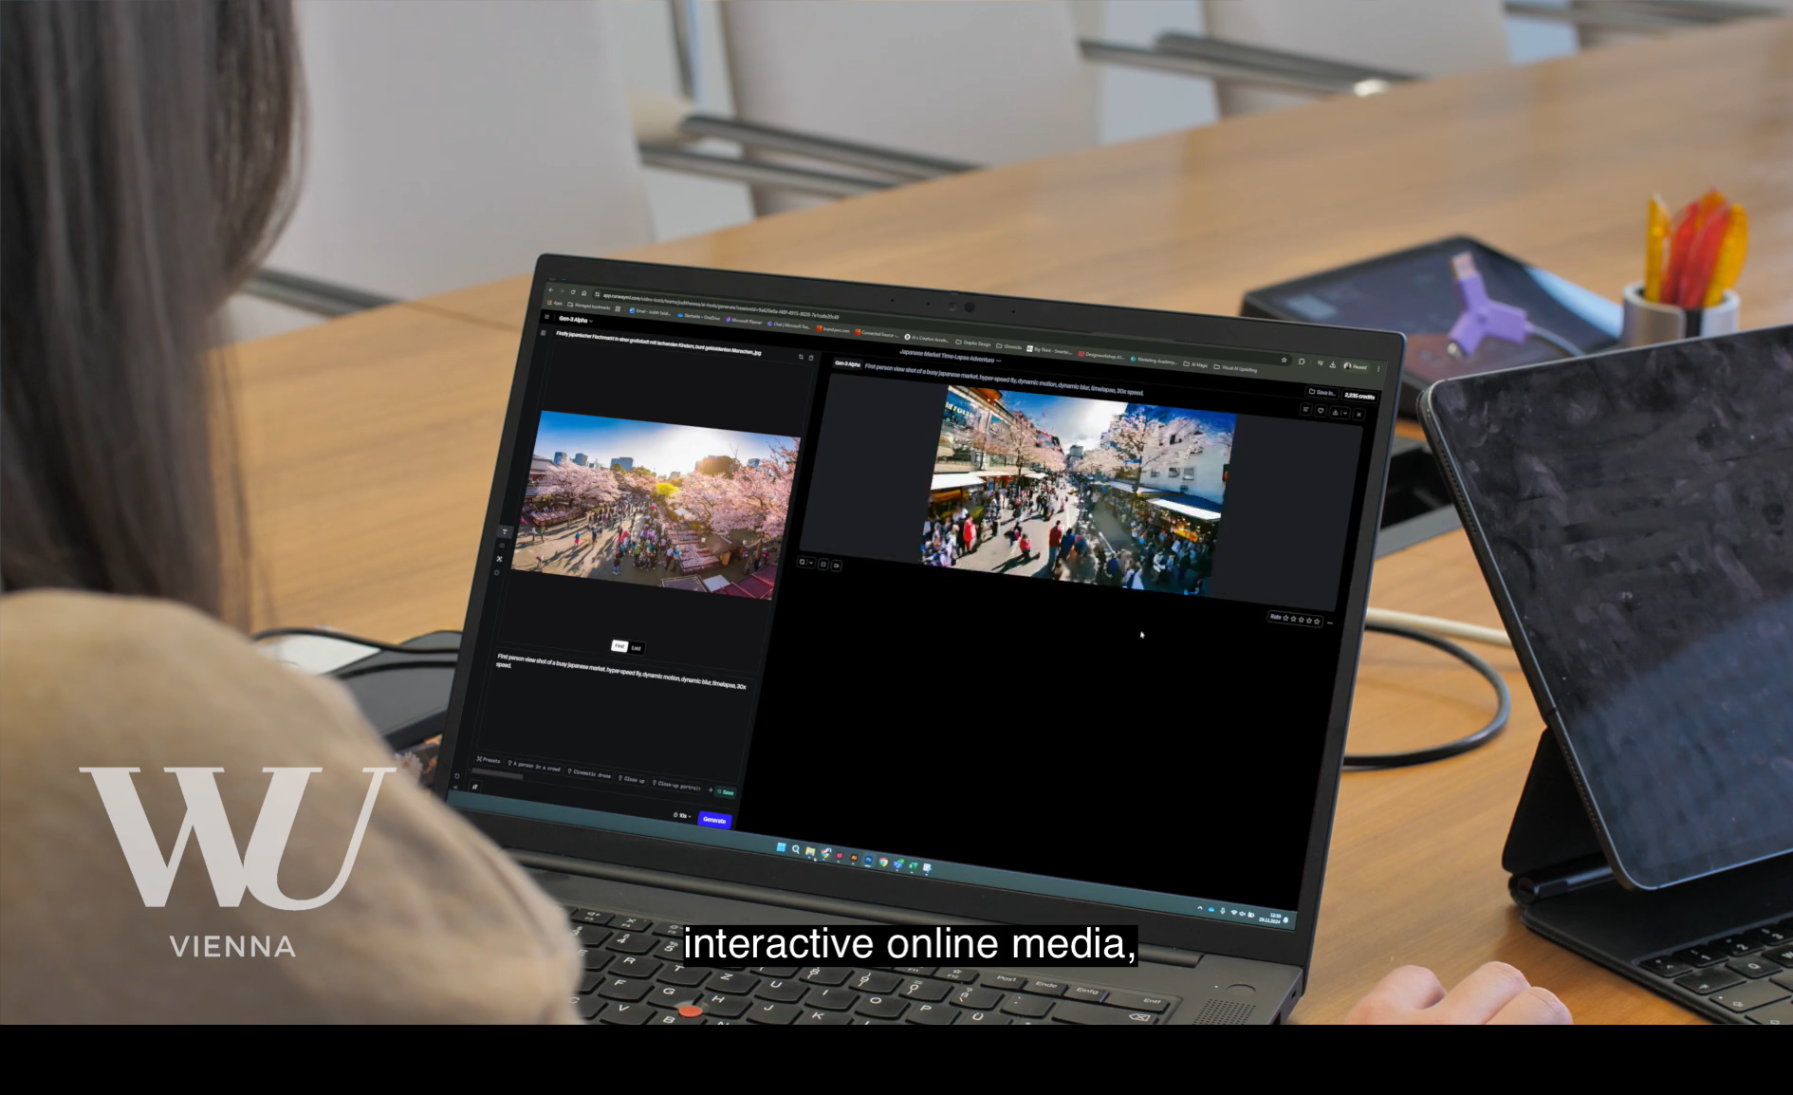
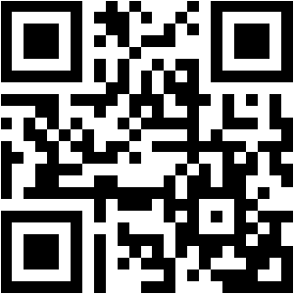
SBWL Digital Marketing Watch our video

Slide 29
We look forward to your application and wish you good luck!
SBWL Digital Marketing
short.wu.ac.at/digitalmarketing
digital.marketing@wu.ac.at
www.wu.ac.at/mca
www.wu.ac.at/imsm

