Slide 1
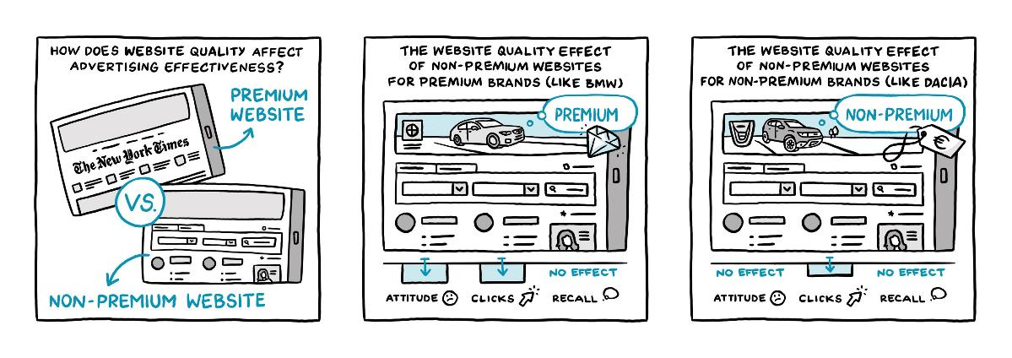
Slides can be used for teaching
The Risk of Programmatic Advertising: Effects of Website Quality on Advertising Effectiveness
Edlira Shehu, Copenhagen Business School
Nadia Abou Nabout, WU Vienna
Michel Clement, University of Hamburg
Paper available at: https://www.sciencedirect.com/science/article/abs/pii/S0167811620300914
Comics by Lana Lauren

Slide 2
More than 60% of worldwide digital ad spend in 2019 ($333.25 billion) spent on programmatic advertising

Slide 3
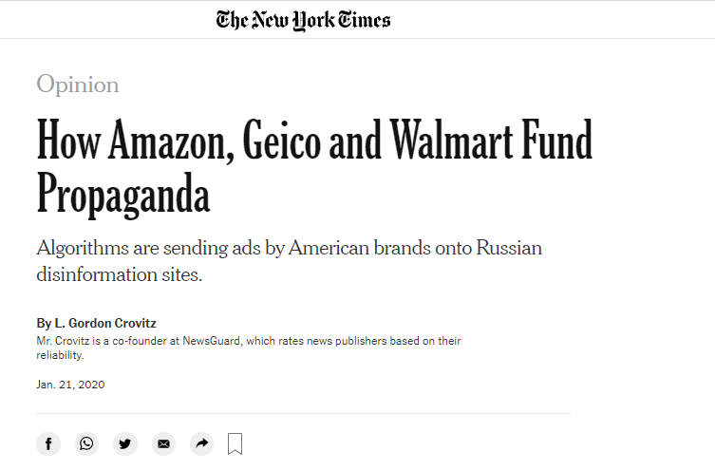
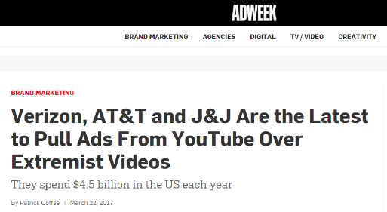
Programmatic advertising gives marketers limited control over where ads appear

Slide 4
Advertisers differentiate between premium and nonpremium websites
Premium websites:
reputable publishers
high-quality editorial content
superior website design
Examples:
nytimes.com
espn.com
vogue.com
nationalgeographic.com
Nonpremium websites:
user-generated content
content aggregators
gaming platforms
user forums
Examples:
allrecipes.com
lifehacker.com
chegg.com
tmz.com

Slide 5
Current practice relies on gut feeling: Premium brands advertise on premium websites
Notes:
P=premium, NP=nonpremium
Question 1: Which goals do you pursue in case of branding campaigns?
Question 2: Which goals do you pursue in case of performance campaigns?
Question 3: What categorization do you use to differentiate between websites of different quality?
Question 4: Where would you run the following campaigns (premium or nonpremium website)?
Branding campaign of BMW
Branding campaign of Dacia
Performance campaign of BMW
Performance campaign of Dacia
* If advertiser is willing to carry the additional costs.

Slide 6
Current practice relies on gut feeling: Branding campaigns advertise on premium websites
Notes:
P=premium, NP=nonpremium
Question 1: Which goals do you pursue in case of branding campaigns?
Question 2: Which goals do you pursue in case of performance campaigns?
Question 3: What categorization do you use to differentiate between websites of different quality?
Question 4: Where would you run the following campaigns (premium or nonpremium website)?
Branding campaign of BMW
Branding campaign of Dacia
Performance campaign of BMW
Performance campaign of Dacia
* If advertiser is willing to carry the additional costs.

Slide 7
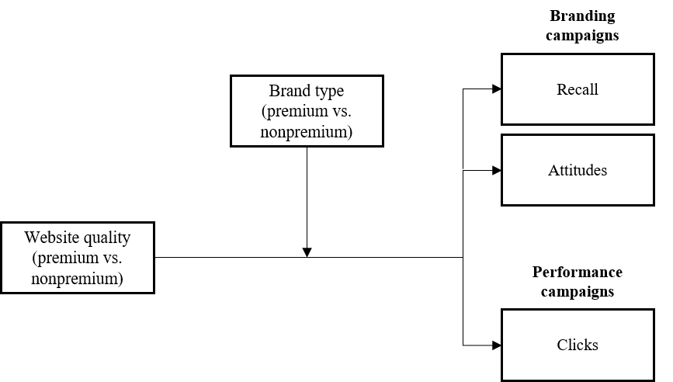
How does advertising on nonpremium websites affect advertising effectiveness?
Study 1
Study 2

Slide 8

Study 1: Setting
Global video sharing platform
Definition of premium vs. non-premium channel provided by video sharing platform
Panelists recruited from GfK Media Efficiency Panel
Randomization of ads to 5,305 respondents (no targeting)
18 premium & non-premium brands
Real search queries
  Potential self-selection bias of respondents’ assignment to premium/non-premium channels based on their real searching behavior

Slide 9
Dealing with potential self-selection bias
Propensity-score matching (PSM) using nearest neighbor algorithm
Variables included in PSM:
  sociodemographic characteristics (age, education, and household status)
  usage characteristics on the video platform during the month prior to our study (time spent online and on the video platform)
  interest in the advertised product category
  number of total video ad impressions before completing the survey
Various robustness checks regarding the PSM can be found in the paper

Slide 10
We do NOT see significant effects on recall

Slide 11
We do see significant effects on attitudes
p < .05

Slide 12
We do see significant effects on attitudes
p < .05

Slide 13
Study 1: Summary
Campaign goal: Brand awareness
Context does not seem to matter!
Campaign goal: Attitudes
Premium brands: Ignoring website quality in brand advertising leads to lower attitudes
Non-premium brands: Do not benefit from advertising on premium websites

Slide 14

Study 2
Data source: One of the largest ad exchanges in Europe
Brands:
  7 premium, 7 non-premium
  Banking, dating, fashion, lottery and betting, travel
Websites: 41 premium, 43 non-premium
Observation period: April 4 – May 3, 2015
Delivered impressions: 379 million
Real campaign data
  Potential endogeneity bias due to strategic advertiser behavior

Slide 15
Setting
Variables of interest:
Dependent variable:
  Ad performance:
  Number of clicks
Independent variables:
  Website quality:
  Premium vs. non-premium
  Brand image:
  Premium vs. non-premium
Control variables:
Brand-level intercepts:
Capture differences in media buying behavior across brands
Impressions:
Decision variable of the online marketer
Banner format:
120 x 600: skyscraper, 160 x 600: wide skyscraper, 200 x 600: wide skyscraper alternative, 300 x 250: medium rectangle, 728 x 90: leaderboard
Week + day-of-week fixed effects

Slide 16
Dealing with potential endogeneity
Reverse causal effect of clicks on website quality as advertisers may decide to place their most promising ads on premium websites
Control function approach
  1. Step: Auxiliary probit model with website quality as dependent variable
  Instrument: For each brand, number of ads of all other brands displayed on premium websites on a specific day t excluding ads by the brand itself
  2. Step: Include residuals from Step 1 in main model with number of clicks as dependent variable
More details can be found in the paper

Slide 17
Effect of nonpremium websites on click behavior for premium brands
2.926
64% fewer clicks when on nonpremium websites
1.727
1.193
1.060

Slide 18
Effect of nonpremium websites on click behavior for nonpremium brands
2.926
1.727
31% fewer clicks when on nonpremium websites
1.193
1.060

Slide 19
Study 2: Summary
Campaign goal: Clicks & performance
Context matters for both, premium and non-premium brands
Negative effects are stronger for premium brands

Slide 20
Implications

Slide 21
Thank you
If you have any questions regarding this material, you can contact us at nadia.abounabout@wu.ac.at
Comics by Lana Lauren

