Slide 1
Industrial Economics
Biliana Yontcheva, PhD
Tel.: 01 31336 4501
e-mail: biliana.yontcheva@wu.ac.at
Office hours: Mo, 10.00 to 11.00

Slide 2
Introduction
In introductory microeconomics, idealized models of firms and markets are analyzed.
IO takes a more realistic look at them.
Industrial organization is concerned with the behavior of firms on markets with imperfect competition.
It adds to the perfectly competitive model the real world frictions: limited information, transaction costs, barriers to entry, etc.
IO considers how firms are organized and how they compete in such a world, their strategic behavior.

Slide 3
Course content
Prerequisites
Completed course in applied microeconomics, understanding of competitive and monopoly markets, basics of profit-maximization
Part 1: Static oligopoly models
Cournot (quantity) competition
Bertrand (price) competition
Game theory

Slide 4
Course content
Part 2: Sources of market power and dynamic models of competition
Natural monopolies (network externalities, economies of scale or scope, innovations)
Local market power/differentiation
Imperfect information and switching costs
Cartels and entry deterrence
Part 3: Chosen topics and industries
Industry case-studies
Network industries
Two-sided markets
Experience and credence goods
Vertically integrated industries

Slide 5
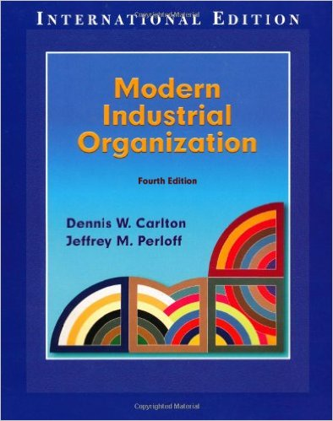
Literature
Belleflamme P., Peitz, M. (2015), Industrial Organization, 2nd. Ed., Cambridge University Press.
Carlton, D., Perloff, J., (2005), Modern Industrial Organization, 4th. Ed., Addison-Wesley.

Slide 6
Literature
Pepall, L., Richards, D., Norman, G., (2014). Industrial Organization: Contemporary Theory and Empirical Applications. Blackwell Publishing. 5th Ed.
Motta, M., (2004), Competition Policy: Theory and Practice; Cambridge University Press
Church, J., and Ware, R., (1999), Industrial Organization; McGraw-Hill
Bester, H., (2004), Theorie der Industrieökonomik, Springer.
Martin, S, (1993), Advanced Industrial Economics, Blackwell.

Slide 7
Course schedule and grading
Grading
1. Written exams with open questions (70%):
Mid-term exam (35%) (April)
Final exam (35%) (May)
2. Participation in class (20%):
Presentation (15%) (April - June)
Participation in discussion (5%)
3. Homework assignments (10%)
Schedule
14 sessions on Wednesdays (from 1pm to 4.15pm)
Extra sessions: 25.05 and 08.06 (from 9am to 12.15pm)

Slide 8
Questions are welcome!
Biliana Yontcheva, PhD
Tel.: 01 31336 4501
e-mail: biliana.yontcheva@wu.ac.at
Office hours: Mo, 10.00 to 11.00

