Slide 1
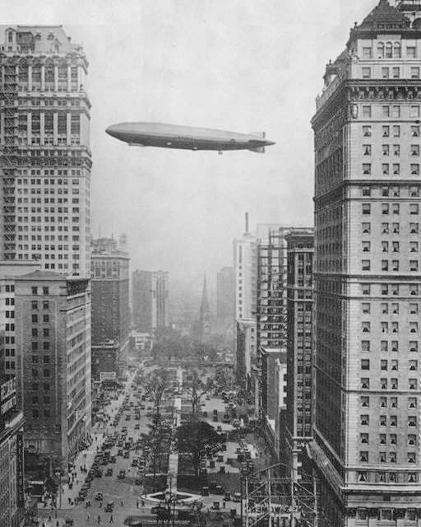

Applied Economic Geography and case studies
Jürgen Essletzbichler
juergen.essletzbichler@wu.ac.at

Slide 2



Living in a flat world
Friedman’s “aha” flat moment
While playing golf in Banglore, India he was told
“Aim at either Microsoft or IBM” …. ‘Aha’….
“When Friedman found in Bangalore not Indians but Americans in name and speech and business practices, he “shared [his] discovery with [his] wife, and only in a whisper. ‘Honey.’ I confided, ‘I think the world is flat” (cited in Leamer 2007)

Slide 3

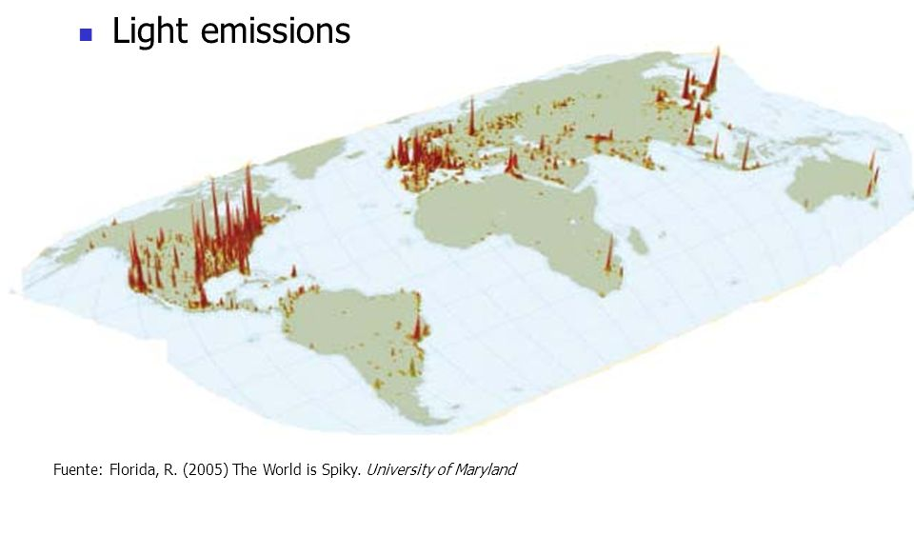
But (un)fortunately, ….

Slide 4
What do we do in this course?
We try and explain the spikiness
How
  > Introduce a set of theoretical frameworks that explain regional economic development
  > Work with empirical data and basic spatial econometric tools to examine spatial economic questions

Slide 5
Theorizing regional economic development
Cluster
Regional innovation systems
Learning regions
Evolutionary economic geography
Path dependence
Lock in
Entry and exit dynamics
Industrial branching
Knowledge complexity
Global commodity chains
Spatial division of labor
Product / industry life cycles
Source: Tondl 2001

Slide 6
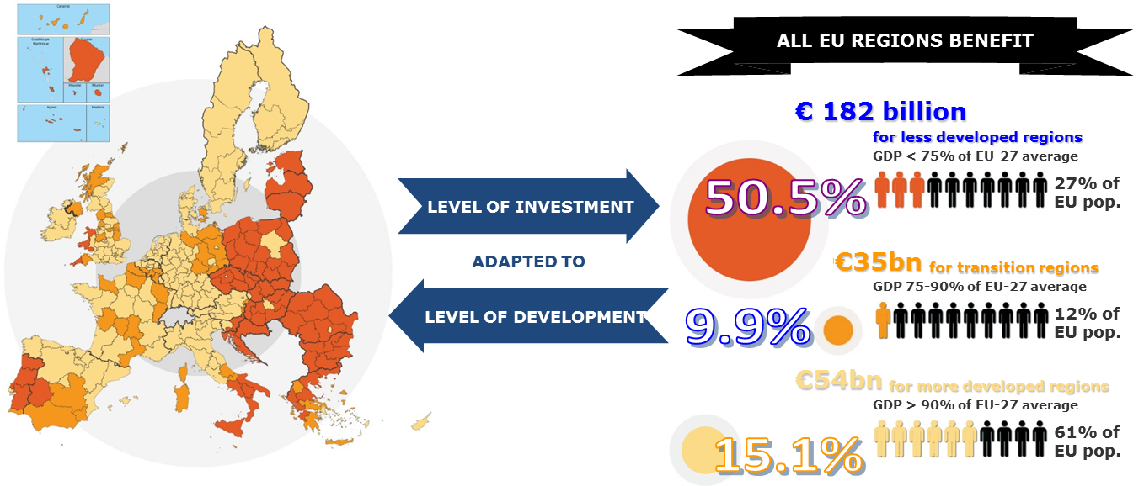
Why is that important?
Preamble to the Treaty of Rome (1957): necessity ‘to strengthen the unity of their economies and to ensure their harmonious development by reducing the differences existing between the various regions and the backwardness of the less favoured regions’.

Slide 7
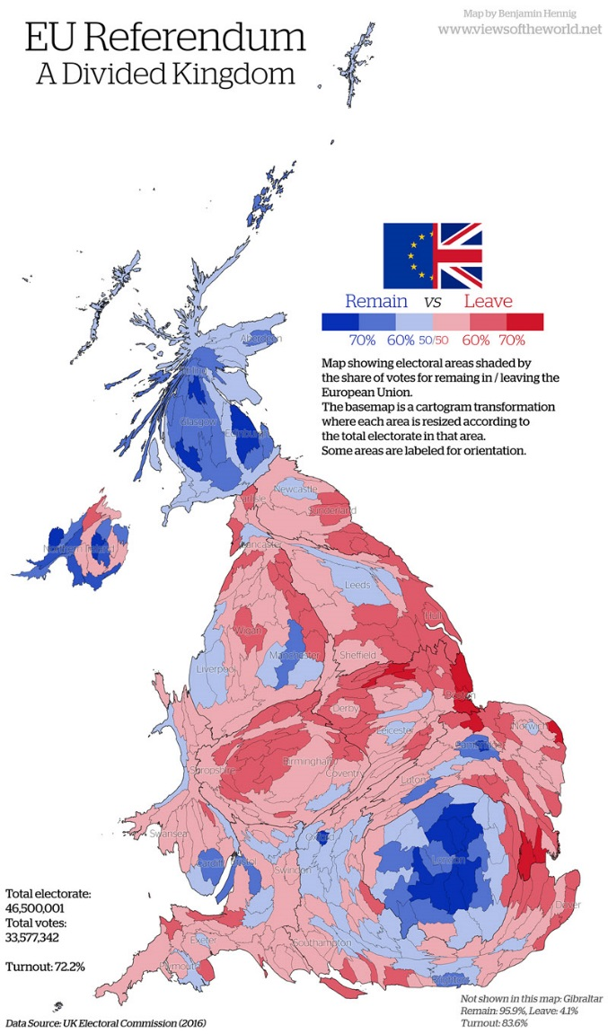
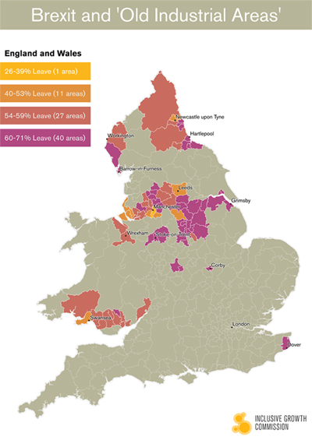
If we do not do that…

Slide 8
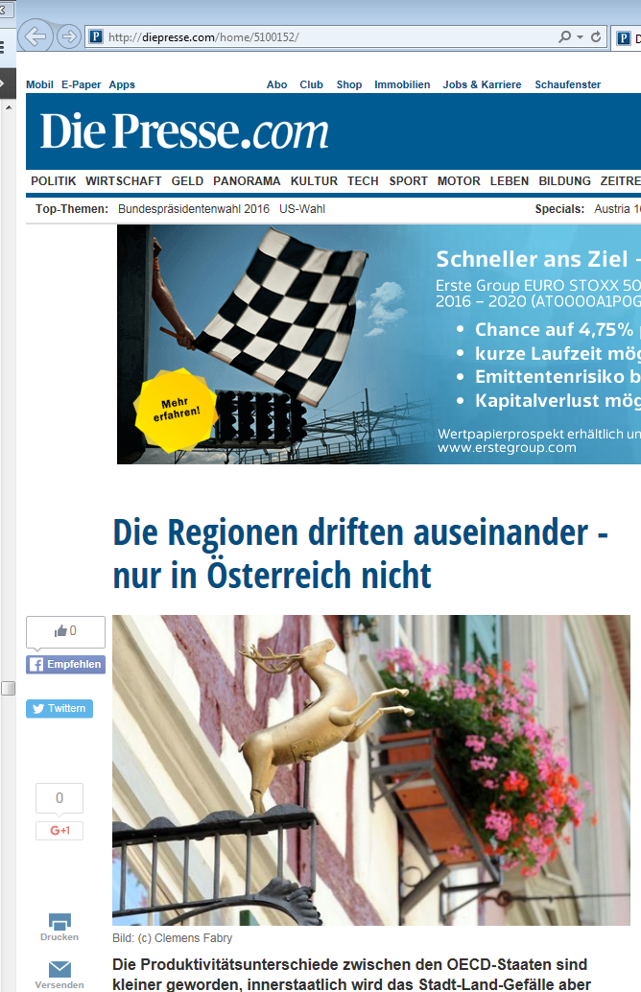
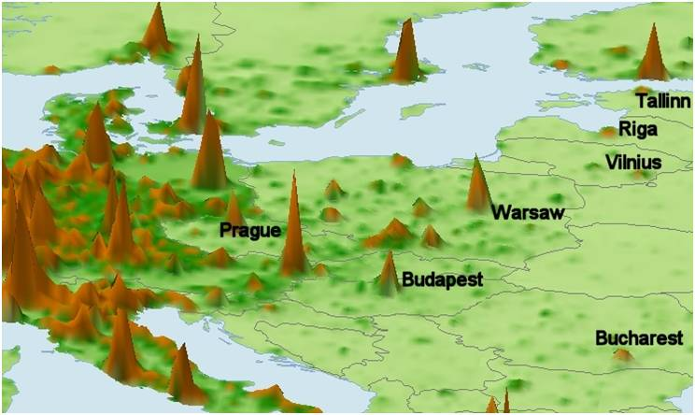
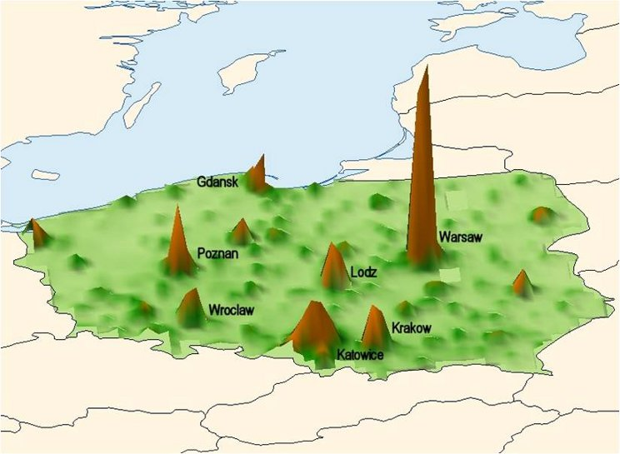
Declining between country and inreasing within country inequality
EU
Poland

Slide 9

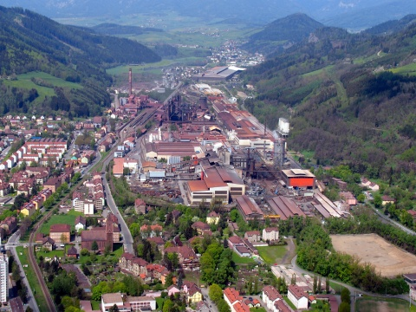

Geographic context
Barca report
From space blind to place based policies
Typologies of regions
Endogenous development
From growth to development and social well-being
Producing capacities for growth
Institutions
Case studies
  Third Italy
  East London
  Styria,…

Slide 10
Learning outcomes
To appreciate why economists should think about the space economy
To understand how geographers think about and address economic problems/questions
To get a grounding in theories of regional/urban economic development
To learn how to read, interpret and critically analyse scientific papers
To work empirically with spatially referenced data and use some basic spatial exploratory and econometric techniques
To learn how to use a simple exploratory spatial data analysis tool (GeoDA)
To gain experience with writing a scientific report

Slide 11
Basic structure
Lectures and discussions: introduction to theories of economic development
  Each week there will be an assigned reading to which you will write short response papers and that serve as basis for the class discussions
Computer seminars: Finding and working with spatial data; mapping, describing and explaining spatial patterns;
Presentations: Presentations of project proposals and final project results

Slide 12
Computer seminars
Learn how to find spatial boundary data
Manipulate them and make maps
Find economic data on EU regions from Eurostat, OECD and Cambridge Econometrics

Slide 13
Computer seminars
Learn how to explore spatial data (mapping, describing,…) with GeoDa

Slide 14
Computer seminars
Define geographic neighbours
Look for spatial clusters and outliers

Slide 15
Computer seminars
Carry out OLS regressions
Develop spatial lag, error and spatial lag of X models
Learning how to choose and evaluate models

Slide 16
Purpose of seminars
Learn how to work with actual data
  Where to find them
  How to manipulate them
  How to use spatial exploratory and spatial econometric tools
Define research questions that can be examined with methods
Work in a group to develop a research report

Slide 17
What kinds of projects?
What explains East West Migration in Europe?
Does geographic proxmity to Germany help explain regional economic growth in Polish regions?
What explains spatial differences in Austrian unemployment rates?
What impact does the recession have on regional poverty?

Slide 18
Assessment
Class participation based on readings: (15%)
Five short response papers (10-15 lines) (25%)
Two page summary of group research proposals (10%)
Presentation (10%)
Final project (40%)
  Use of theory to identify questions; use of methods to examine them; Analysis/interpretation.

Slide 19
Summary
This is a hands on practical course
At the end of the course you will be able to
  differentiate between and evaluate different theoretical frameworks on regional economic development
  read, interpret and critically analyze research papers
  develop research questions
  find and work with empirical data
  make maps
  apply spatial econometric tools
  develop, execute and deliver a research project

Slide 20



Questions?

