Slide 1
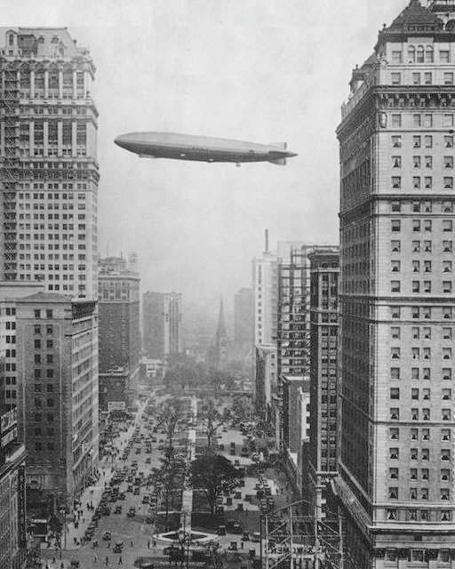

Applied Economic Geography and case studies
Jürgen Essletzbichler
juergen.essletzbichler@wu.ac.at

Slide 2



Living in a flat world
Friedman’s “aha” flat moment
While playing golf in Banglore, India he was told
“Aim at either Microsoft or IBM” …. ‘Aha’….
“When Friedman found in Bangalore not Indians but Americans in name and speech and business practices, he “shared [his] discovery with [his] wife, and only in a whisper. ‘Honey.’ I confided, ‘I think the world is flat” (cited in Leamer 2007)

Slide 3

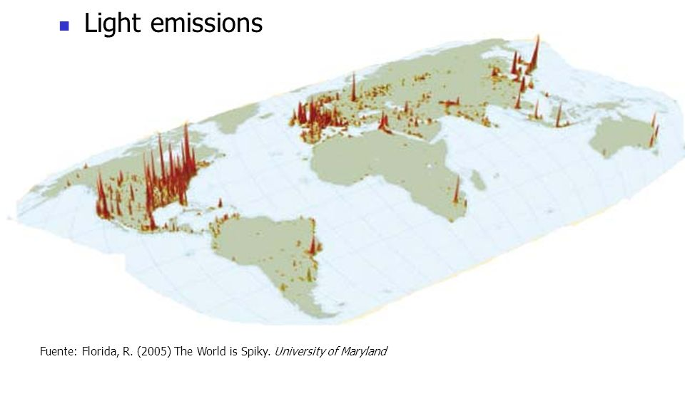
But fortunately, ….

Slide 4
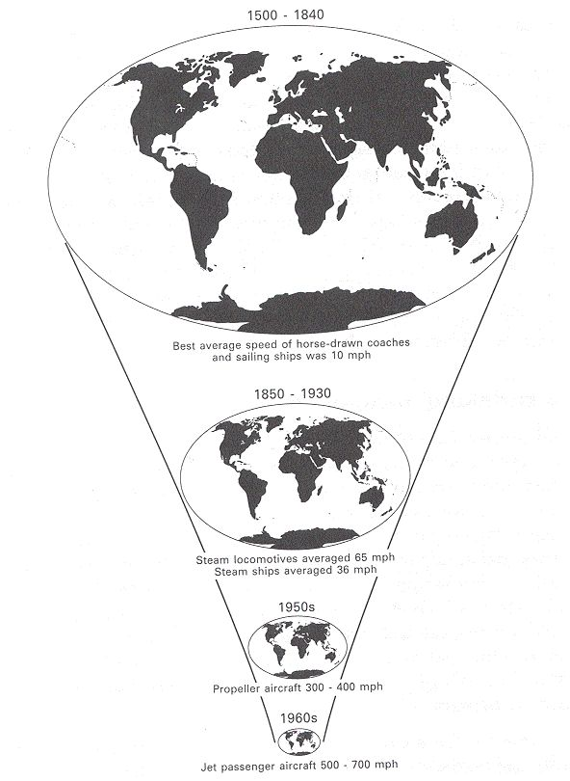


Despite globalization, we are living in a geographically unequal world

Slide 5
Main points
Despite globalization and lower transport and information costs we see concentration of economic activity in space
Some regions and cities are better equipped to deal with challenges and opportunities of globalization and grow or decline
We want to find out what processes and facts explain those differences
Empirical focus will be on EU regions

Slide 6
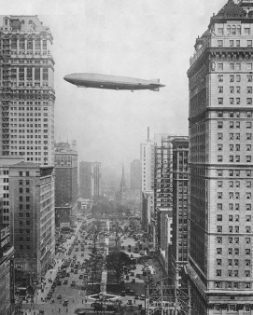


General theorizing coupled with geographic context
Predicting flattening
Convergence
Classical regional growth theory
Product life cycle hypothesis
Predicting spikiness
Divergence
New Geographical Economics
Cumulative causation and growth poles
Agglomeration economies

Slide 7
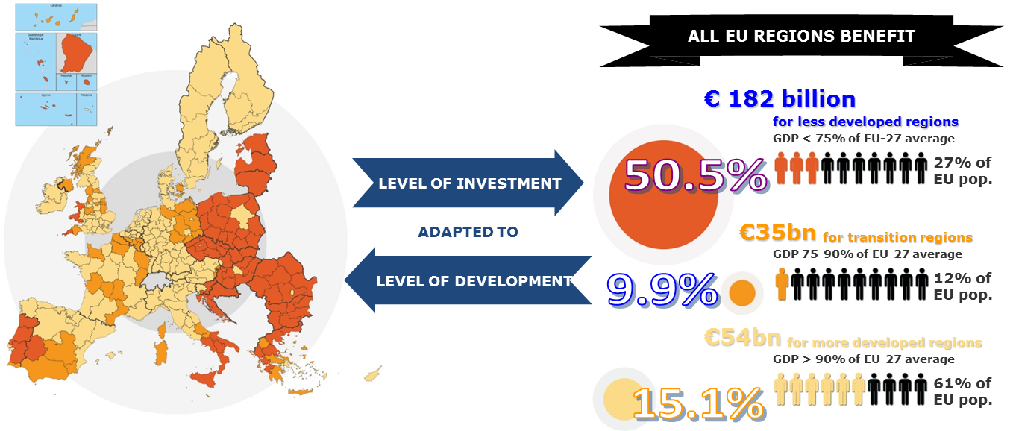
Why is that important?
Preamble to the Treaty of Rome (1957): necessity ‘to strengthen the unity of their economies and to ensure their harmonious development by reducing the differences existing between the various regions and the backwardness of the less favoured regions’.

Slide 8
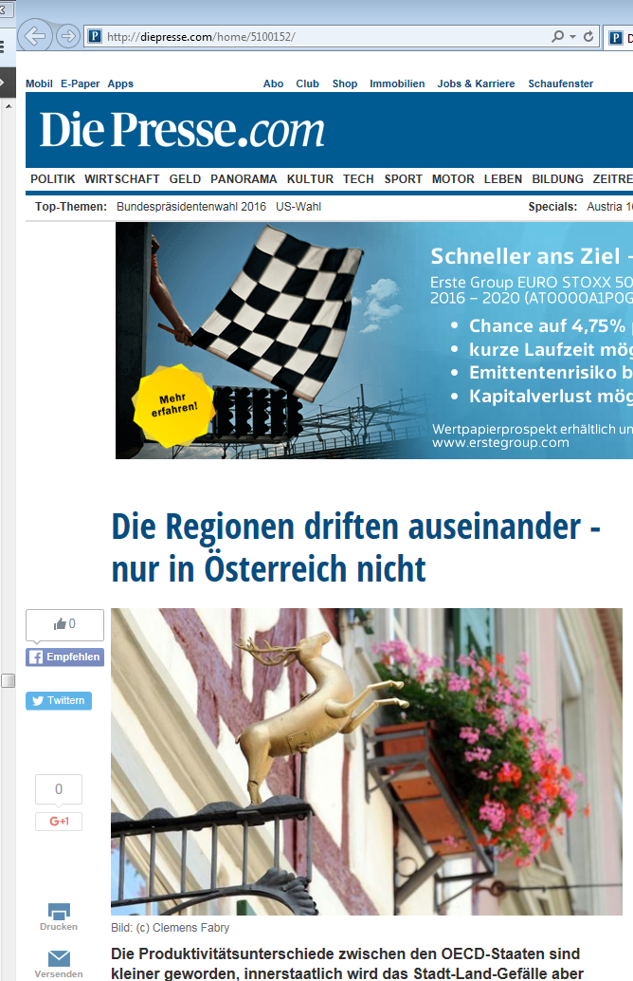
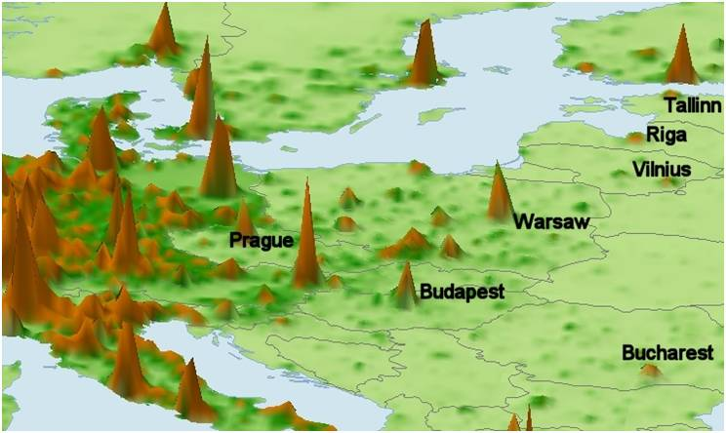
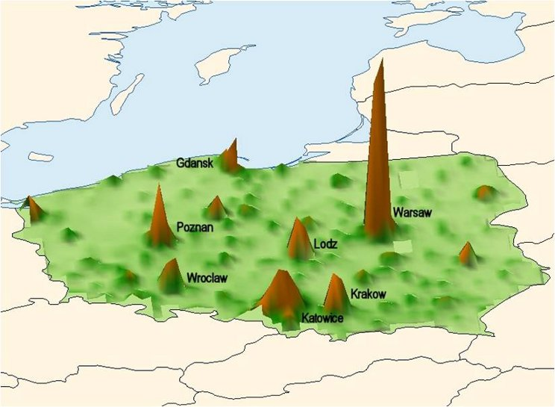
Declining between country and inreasing within country inequality
EU
Poland

Slide 9

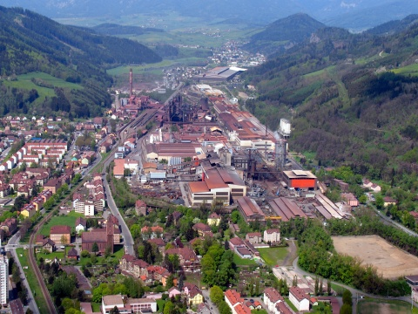

Geographic context
Barca report
From space blind to place based policies
Typologies of regions
Endogenous development
From growth to development and social well-being
Producing capacities for growth
Institutions
Case studies
  Third Italy
  East London
  Styria,…

Slide 10
Economic geographers grapple with those issues
Economic geographers are interested in explaining the causes and consequences of uneven development within and between regions. The discipline’s goal has long been to offer multi-faceted explanations for economic processes – growth and prosperity as well as crises and decline – manifested across territories at various scales: local, regional, national
and global.
Contemporary economic geographers study geographically
specific factors that shape economic processes and identify key agents
(such as firms, labour and the state) and drivers (such as innovation,
institutions, entrepreneurship and accessibility) that prompt uneven
territorial development and change (such as industrial clusters, regional
disparities and core – periphery). Ayokama et al. 2010, p.1

Slide 11
Learning outcomes
To appreciate why economists should think about the space economy
To understand how geographers think about and address economic problems/questions
To get a grounding in theories of regional/urban economic development
To work empirically with spatially referenced data and use some basic spatial exploratory and econometric techniques
To learn how to use a simple exploratory spatial data analysis tool (GeoDA)
To gain experience with writing a scientific report

Slide 12
Basic structure
Lectures and discussions: introduction to theories of economic development, link to EU cohesion policy and limitations/extensions of different theoretical frameworks
Computer seminars: Finding and working with spatial data; mapping, describing and explaining spatial patterns;
Presentations: Presentations of project proposals and final project results

Slide 13
Computer seminars
Learn how to find spatial boundary data
Manipulate them and make maps
Find economic data on EU regions from Eurostat, OECD and Cambridge Econometrics

Slide 14
Computer seminars
Learn how to explore spatial data (mapping, describing,…) with GeoDa

Slide 15
Computer seminars
Define geographic neighbours
Look for spatial clusters and outliers

Slide 16
Computer seminars
Carry out OLS regressions
Develop spatial lag, error and spatial lag of X models
Learning how to choose and evaluate models

Slide 17
Purpose of seminars
Learn how to work with actual data
  Where to find them
  How to manipulate them
  How to use spatial exploratory and spatial econometric tools
Define research questions that can be examined with methods
Work in a group to develop a research report

Slide 18
What kinds of projects?
What explains East West Migration in Europe?
Does geographic proxmity to Germany help explain regional economic growth in Polish regions?
What explains spatial differences in Austrian unemployment rates?
What impact does the recession have on regional poverty?

Slide 19
Assessment
Class participation based on readings: (10%)
Exam based on compulsory readings and lecture slides (30%)
  To examine your grasp of different theoretical frameworks of regional development
Presentation (15%)
  Here you have to come up with your own project based on themes covered in class and techniques learned in computer seminars
Final project (45%)
  Use of theory to identify questions; use of methods to examine them; Analysis/interpretation.

Slide 20
Summary
Mixture of lectures, discussions, seminars and presentations to answer questions such as
  Why, despite globalization, do we live in a spiky world?
  Why do we see and should be concerned about spatially uneven development?
  Why is spatial context important to understand actual regional develoment trajectories?
  How do we formulate and carry out a research project?

Slide 21



Questions?

