Slide 1
Costs
Guiding Questions
What kind of investment costs do you face to set up the project?
What are the costs to keep the project running for one year?
When are which costs due?
What are your yearly expenses in a regular year?

Slide 2
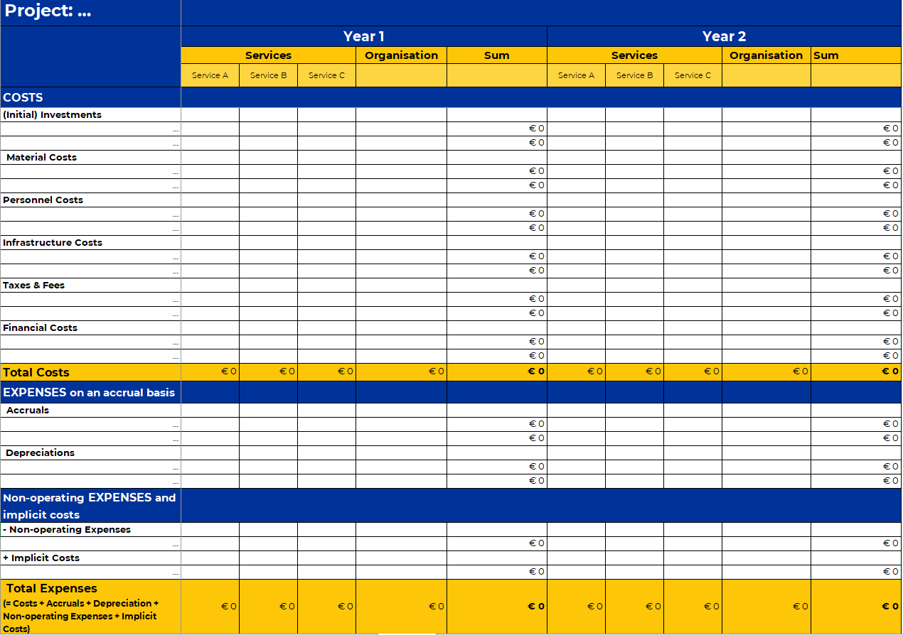
Costs
Check out the Excel “Financial Plan” to calculate your costs and expenses!

Slide 3
My Project: Costs
 | year 1 | year 2 | year 3 | year 4 | year 5
COSTS
(Initial) Investments
Material Costs
Personnel Costs
Infrastructure Costs
Taxes & Fees
Financial Costs
Total Costs
EXPENSES on an accrual basis
Accruals
Depreciations
Non-operating EXPENSES and implicit costs
- Non-operating Expenses
+ Implicit Costs
Total Expenses

