Slide 1
I have been an Entrepreneur for the past 20 years and I'm managing director of the Austrian business accelerator funkensprung.com. So what do we do?
3 Things: We serve innovative companies with coworking facilities, Consultancy, and support startups as business angels in getting their great ideas to work.

Slide 2
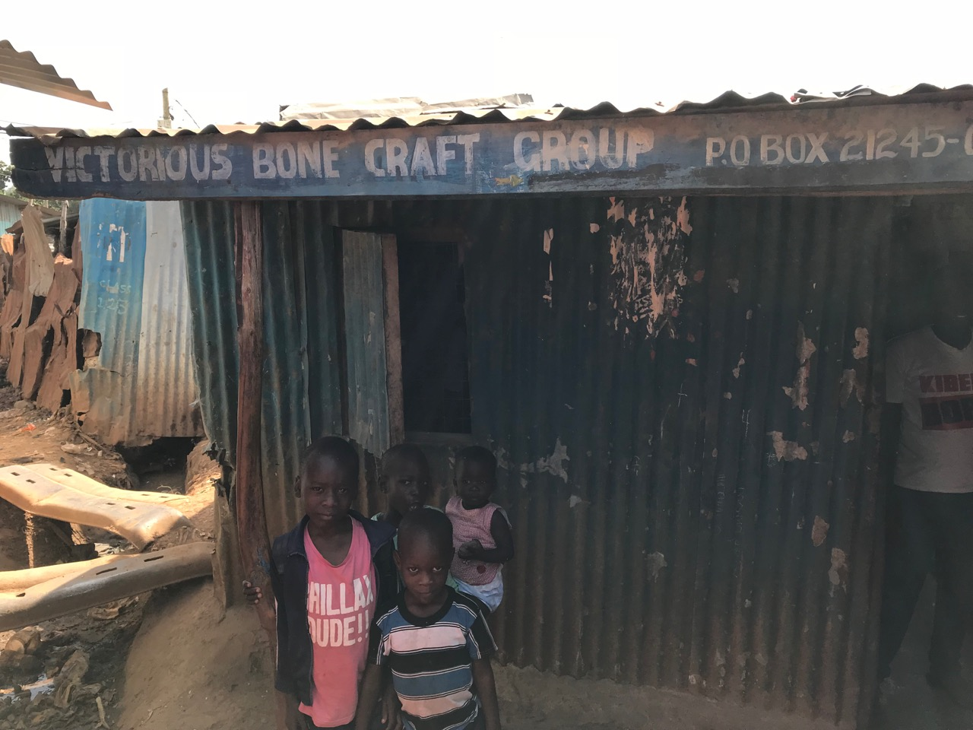
I have been travelling to northern Africa quite often, to Marocco, Egypt, Tunisa, but never came down to the sub-sahara reagion. The pictures I have had in mind about those countries where those that media and NGOs kept telling us: pictures of failed states, dictatorships, crisis, catastrophes, war, starving children or slums as here in Kibera in Nairobi.
At that time, when one of my biggest mentors gave me the advice to get up, go there and see with my own eyes in order to escape the bubble, I quickly decided to join Hans Stoisser, Africa Expert and Author of "The Black Tiger" on a learning journey to Silicon Savannah, Nairobi, Kenya last year and to Tikali in Rwanda this year.

Slide 3
The experience was mind-blowing and left a deep impact on my life.
I was able to learn about the other, swiftly growing Africa: high tech hubs and a vibriant, most interesting startup ecosystem.

Slide 4
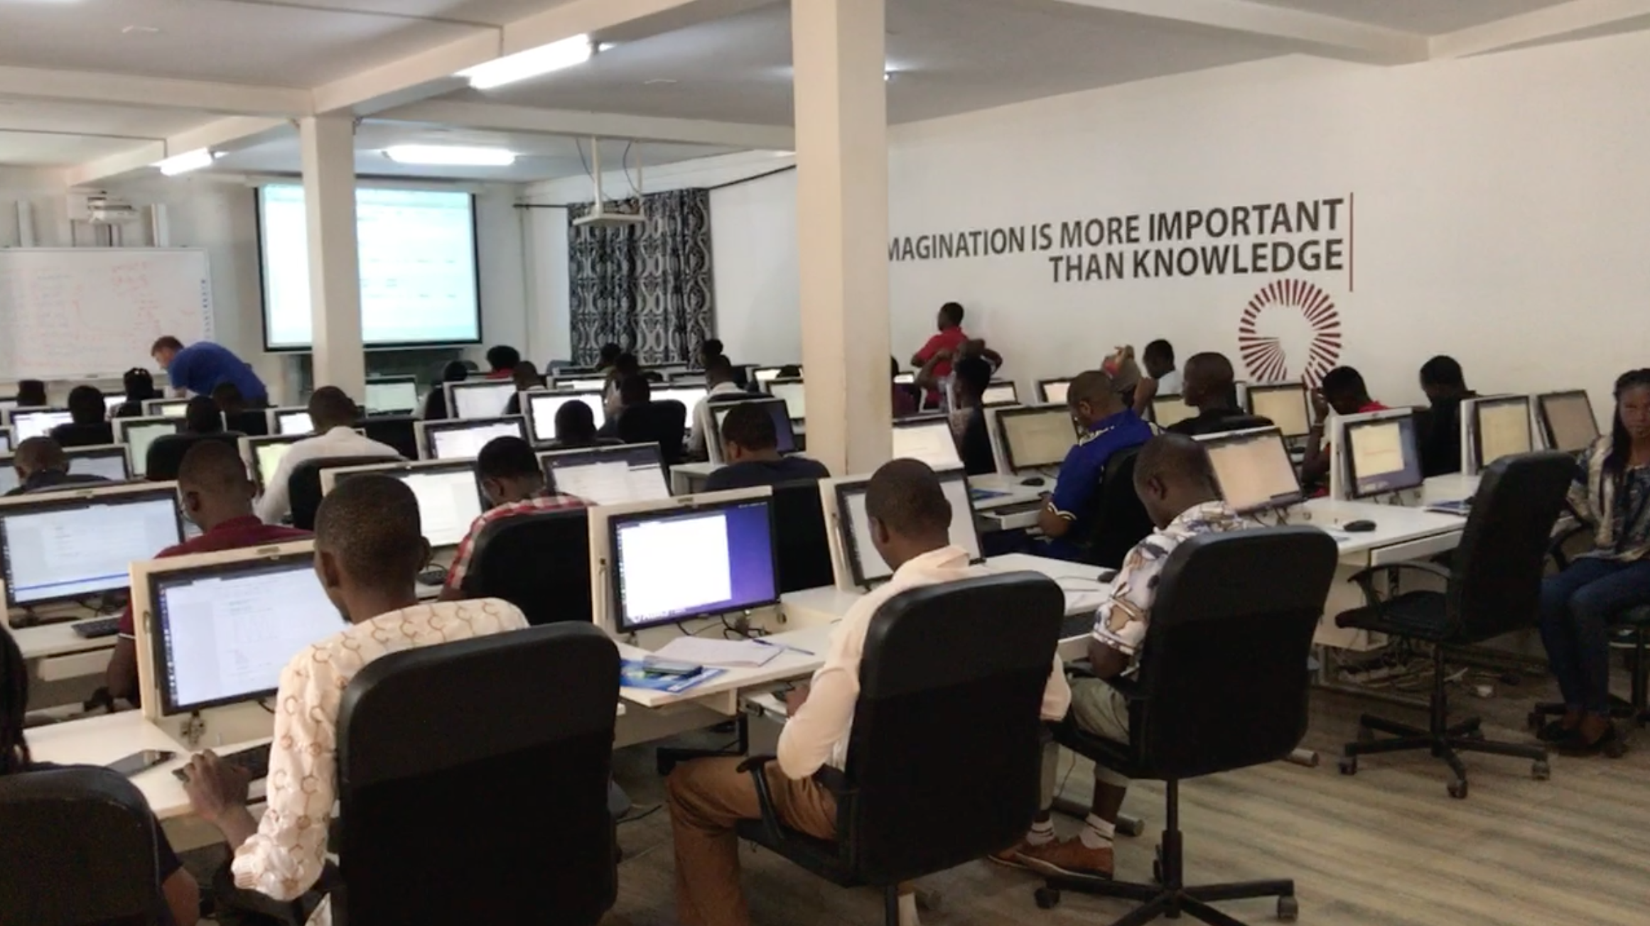
Universities focusing on crypto economy, artifical intelligence and machine learning.

Slide 5
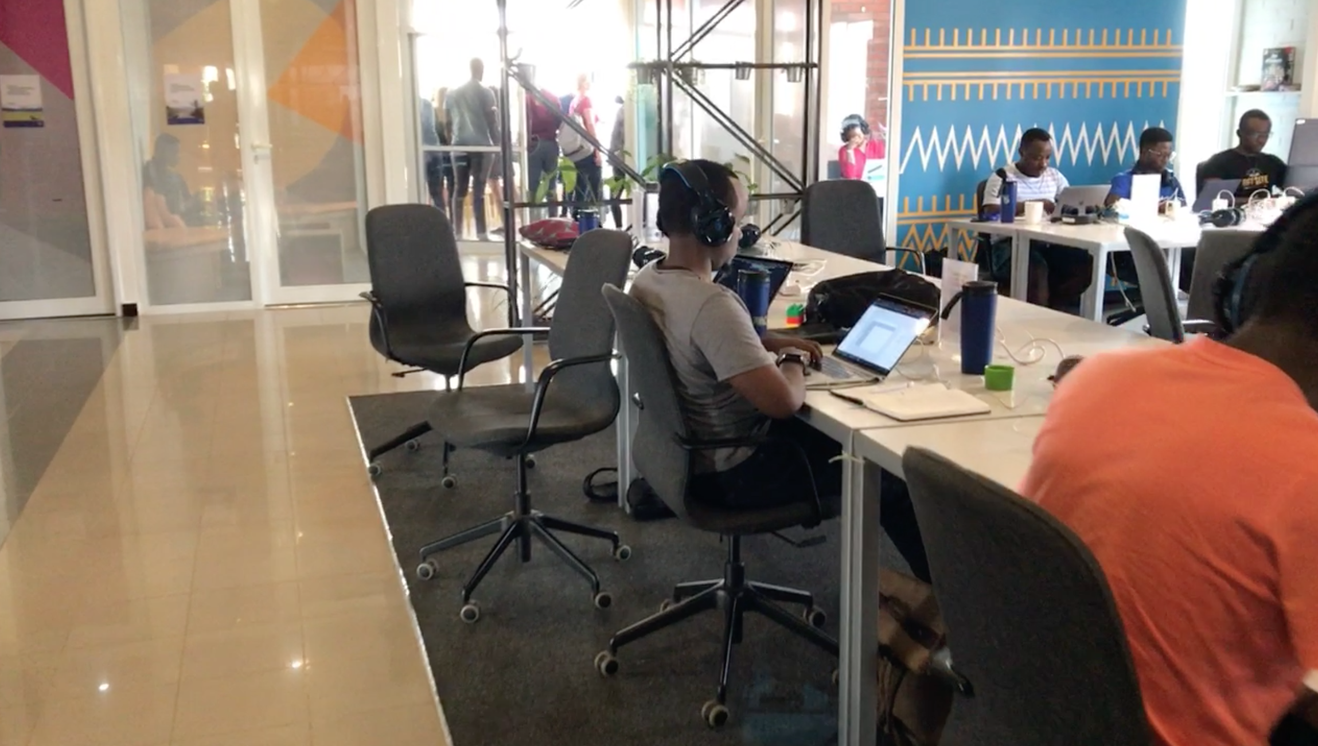
I visited the Andela project, where thousands of senior developers are being educated and trained.

Slide 6
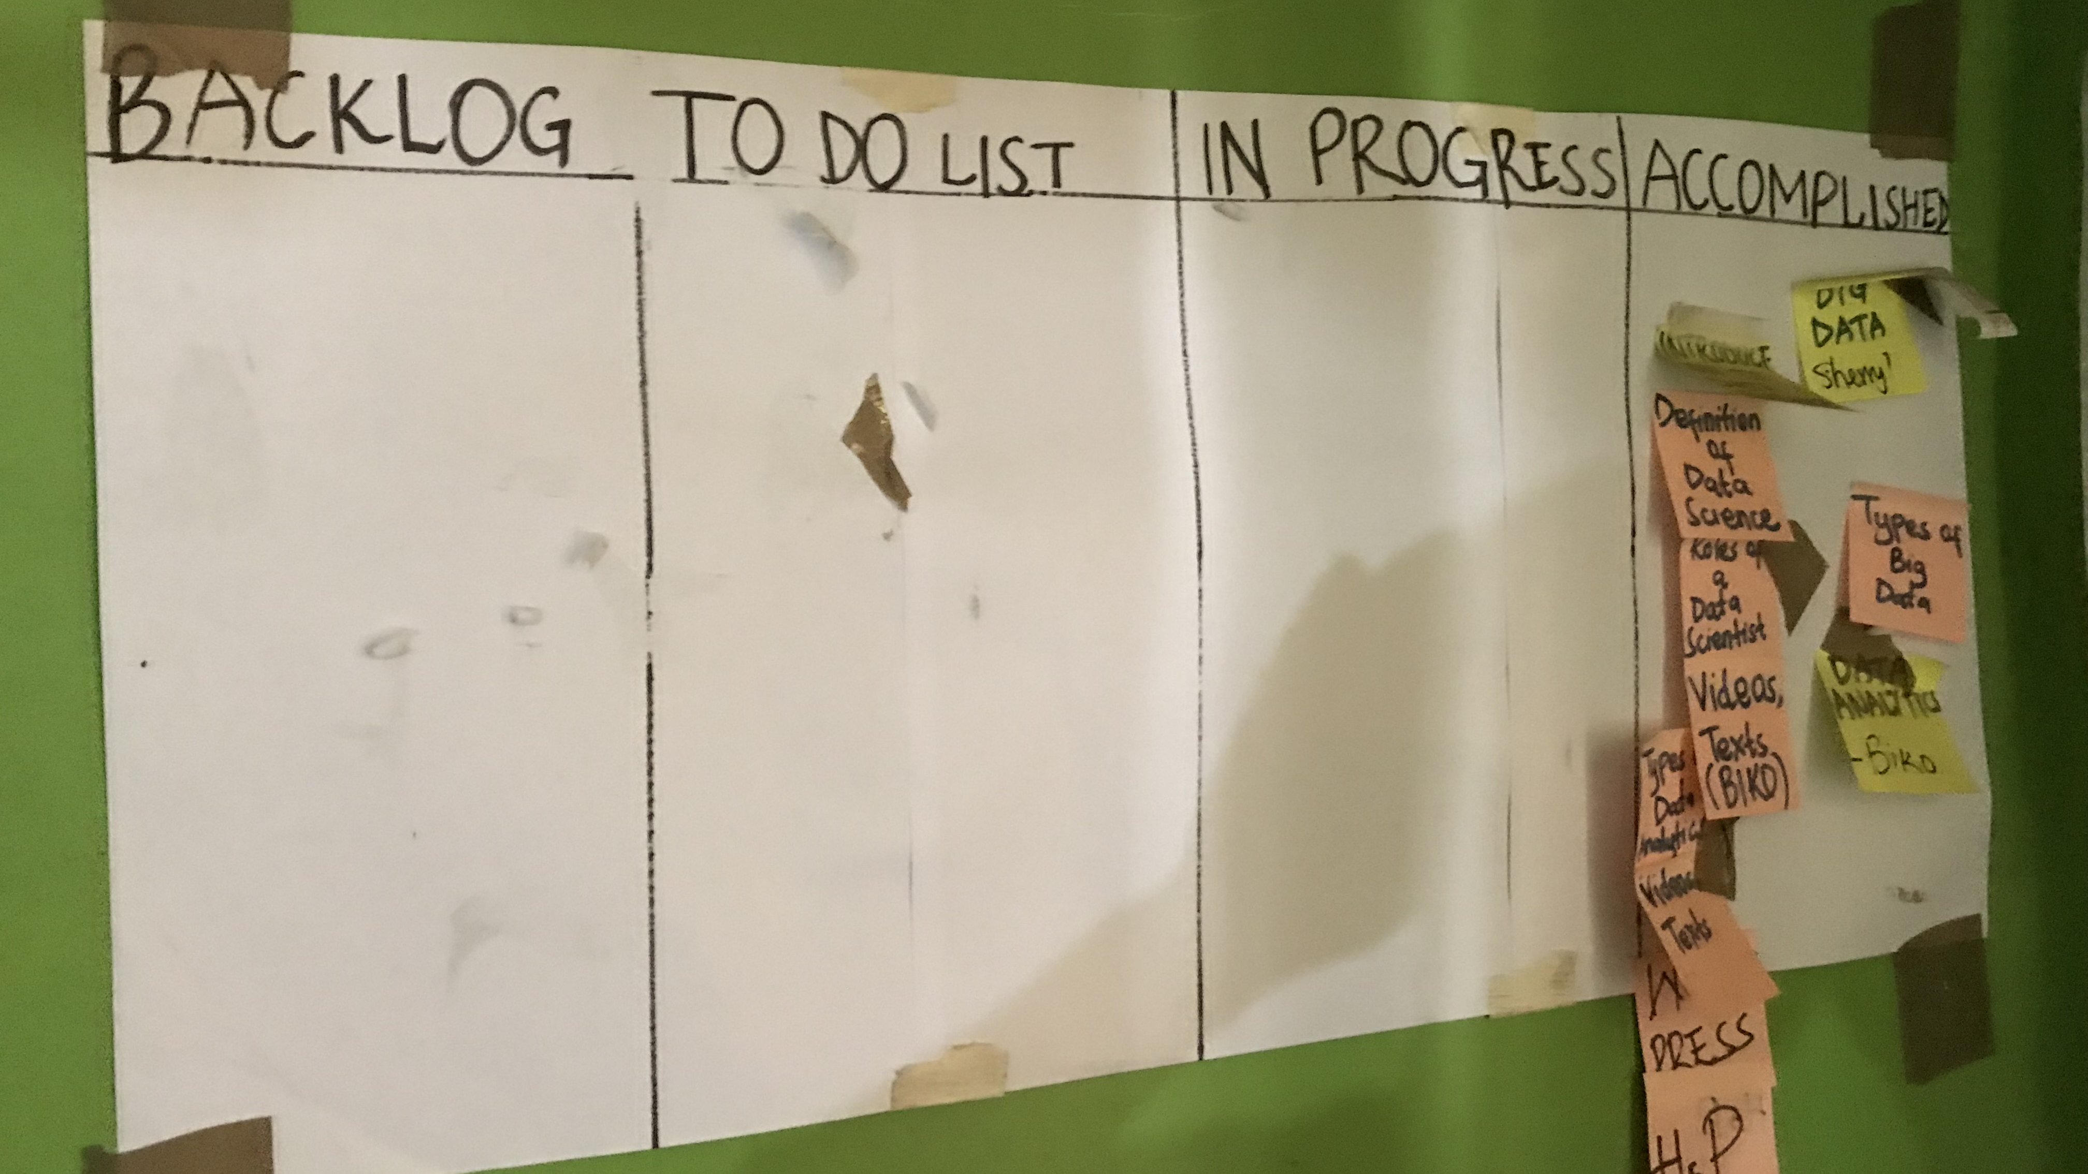
And even in the informal settlement of Kibera, I found an incubator that is training young people from the streets in programming and agile working methods.

Slide 7
I learned about leap frogging innovations, such as mobile money service mpesa,

Slide 8
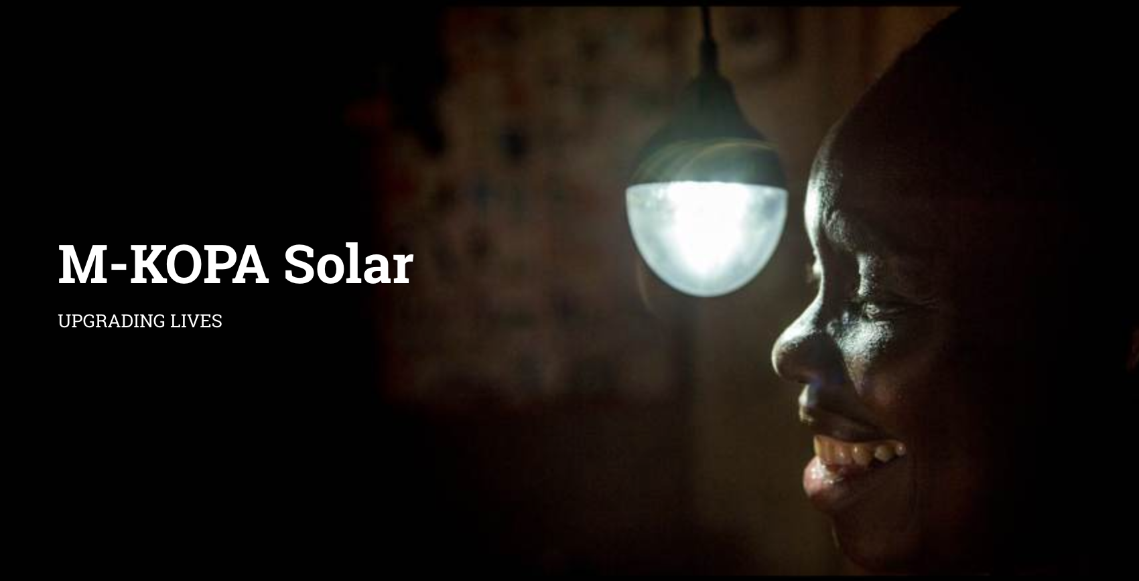
solar power provider mkopa

Slide 9
or the largest cargo drone service zipline that is delivering blood, vaxinations, and medicals all over the countries of Rwanda and Ghana within minutes through autonomously flying drones, serving 13Mio people with instant access to urgent medicines.

Slide 10
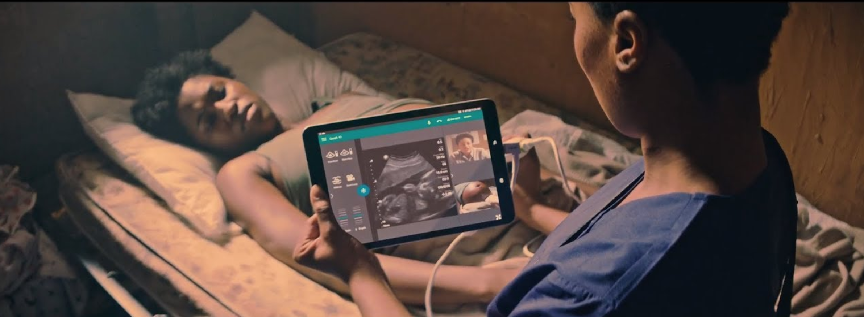
I'm really happy that Hannes is joining us here today to tell us more about his startup Ilara Health.
And there is many, many other exiting projects being developed in Africa at the moment.

Slide 11
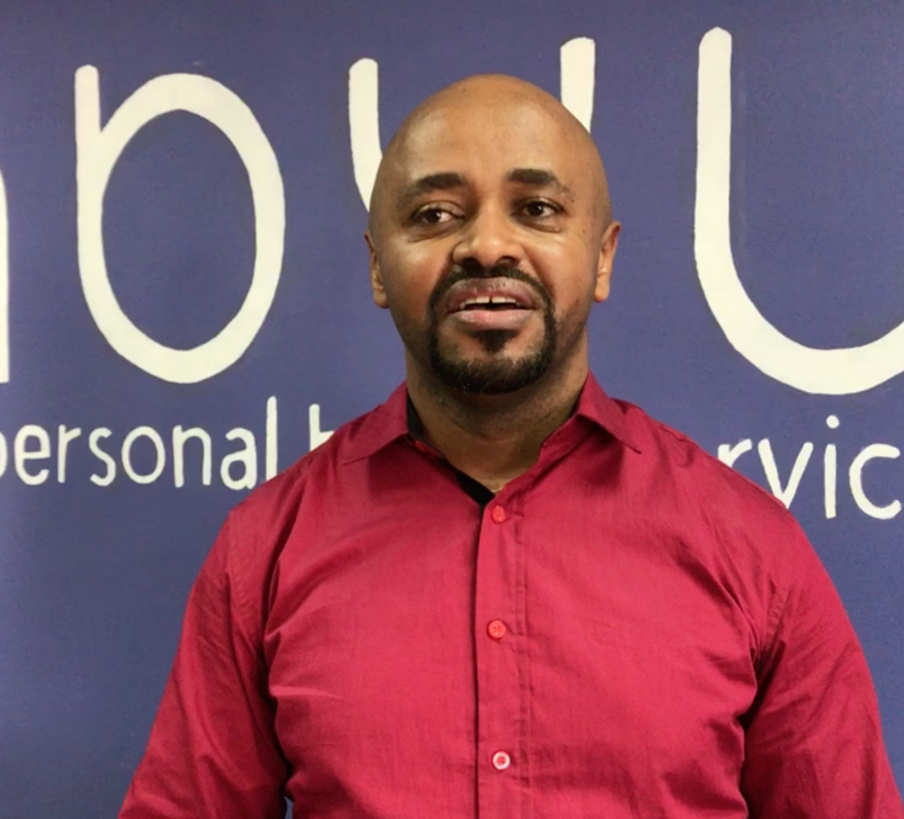
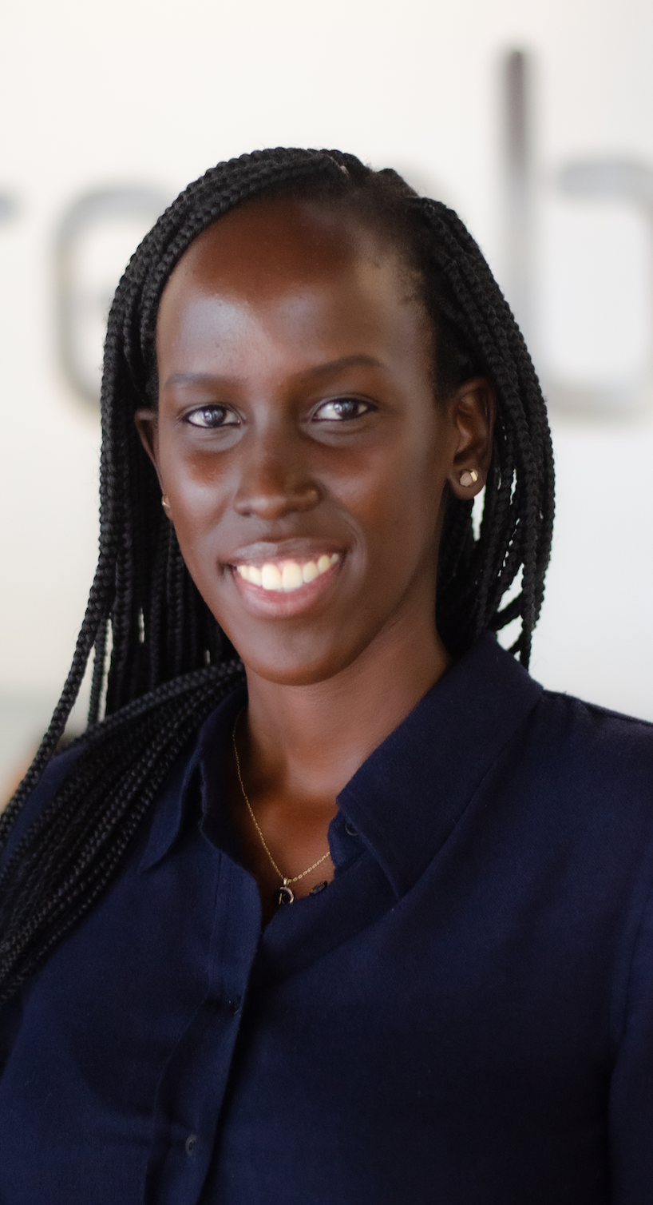
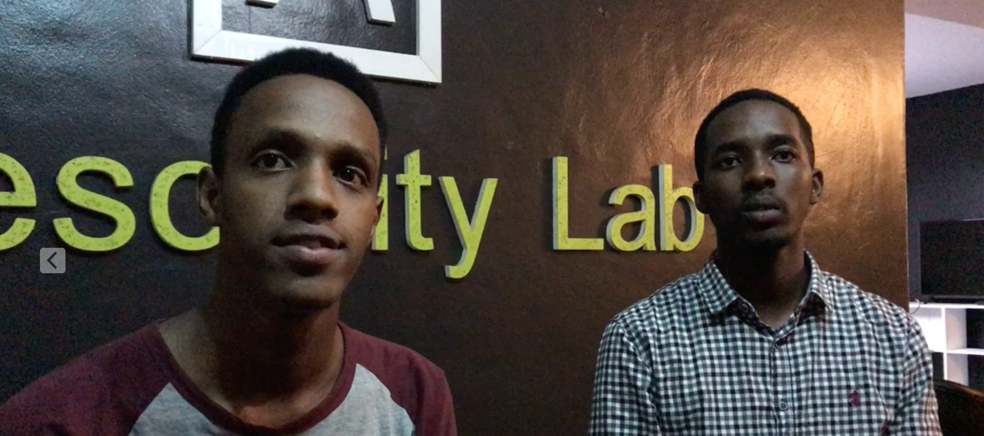
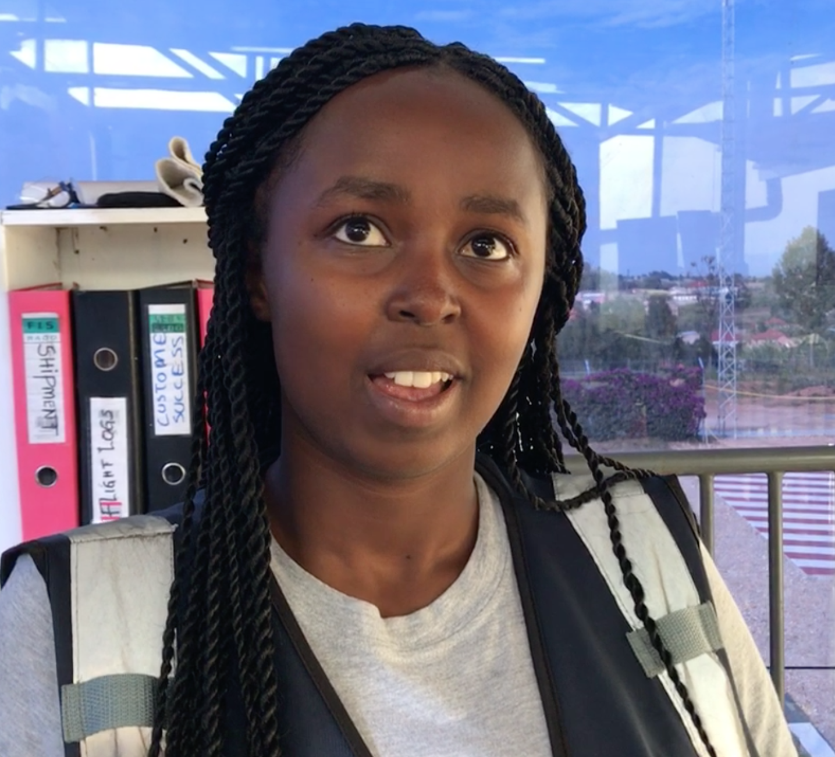
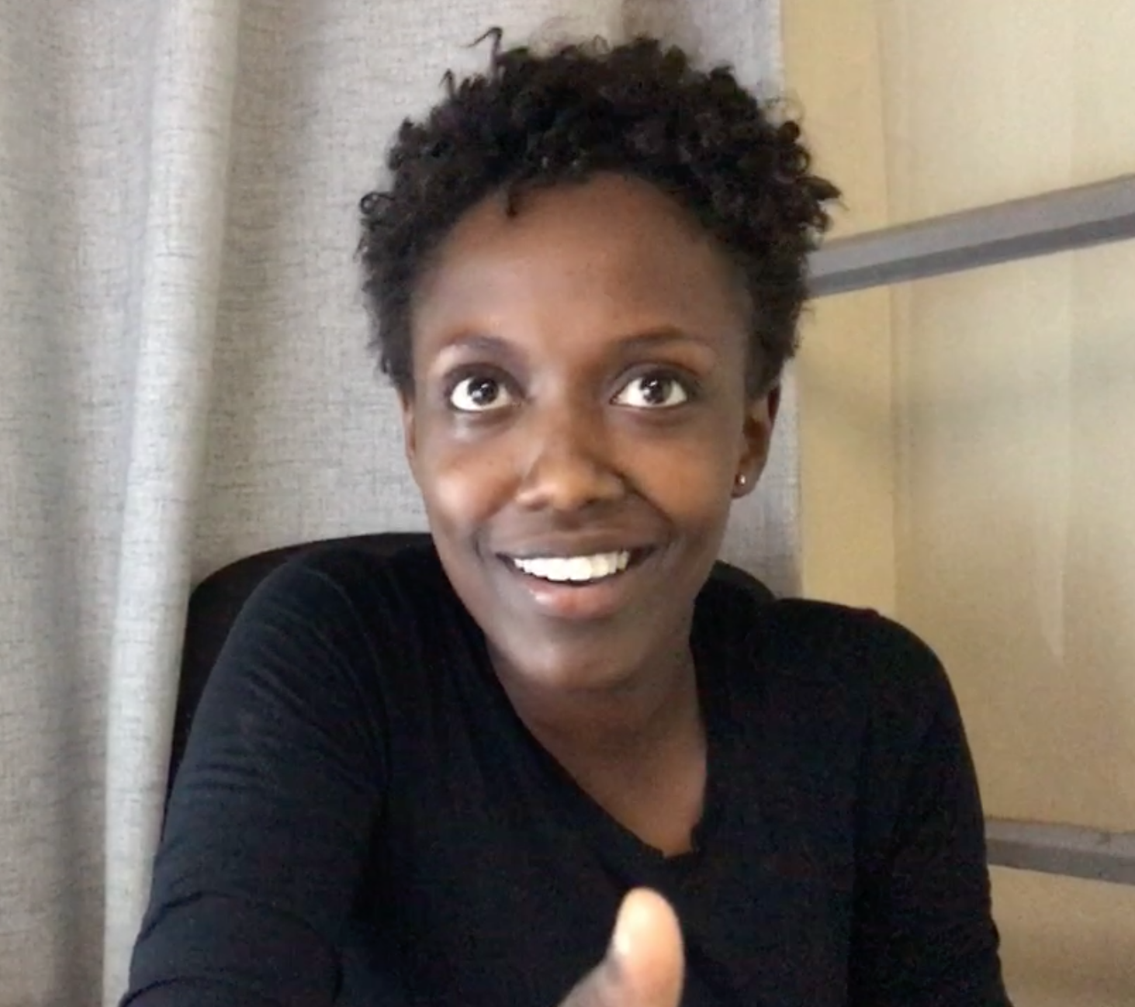
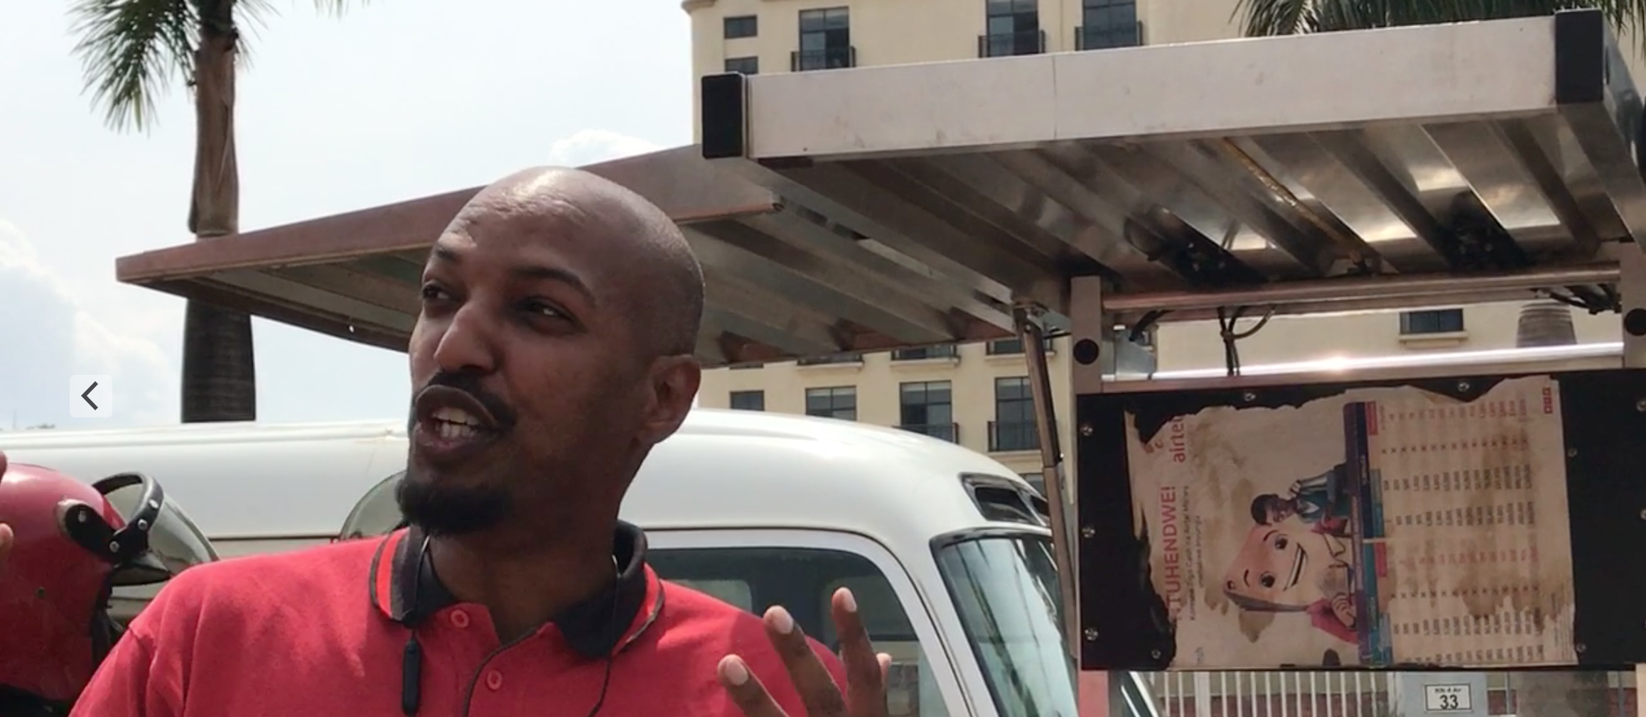
Next to leapfrogging innovations, I also met a very young, yet entrepreneural, well educated, responsible and heavily growing population.
A growing middle class and a huge demand of a newly interconnected society that is now becoming part of a globel digital economy.

Slide 12
A culture that, thanks to digital connectivity, is becoming more transparent on a global level, showing the richness, extreme diversity and strengths of Africa, for example in fashion, music, design, world views and traditions.
An adaptive mindset that might be able to address climate change and is thinking in nonlinear, out-of-the-box approaches.
That will be so much needed for the next centuries.
Since then I keep sharing my experiences, not just with MBA classes at this university, but at every occassion that I can find to spread the news and wake up my entrepreneural colleagues so they start realising the huge window of opportunity that has just opened up on solving REAL problems on big scale.

Slide 13
SAY HELLO:
bernhard.hoetzl@funkensprung.com

