Slide 1

How can specialized dictionaries account for variation and the dynamics of understanding?
4th WU Symposium on International Business Communication
Dictionaries and Beyond
April 6 – 8, 2011
WU Vienna
Rita Temmerman
Centrum voor Vaktaal en Communicatie (CVC)
Erasmus University College Brussels

Slide 2
The Dictionary of the
Third Millennium?

Slide 3
The ideal dictionary
‘I will be shamelessly selfish and ask for the impossible. I will advocate for a dictionary that will always adapt to my needs and always be ready to provide me with exactly the answer that I need and will also agree with. I also expect the dictionary to be able to give satisfactory answers to those questions that I forget to ask.’ (Varantola 2002: 31)

Slide 4
More and better
‘[T]he direction in which electronic lexicography is moving is exactly this: towards more content, more flexibility and customisation, more user-friendliness, better access and more connectivity with other sources of knowledge, lexicographic and beyond.’
(Sobkowiak 1999: 275)

Slide 5
A huge web
Zaenen (2002: 232–5) mentions Pustejovsky’s Generative Lexicon, Fillmore’s Frame Semantics, Miller’s WordNet or Mel'čuk’s Meaning-Text lexical functions. In each of these semantic formalisms ‘the lexicon is viewed as a repository of thousands of concepts and words linked to one another in a huge web’ (Fontenelle 2000: 230).

Slide 6
Metaphors underlying present day dictionaries and beyond:
NETS and WEBS and CLOUDS

Slide 7
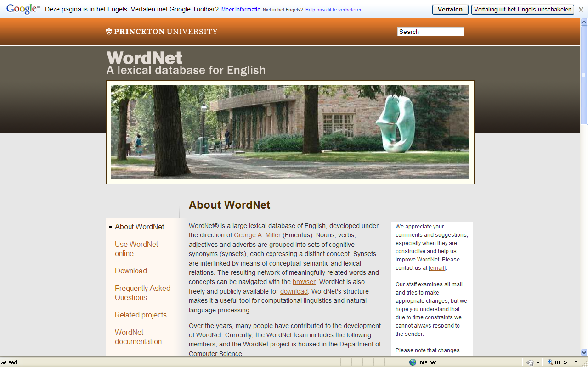

Slide 8
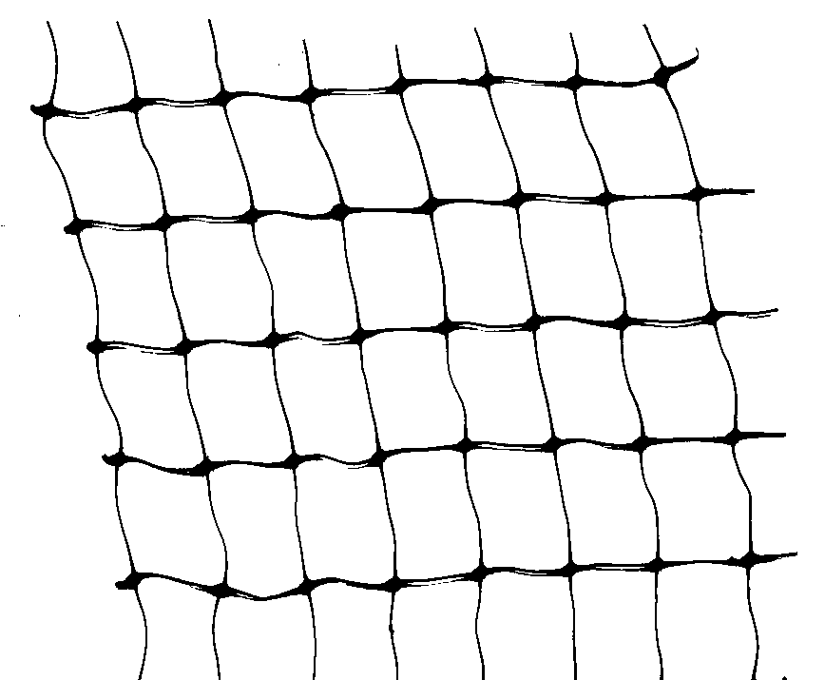
WordNet (Fellbaum, 1998)
A lexical knowledge base of the English language
http://wordnetweb.princeton.edu/perl/webwn
Offers a number of synonym sets, organised into a hierarchy (hyponyms, hyperonyms)
Each synonym set is associated with a brief natural language description

Slide 9
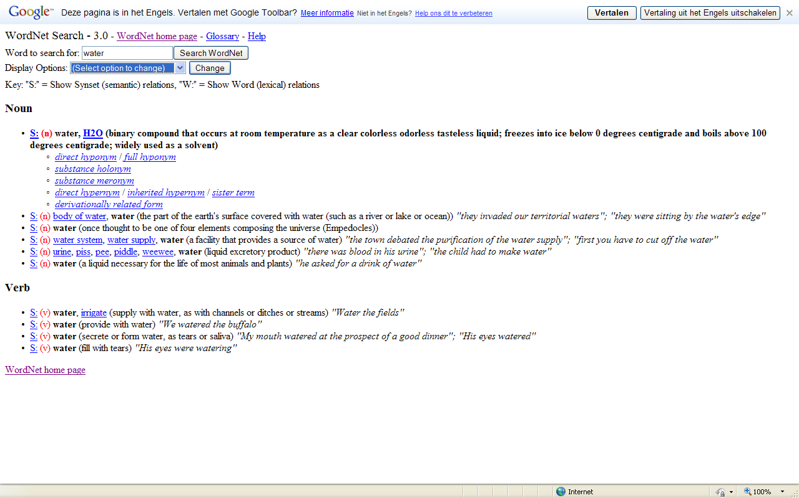

Slide 10
Framenet
The Berkeley FrameNet project is creating an on-line lexical resource for English, based on frame semantics and supported by corpus evidence.
The aim is to document the range of semantic and syntactic combinatory possibilities (valences) of each word in each of its senses, through computer-assisted annotation of example sentences and automatic tabulation and display of the annotation results.
The major product of this work, the FrameNet lexical database, currently contains more than 11,600 lexical units, more than 6,800 of which are fully annotated, in more than 960 semantic frames, exemplified in more than 150,000 annotated sentences.
It has gone through five releases, and is now in use by hundreds of researchers, teachers, and students around the world.
http://framenet.icsi.berkeley.edu/index.php?option=com_frontpage&Itemid=1

Slide 11
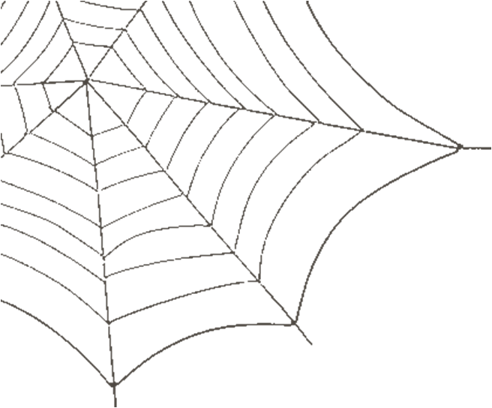
The Semantisch Web
The Semantic Web is not a separate Web but an extension of the current one, in which information is given well-defined meaning, better enabling computers and people to work in cooperation
The Semantic Web will bring structure to the meaningful content of Web pages, creating an environment where software agents roaming from page to page can readily carry out sophisticated tasks for users
Tim Berners-Lee, James Hendler, and Ora Lassila. Scientific American (May 2001)

Slide 12
Towards intelligent agents
I have a dream for the Web [in which computers] become capable of analyzing all the data on the Web – the content, links, and transactions between people and computers. A ‘Semantic Web’, which should make this possible, has yet to emerge, but when it does, the day-to-day mechanisms of trade, bureaucracy and our daily lives will be handled by machines talking to machines. The ‘intelligent agents’ people have touted for ages will finally materialize.
– Tim Berners-Lee, 1999

Slide 13
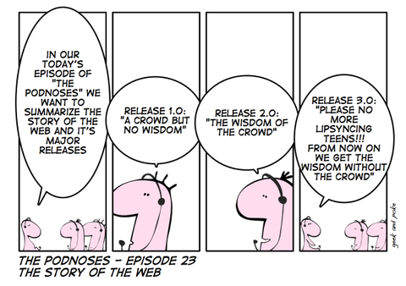
Web 3.0

Slide 14
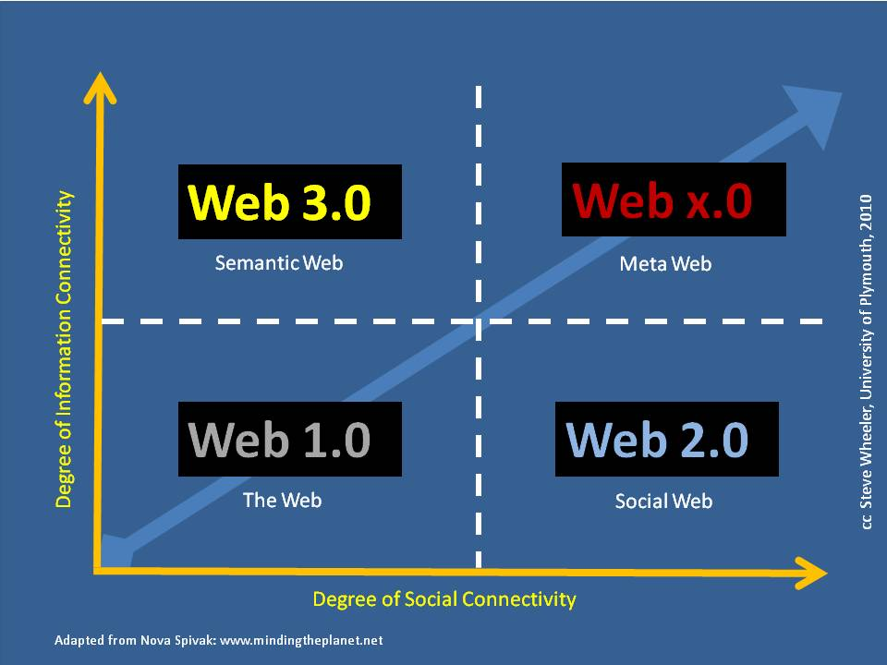

Slide 15

Word clouds
http://tagcrowd.com/

Slide 16
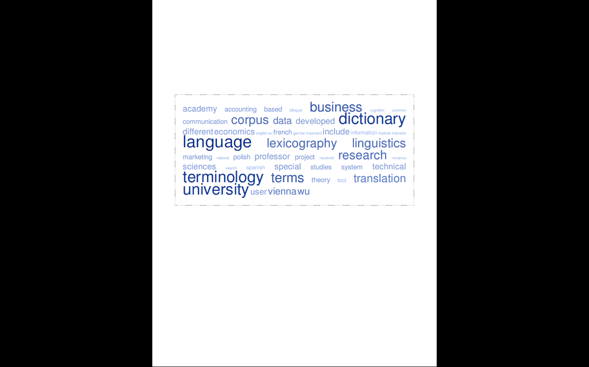
Wordcloud for 4th WU symposium

Slide 17
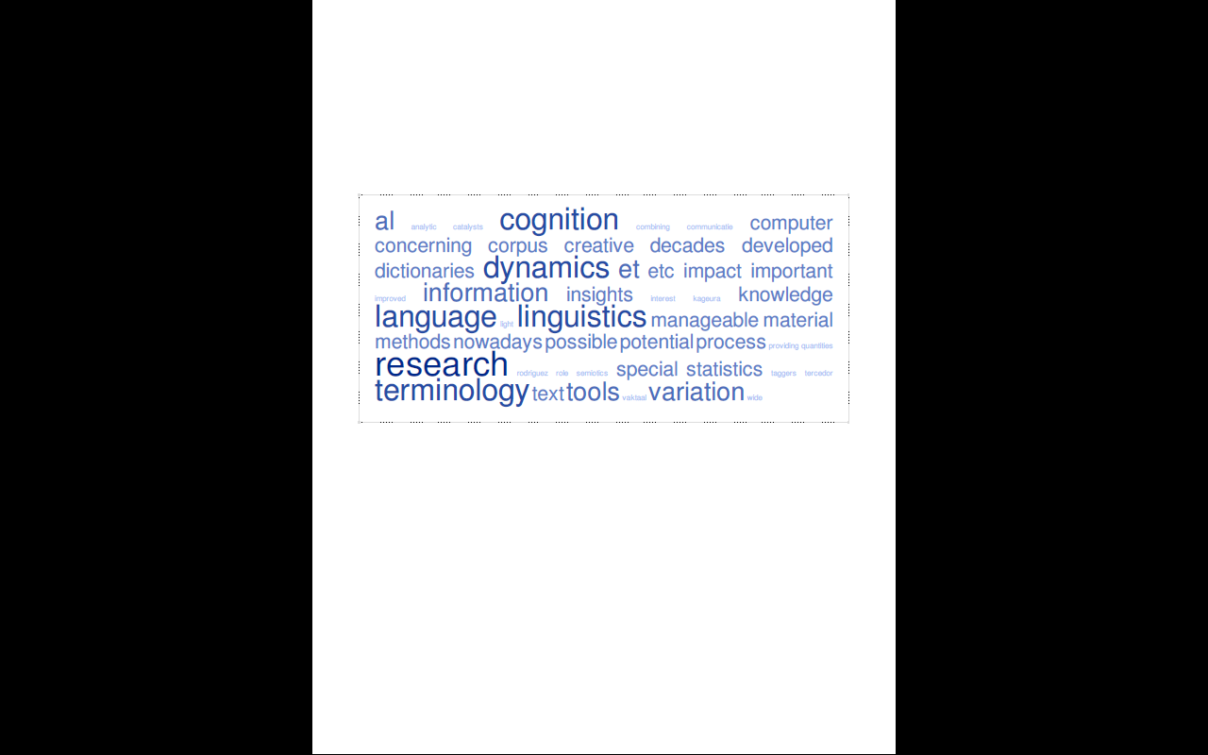
Wordcloud my abstract

Slide 18
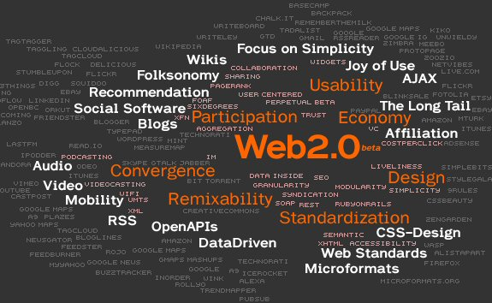
Web 2.0

Slide 19
Dynamics of cognition and terminological variation in special language dictionaries

Slide 20
In this talk we will concentrate on how new insights concerning the dynamics of cognition and terminological variation are likely to influence the contents and form of terminological dictionaries.
Terminology 17(1) 2011 The dynamics of terms in specialized communication. An interdisciplinary perspective.
(eds. R. Temmerman & M. Van Campenhoudt)
Meta (2011) Corpora, specialized translation and dictionaries
(eds. M. Van Campenhoudt & R. Temmerman)

Slide 21
First we need to emphazise that:
New since a few decades is that computational processing of texts is possible now and that large quantities of textual information is at our disposal, also - and most importantly nowadays - via the world wide web, thus providing materials for detailed observation.

Slide 22
Scope for research has grown
The computer has revolutionized the possibilities for organizing, distributing and accessing information. Now that so much information has been made machine-readable, the scope for research has grown tremendously.
Moreover new techniques for making the vast material manageable have seen the light.
  Free text searching has been improved by linguistic and statistical methods.
  The analytic and descriptive tools developed in corpus linguistics (lemmatizers, syntactic parsers, POS taggers and annotation tools, term (also multiword) extractors, etc.) have had their impact on research methodologies for terminology researchers

Slide 23
What corpus linguistics did for research in terminology
1. Research into morphosyntactic and semantic variation
2. Research into automatic extraction of terms and phrases (multi-word units, formulaic sequences, collocates)
3. Research into markers like « is a type of » indicating hyponymy; « is composed of » or « contains » indicating meronymy. A list of markers for e.g. cause-result can be used by corpus annotation tools
Desmet, Isabelle (2011 forthcoming)

Slide 24
Recent topics in terminology studies
1. Terminology in texts: terms, texts and linguistic contexts
2. Terminology in social, sociocognitive and cultural contexts : terms, cognition, culture and society
3. Variation of terminology is studied in multilingual contexts, in discourse, framings and settings
4. Diachronic study of terms

Slide 25
Enrich dictionaries thanks to corpus research
Bertels, A. & S.Verlinde (forthcoming) show how new approaches in corpus analysis could enrich traditional lexicographic descriptions.
They examine a set of trend verbs, i.e. verbs indicating an increase, in English, French and Dutch, building on several analyses of parallel corpora and targeted monolingual corpora.
  The parallel corpora, on the one hand, provide information on the frequency and equivalence of translations. MDS (MultiDimensional Scaling) analyses on this quantitative data yield interesting results in terms of verb translation profiles.
  The monolingual corpora in the target language, on the other hand, allow them to refine these results and to extract salient collocates, showing the combinatorial properties of trend verbs. The results of all these analyses, offering insight on translation profiles and lexical profiles, can be used to enrich traditional lexicographic descriptions in translation dictionaries.

Slide 26
Knowledge rich contexts
The linguistic and cognitive shifts in terminology studies has led to a more discourse-centered approach with a focus on how terms are used in texts.
Terminological knowledge bases have an underlying network of semantic relations. Such a network can be derived from corpus analysis and the extraction of terminological units and semantic relations from knowledge-rich contexts (Meyer, 2001).

Slide 27
Towards the terminological dictionary of the third millennium: dynamicity and variation

Slide 28
Examples of dynamics in specialised dictionaries

Slide 29
Dynamicity
In the past semantic relations in termbases were mainly restricted to generic-specific and part-whole relations representing static configurations.
According to Faber et al. (2009:1) terminological knowledge bases can acquire greater coherence and dynamicity when:
(1) a frame-based structure is used as the top level representation for all concepts
(2) a wider range of conceptual relations are contemplated, some of which may be domain-specific.

Slide 30
Dynamic terminological database
  EcoLexicon:
  http://manila.ugr.es/visual/

Slide 31
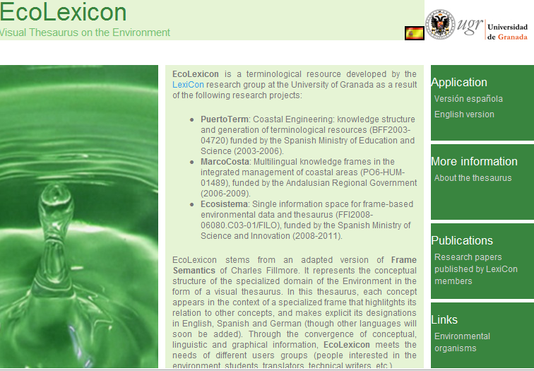

Objetivo de una definición
Explicitar la pertenencia de un concepto en una categoría conceptual
Reflejar sus relaciones con otros conceptos dentro de la misma categoría
Especificar atributos y características esenciales

Slide 32
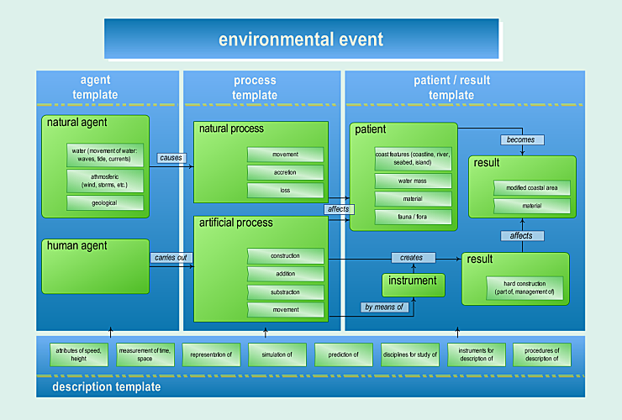
Notes:
The content in EcoLexicon is organized in such a way that it goes from very general to more specific levels. The most generic level is the Environmental Event (EE), which provides a frame for the organization of all concepts in the knowledge base.
The EE is conceptualized as a dynamic process that is initiated by an agent (either natural or human). This process affects a patient(an environmental entity) and produces a result These categories (agent, process, patient, etc.) are the concept roles characteristic of this specialized domain. Additionally, there are peripheral categories which inlcude instruments that are typically used during the EE, as well as a category where concepts of measurement, analysis and description of the processes in the main event are included. This event-based representation facilitates knowledge acquisition in text processing since conceptual categories are bound together by event knowledge

Slide 33
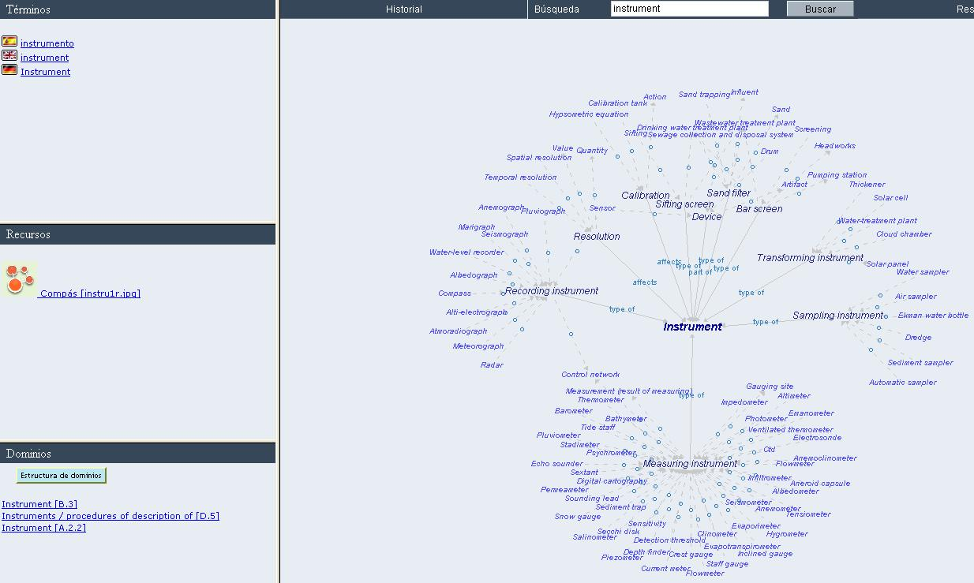
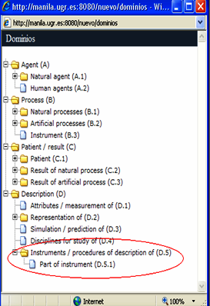

[INSTRUMENT]

Slide 34
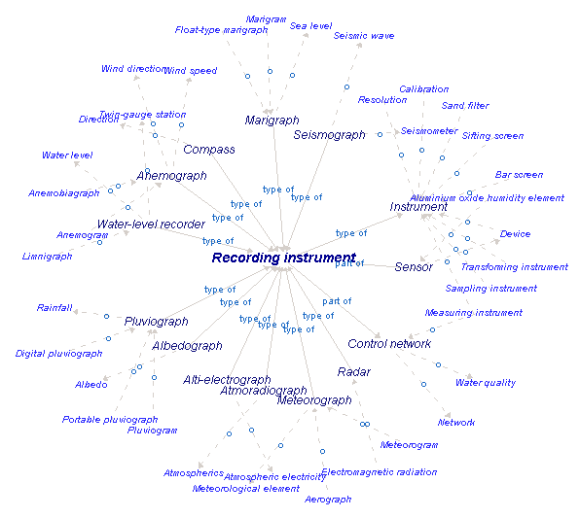
Instrument Recording instrument Mariagraph
Float-type mariagraph

Slide 35
[INSTRUMENT]

Slide 36
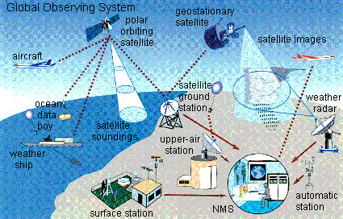
RECORDING INSTRUMENT
 |  | collect information [HAS_FUNCTION]

Slide 37
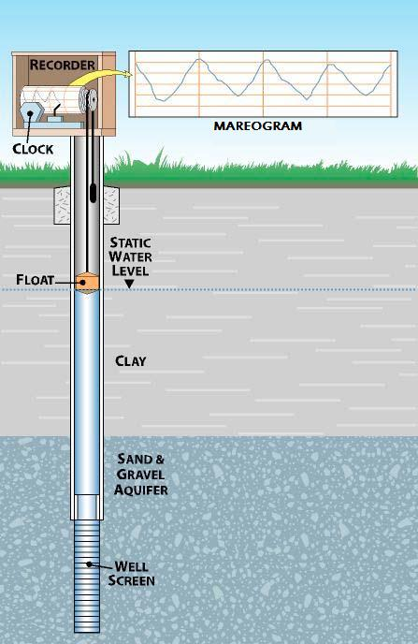
MARIAGRAPH
 | recording instrument [ISA] clock, float, counter weight [PART-OF] harbour, port, tidal marsh [LOCATION-OF] mareogram [RESULT-OF]

Slide 38
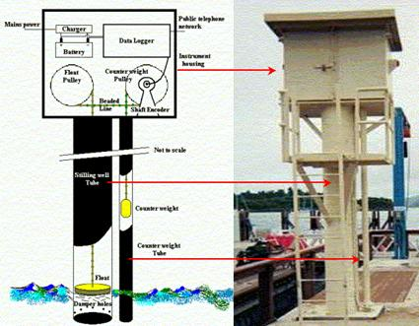
FLOAT-TYPE MARIAGRAPH
 |  | tide gauge [IS-A]

Slide 39
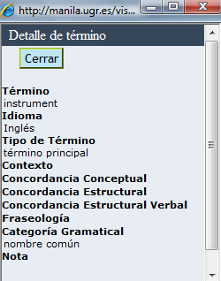
[INSTRUMENT]

Slide 40
Dynamics of terminology in society
In “Shifts in the Concept of War: New War Terminology and its Legal Consequences” Hanneke van Schooten shows that expressions like a state is at war and declaration of war (as e.g. contained in the Dutch Constitution) have fallen into disuse. Conflicts are now described as police actions, peacekeeping operations, missions, armed conflicts, a terminology often leading to confusion.
Van Schooten, H 2009

Slide 41
Dynamics, diversity and context in legal terminology
In “Legal Terms across Communities: Divergence behind Convergence in Law” Le Cheng and King Kui Sin (2009) claim that even though legal terms are generally considered to have self-referential meaning, most of them acquire their meaning in a given context. The authors argue that legal terms do not carry inherent meaning but only denote in a particular temporal and spatial context. Jurisprudence seeks how meaning was created. Using data from mainland China, Hong Kong, Macau and Taiwan, the authors demonstrate diversity and try to defend legal terms as signs while at the same time showing that it is necessary to tolerate terminological diversity.

Slide 42
Diversity of context and variation
Meaning is acquired in context, more specifically, within a frame including a semantic and pragmatic background. Within the domain of the environment, Reimerink et al. select and manipulate multimodal information to offer two kinds of contexts to the end-user:
1. FrameNet-like contexts, more specifically, sentences showing the different syntactic constructions of the frame elements and the target predicate;
2. combined contexts, including knowledge-rich linguistic contexts coupled with knowledge-rich visual contexts, which provide a comprehensive view of related processes and specialized lexical units.
In the TKB EcoLexicon, the resulting multimodal contexts are structured in terms of specific frames and general events. Thus, the end-users have the possibility to find both cognitive and communicative information, which is selected according to the user’s level of expertise.
Reimerink, A. and M. García de Quesada and S. Montero-Martínez. 2010. “Contextual information in terminological knowledge bases: A multimodal approach” Journal of Pragmatics 42(7) 1928–1950

Slide 43
Research questions in terminology

Slide 44
Anne Condamines (forthcoming)
The methods used in corpus linguistics are very relevant in order to analyze how terminology works within texts.
She studies the emergence of a new field, i.e. exobiology.
Condamine shows how three types of clues (formal, quantitative and distributional) are used in order to identify polysemy, synonymy or loanwords.

Slide 45
Dancette (forthcoming Meta 2011)
The inclusion of a large number of semantic relations (SRs) in specialized multilingual dictionaries, facilitated by leveraging the huge capabilities of information technologies for corpus processing, is a new avenue in terminography.
This contribution discusses the integration of complex SRs into two multilingual dictionaries, one in the field of retail sales, and the other in global economy.
The dictionaries discussed illustrate the idea that classes of SRs can reflect the conceptual structure of a given field. Whereas some classes are canonical and common to all fields (relations of generic, specific, part/whole, agent), many are domain-specific.
The aim of this contribution is to show how the dictionary’s semantic structure can help users manage their knowledge and facilitate the retrieval of information according to their own needs.

Slide 46
KRISTIAENSEN AND DOMAIN DYNAMICS Terminology 17(1) - 2011
Organisational Behaviour, Financial Accounting and Crisis, Restructuring and Growth

Slide 47
Kristiaensen (2011)
Kristiaensen discusses how scholarly areas are subject to different kinds of external pressure resulting in both concept and term changes.
Examples from three different economic-administrative domains i.e. Organisational Behaviour, Financial Accounting and Crisis, Restructuring and Growth. All three are subject to external pressure which causes both concept and term changes.
However, she finds that the factors causing the knowledge development are quite different

Slide 48
Three domains were investigated
  Organisational Behaviour
  Financial Accounting
  Crisis, Restructuring and Growth.
The examples from the domains are discussed in relation to degrees of cognitive change; gradual change, revolutionary change and change resulting from a complex problem solving process, respectively.

Slide 49
Economics and Business Administration
Economics
Micro-economics
Finance and Management Science
Strategy and Management
Macro-economics
Management Accounting
Financial Accounting
Organisational Behaviour (OB)
Crisis, Restructuring and Growth
1
3
2

Slide 50
Selection of corpus material
Typically, the scholarly areas will be represented in textbooks which comprise common theories, methods and concepts of the domain. In the analysis of the concept and term dynamics of Organisational Behaviour, textbooks aimed at students at university level have therefore been selected
When analysing the second domain of Financial Accounting, the recent international standards of financial reporting (IFRS) and accounting (IAS) have been used as corpus material. Furthermore, the Norwegian accounting acts of 1999 and 2005 have provided material for cross-cultural comparisons.
For the analysis of the third domain of Crisis, Restructuring and Growth, the Norwegian Newspaper corpus (NNC; http://avis.uib.no/) has been used to extract the most updated terminological information in Norwegian.

Slide 51
Standards
For Financial Accounting, textbooks are no longer the most reliable source of updated terminological data.
Instead, international standard-setting documents, national legislation and accounting practices should be investigated to produce current representation of its concepts and terms.

Slide 52
IAS & IFRS
The changes in Financial Accounting may to a great extent be attributed to supranational political measures.
The more global international trade and industry has become, the greater the need has become to have transparent and comparable financial reports.
This has been one of the motives for the European initiative to harmonize the presentation of financial statements of public limited companies, through the international accounting standards (IAS) and the international financial reporting standards (IFRS) adopted by the EU in 2002.

Slide 53
International communication
The international accounting standards, which have been implemented globally, have been prepared using the English language.
Thereafter, the standards have been translated into various national languages, like Norwegian.
The greatest challenge in this adaptation process has not been to choose the best terminology to denote the various accounting concepts, but to delineate the concepts in such a way that the adaptation to a national accounting legislation is successful.

Slide 54
International harmonisation: culture-free concepts
International harmonisation presupposes that the concepts of the standards are culture-free, i.e.
  the content of a set of concepts described in the international standards are understood the same way when it comes to inherent characteristics across nations and accounting practices
  the whole conceptual apparatus, including all concepts and their relations are the same. This is a necessary condition for the standards to be convergent and transparent.
The obvious proof of such transparency would be that the terminologies used in the national-adopted standards are equivalent across countries.

Slide 55
Complex problem solving in Crisis, Restructuring and Growth
A project at NHH on the financial crisis based on newspaper analysis.

Slide 56
variation
In the financial crisis period of 2007-2010, the analysis shows that several related concepts exist in addition to financial crisis, with several term variants (frequencies are added in the brackets):
  finanskrise [financial crisis; 2064]
  økonomisk krise [economic crisis; 739]
  nasjonal krise [national crisis; 40]
  norsk krise [Norwegian crisis; 6]
  finansiell krise [financial crisis; 57]

Slide 57
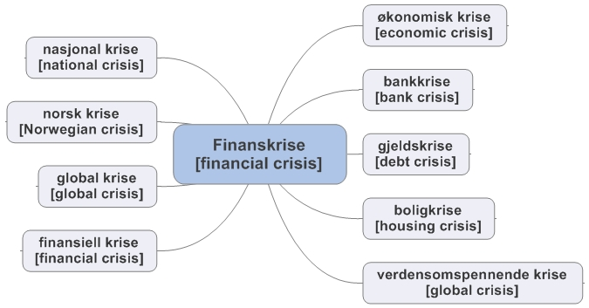
Financial crisis: variation

Slide 58
Subprime & hedge fund
The situation with rising defaults on subprime mortgages in the US is said to have triggered the global financial crisis. In particular, hedge funds and banks all over the world were suddenly exposed and the financial crisis became a fact.
Although appearing frequently in Norwegian newspapers in the period of the financial crisis, the content of the two concepts have not really been delineated yet in a Norwegian setting, and a number of terms or expressions are used to represent the concept : VARIATION

Slide 59
Culture bound
as subprime and hedge fund are subject to both national monetary policies and national and/or international financial markets regulations, respectively
the interpretation of hedge fund is still being discussed in Norwegian courts in the wake of national security scandals caused by speculative investments by Norwegian municipalities.

Slide 60
Pedro A. Fuertes-Olivera and Sandro Nielsen Terminology 17(1) - 2011
DYNAMICS OF TERMS IN ACCOUNTING: evocative terminology in translation

Slide 61
Pedro A. Fuertes-Olivera and Sandro Nielsen
what the construction of the accounting dictionaries reveals about metaphorical terms in culture-bound subject fields.
The authors discuss a network of internet dictionaries in English, Danish, and Spanish.
They discuss strategies for translating English metaphorical terms into Spanish assuming that bilingual accounting dictionaries should use similar terms in both source and target languages.

Slide 62
Evocative language in translation
acronym: coincidence mnemonic aid: PIGS
metaphors: examples
  transactions made at arms length
  thin capitalisation
  hedge fund

Slide 63
A case study: the translation of English metaphorical terms into Spanish
‘Spanish PIGS’(cerdos): the English acronym PIGS (it stands for Portugal, Italy, Greece, and Spain) is frequently used by Spanish conservative newspapers to criticise the economic policy pursued by Spain‟s socialist government.
the acronym PIGS is a lemma in the Spanish Accounting Dictionary compiled by Fuertes and Nielson and has been defined without mentioning its connection with English pig.
They have included a usage note that describes the metaphorical mappings of this acronym in contemporary Spanish based on the potential of metaphors to frame social discourse:

Slide 64
PIGS
definición
PIGS es un acrónimo formado en ingles por las iniciales de Portugal, Italy, Greece, y Spain que utilizan los mercados financieros para referirse a estos cuatro países que comparten algunas magnitudes y características económicas, como formar parte del euro y estar muy endeudados.
Nota de uso
Es frecuente encontrarnos con referencias a este término en las que se traduce el acrónimo PIGS por cerdos, el término español para pigs. Normalmente estas referencias indican una intencionalidad política asociando la palabra cerdos a una serie de decisiones de política económica que favorecen el incremento del déficit de una economía.

Slide 65
Metaphors in translation
arm’s length
Definition
If transactions are made at arm's length, the transactions are conducted on terms and at prices that would have applied if the transactions had been made between knowledgeable, willing, independent parties.
en condiciones de igualdad
Synonym
A precio de mercado

Slide 66
thin capitalisation
subcapitalización
Synonym
capitalización delgada
Usage note
Spanish accountants prefer the Spanish term „subcapitalización‟ to the IAS/IFRS term „capitalización delgada‟. This literal translation is nonsensical in Spanish.
a novel metaphor introduced into Spanish by the translators of the international accounting standards. The solution F. & N. have adopted consists in retaining the traditional Spanish accounting term as equivalent, presenting the IAS/IFRS term as synonym, and including a usage note that explains the difference between the two Spanish terms

Slide 67
hedge fund
fondo de cobertura
Synonym
hedge fund
The use of hedge in the English expression indicates that the fund is used to protect investors against potential and unknown dangers – ‘to keep trespassers out’ in the literal sense of the word. Its Spanish equivalent is ‘fondo de cobertura’, which has a similar metaphorical association between its literal translation ‘seto’ (a physical object) and its mapping onto the abstract ‘cobertura’ (something you put over something in order to hide it, protect it, or close it). Although ‘fondo de cobertura’ is easily understood by Spanish speakers, we have included the English term as synonym because it is frequently used in Spanish accounting texts

Slide 68
Translate from evocative to neutral?
F & N propose solutions to some of the decisions lexicographers and terminologists have to take when translating English metaphorical terms into Spanish based on two basic assumptions of the dynamics of terms.
The first one consists in offering neutral Spanish terms, i.e., terms that do not smack of ideological motivations. This is especially relevant when translating metaphorical terms as the conceptual theory of metaphor has shown that metaphors are used to frame political and economic discourse.
The second assumption leads us to propose lexicographical practices that will retain the same conceptual scenario in the source and target metaphorical terms.

Slide 69
In conclusion
Where is « terminology studies » as a discipline going?
New technical developments make it possible to do original research
New possibilities to modernize and keep up to date the dictionary as a product,
  partly thanks to knowledge management techniques and the Web,
  partly thanks to human creative use of new insights and techniques

