Slide 1

Communication in International Projects:
An Evidence-based Framework for Conceptualising Intercultural Competence
Helen Spencer-Oatey
University of Warwick, UK

Slide 2


Overview
Overview
eChina-UK Programme & Global People (GP)
GP Intercultural Competency Framework
Analytic Foci of Studies of Intercultural Business Discourse
Global People: Communication Issues
Global People Resources

Slide 3

The eChina-UK Programme and the Global People Project

Slide 4
eChina-UK Programme
Set of Sino-British collaborative projects on eLearning in education
Funded by the Higher Education Funding Council for English (HEFCE) (£4 million) & supported by Chinese Ministry of Education
Involved British and Chinese universities working in partnership
The Programme has had 3 phases

Slide 5
Global People: Background
Phases 1 & 2: British & Chinese universities worked collaboratively on range of eLearning in education projects
Phase 1: 2003-2005.
Phase 2: 2005-2007.
Global People Project forms Phase 3 of the eChina-UK Programme
Phase 3: 2007-2009.

Slide 6
Global People: Background
Two of HEFCE’s Key Goals for the eChina-UK Programme:
Strengthen collaboration between China and the UK
Disseminate generic insights on a range of issues, including the benefits & challenges of working interculturally

Slide 7
Global People: Background
Phase 3 (Global People): 2008–2009
Key Aims:
Draw out learning from the eChina-UK Programme on working interculturally
Identify generic frameworks and models (i.e. not country specific)
Develop resources that are of practical value to those working in international projects (especially in HE)

Slide 8
Global People: Background
Phase 3 (Global People): 2008–2009
Procedure:
Review the literature on intercultural competence and on working across cultures
Analyse data from the eChina-UK Programme & Projects from an intercultural perspective
Collect new interview data from eChina-UK project members

Slide 9
Frameworks & Models
http://www.globalpeople.org.uk/
Life cycle model of intercultural partnerships
Learning process model
Competency framework

Slide 10
Frameworks & Models
http://www.globalpeople.org.uk/
Life cycle model of intercultural partnerships
Learning process model
Competency framework

Slide 11
Global People Intercultural Competency Framework

Slide 12
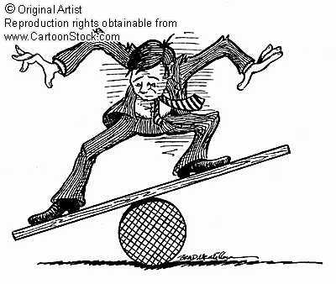
The Competency Framework
Intercultural collaborations are a delicate balancing acts
Our Competency Framework was developed to help raise awareness of competencies that facilitate intercultural work
It is grounded in the experiences of members of the eChina-UK Programme

Slide 13
The Competency Framework
Identifies four competency clusters
  Knowledge and Ideas
  Communication
  Relationships
  Personal Qualities and Dispositions
Explains each competency and discusses why it is important for intercultural effectiveness
Illustrates each competency with a case study example from the eChina-UK Programme (some of them supported by audio clips)

Slide 14
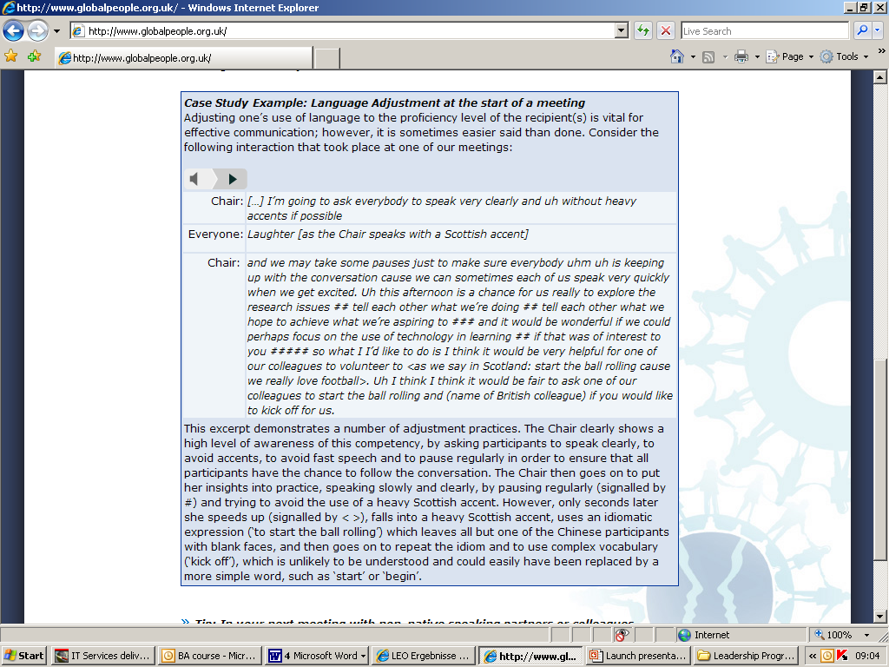

Slide 15
Analytic Foci of Studies of Intercultural Business Discourse

Slide 16
Analytic Foci
Choice of language/use of different languages (e.g. Cheng & Mok 2008; Du Babcok and Babcock 1996; Louhiala-Salminen 2002; Miller 1995; 2008; Poncini 2003; Rogerson-Revell 2008; Sunaoshi 2005)
Achieving Understanding of the Message (e.g. Cheng & Warren 2007; Du Babcok and Babcock 1996; Fung 2007; Marriott 1995; Miller 1995, 2008; Rogerson-Revell 2008; Sunaoshi 2005)

Slide 17
Analytic Foci
Communication Style (e.g. Li et al. 2001)
Management of Rapport/Construal of Relationships (e.g. Bilbow 1997; Gimenez 2002; Miller 1995; Poncini 2002; Spencer-Oatey & Xing 1998, 2003, 2004, 2008)

Slide 18
Global People:
Communication Issues

Slide 19
Communication: Language
English or Chinese?
Chinese 16: “I think we should show consideration for each other in terms of language. China is now developing very fast; they should know some Chinese to communicate with us. … We have learned a lot of English; it’s their turn to learn some basic Chinese, as it’s two-way
communication. I find it weird that they don’t know even a word of Chinese.”
他们应该懂中文

Slide 20

Communication: Language
Chinese or English?
Chinese 21: The working language was English. Due to the language problems, when we couldn’t express ourselves clearly, it seemed that we were disadvantaged.

Slide 21
Communication: Language Use
Meaning needs to be negotiated
British 09: When I first joined, I spent weeks if not months on a simply practical confusion as to what is a unit, a module, what was the other one?
British 06: Activity
British 09: There was no standard definition, so I was like blocked at the first hurdle, and so I wasn’t quite sure how much material I’d got to write … I thought I don’t understand this, I can’t do this.

Slide 22
Communication Issues
Many elements of Communication corresponded to the foci of the IC business discourse studies; i.e. The importance of:
  Language learning
  Language adjustment
  Active listening
  Attuning
  Stylistic flexibility

Slide 23
Communication Competency Cluster
Language learning
Language adjustment
Active listening
Attuning
Stylistic flexibility
Communication management
Building of shared knowledge (helps develop mutual trust)

Slide 24
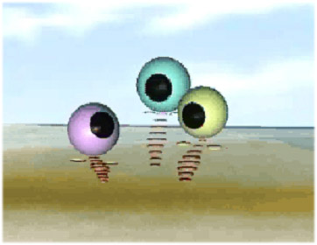
Communication: Management
Management of Channels of Communication
Chinese Researcher: In your opinion, was the communication effective?
Chinese 20: No, it wasn’t. Though both Chinese and British sides had their own project managers, they couldn’t do all the communications on their own. We should have embedded different communication mechanisms in the project at different levels.

Slide 25

Communication: Management
Attention to Communication Protocols
Chinese 06: The UK colleagues are more likely to raise issues directly. Their logic is that issues should be raised first, then they’ll try their best to find solutions. … Sometimes the UK project manager sent some suggestions to us. When we got the suggestion, we usually got
nervous and wondered ‘must we do it immediately?’ or ‘are they commanding us to do this?’ But working together with them for a while I gradually realised that I could voice my opinions too and take time to think. It wasn’t a problem.

Slide 26
Communication: Management
Attention to Communication Networks
Chinese 02: Sending mass emails is a good way. But when we send such emails, it will infringe Chinese principles. If I send such an email to a person in a higher position, s/he will feel offended. Nowadays we send various materials by email, but Chinese are special, superiors will feel particularly insulted. … Sending emails to superiors is not a good way, because it shows no regard for status differences between people. Some superiors dislike equality, so the best way to communicate with them is to submit a report, either in written or oral form.

Slide 27
Communication: Management
Finding the right person to talk to
Establishing the most effective modes of communication
Establishing suitable networks for communication distribution
Agreeing on choice of language
Establishing communication protocols

Slide 28
Communication: Establishing Shared Knowledge
Not all information can be encoded in language;
In IC interaction, people typically have less background knowledge in common;
Deliberately planning for the establishment of shared knowledge is vital.

Slide 29

Communication Competency Cluster
Language adjustment
Building of shared knowledge (helps develop mutual trust)

Slide 30
Global People Resources

Slide 31
Global People Resources
http://www.globalpeople.org.uk/
Life cycle model of intercultural partnerships
Learning process model
Competency framework
Range of publications (downloadable, free of charge)

Slide 32
Global People Toolbook
Rationale: Intercultural effectiveness is vital for the success of projects yet is often overlooked in the planning
Purpose: Provide a practical, step-by-step guide to managing the intercultural aspects of an international partnership

Slide 33
Global People Toolbook
Audience: Academics, project managers and other staff responsible for planning, managing or reviewing intercultural collaborations
Sources of Information: Broad research base, with authentic examples from the eChina-UK Programme

Slide 34
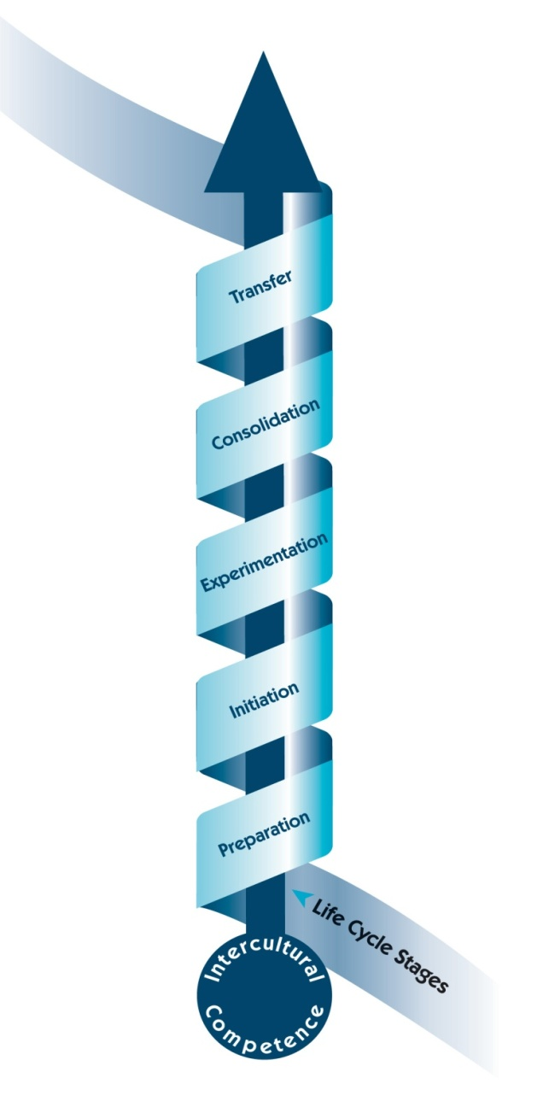
Global People Toolbook
Five-stage life cycle model
Preparation
Initiation
Experimentation
Consolidation
Transfer

Slide 35
Global People Toolbook
For each stage of the life cycle model:
Main Activities for the stage
Authentic Case Study from the eChina-UK Programme
Commentary on the case study – with reference to Core Competencies
Practical implementation Tips
Management and development Tool

Slide 36

Let’s take a quick walk through......

Slide 37
Stage 1: Preparation
Activities
Develop a vision
Research the context
Audit intercultural skills
Break the ice
Review channels of communication

Slide 38
Illustrated by..........
Case Study – early days of the eChina-UK Programme
Commentary – relates Activities to Case Study, showing how these operate in a real-life context, and identifies the intercultural competencies of most value to this Stage

Slide 39
For practical guidance....
Tips – A set of tips
Tool - 6 tools located in a Resource Section at the back of the Toolbook.
Team Resource Audit - a simple instrument for reviewing the intercultural (including language) skills in your (actual or desired) team

Slide 40

Active learning runs through the process

Slide 41
Learning Process Model
Highlights the importance of active learning in developing intercultural competence
Encourages project leaders to build reflection and knowledge-sharing into the project plan
Provides a simple 3-phase model to identify the core learning process
Provides examples of how to embed learning into the partnership experience
Acquisition-Awareness-Embedding

Slide 42
To sum up......
Research-based but focused on practice:
Grounded in international research
Activity-oriented
Illustrated with authentic case studies
Practical tips
Tools for individual and team development
Detailed complementary material on the website

Slide 43
Global People Website
Provides an insight into:
  What the project is about
  Who it is for
  Why intercultural competence matters
Provides further research-based information and resources, including extensive authentic examples.

Slide 44







Slide 45
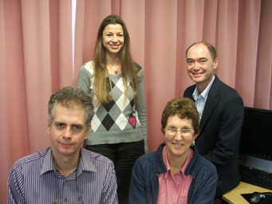
Thank you
The Global People Team
Helen Spencer-Oatey, Stuart Reid, Stefanie Stadler and Nigel Ewington

