Slide 1
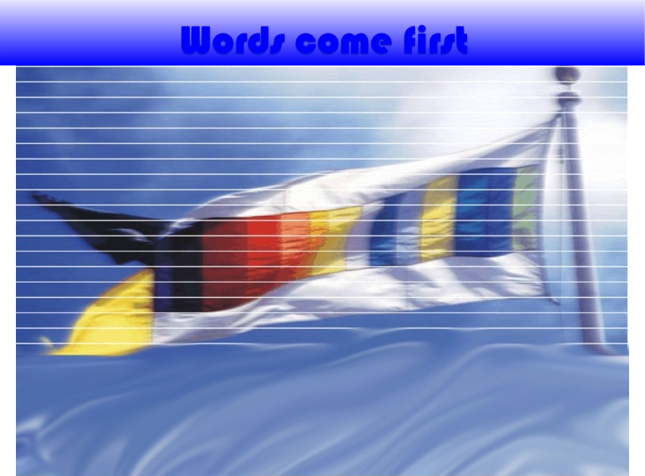
Heringer: Hot Words
Heringer

Slide 2
Heringer: Hot Words
2
Culture
Michael Agar 1993
Culture is something those people "have", but it's more than that.
It's also something that happens to you when you encounter them.
Culture happens when you learn to use a second language.
Culture starts when you realize that you've got a problem with language, and the problem has to do with who you are.
Culture is in language, and language is loaded with culture.
Culture, the experience of it, starts when you go bottom-up.
Heringer
Heringer
Heringer

Slide 3
Heringer: Hot Words
3
Rich points
The particular place in one languaculture that makes it so difficult to connect with another, I'll call it rich point. (Agar 1993: 100)
Rich points [...] happen when, suddenly, you don't know what's going on. (Agar 1993: 106)
Rich points signal where the languacultural action is. (Agar 1993: 106)
Grammar and vocabulary contain rich points that require frames for their understanding. (Agar 1993: 144)
The rich points in a languaculture you encounter are relative to the one you brought with you.
(Agar 1993: 100)
Heringer
Heringer
Heringer

Slide 4
Heringer: Hot Words
4
Schmäh
I heard it several times, saw it used in a book review and a newspaper article, looked it up in a couple of dictionaries, and read about it in a guidebook. It looked central, slippery, and interesting, and I had no idea what it really meant.
I asked if they knew what Schmäh meant and they all looked at me like I’d asked if the sun rose in the morning. Of course they did. But then, as we discussed it, all kinds of disagreements followed. Schmäh was Viennese. No it wasn’t, it was Austrian, or universal. It was something men did. No it wasn’t. It was more characteristic of the lower classes. No it wasn’t. It was telling jokes, picking up a woman in a bar, manipulating a situation, what politicians did, a way of life. No it wasn’t. Yes it was.
I sat back and listened and realized that Schmäh was about as rich as a rich point could get.
(Agar 1993: 100)
Heringer
Heringer
Heringer

Slide 5
Heringer: Hot Words
5
Hot Words
The Hot Words concept does not concern the shape of words, but its use in the widest sense.
Hot Words play an important role in the history and the actual discussion of a culture.
The use of Hot Words is by no way clear cut.
Natives have problems to explain Hot Words.
Sometimes Hot Words are loaded with emotions, positive or negative.
Sometimes Hot Words function as symbols of cultural identity.
Heringer
Heringer
Heringer

Slide 6
Heringer: Hot Words
6
How to identify Hot Words?
Learners face problems with the use of the word (because of its scattered, often controversal meaning).
You cannot get the meaning by translation.
Natives see the word as symbol of their identity.
The word played or plays a role in public discussion.
The meaning constitutes a cultural frame.
Experts, teachers suppose that the word is apt to explain a cultural frame.
Heringer
Heringer
Heringer

Slide 7
Heringer: Hot Words
7
Chunks as frames?
companies repair their balance sheets
loans ... their balance sheets [...] banks
loans on|off their balance sheets
to clean up their balance sheets
banks ... their balance sheets
companies balance sheets ... their profits
bad loans from|off on banks balance sheets
of bad loans off|on their|banks balance sheets and ...
profits and balance sheets
on the bank's balance sheet
has ... strong balance sheet
governments have ... to balance their budgets
to balance their budgets
sustainable current-account balance ... then ... a
Heringer
Heringer
Heringer

Slide 8
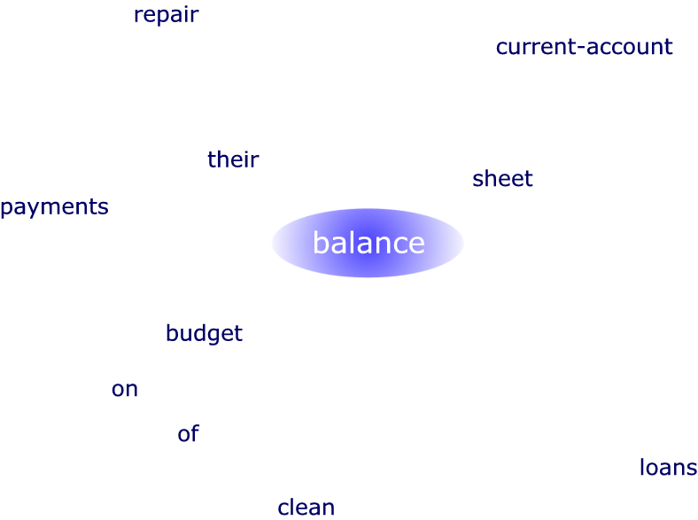
Heringer: Hot Words
8
Didactic arrangement
Heringer
Heringer
Heringer

Slide 9
Heringer: Hot Words
Contrasts
eine rundum positive [...] Bilanz der
zieht [... eine] düstere Bilanz der
zieht [... eine|positive] Bilanz
zog [...] zufrieden [...] Bilanz
traurige Bilanz ... Tote ... Verletzte
zwei Niederlagen lautete die ernüchternde Bilanz der sechs
eine ausgeglichene [...] Bilanz [...] vorlegen ... können
Die Bilanz [...] fiel [...] positiv aus
eine äußerst negative [wirtschaftliche] Bilanz
gestern bei der Vorlage der Bilanz für das vergangene Geschäftsjahr
bei der Vorlage der Bilanz für das abgelaufene Geschäftsjahr
Heringer
Heringer
Heringer

Slide 10
Heringer: Hot Words
Contrasts
be liable [...] for
criminally liable for ...
liable for damages
be held [criminally] liable for ...
liable for ... tax
are [...] liable to|for ...
are liable [...] to
liable to pay
company ... liable
who ... are liable for ...
then [...] liable for ...
not [...] liable ... the
were liable
it ... be liable for ...
Heringer
Heringer
Heringer

Slide 11
Heringer: Hot Words
Contrasts: Near partners
liability Haftung
limit beschränkt
limited Gesellschaft
unlimited verschuldensunabhängig
cap unbeschränkt
contingent zivilrechtlich
auditors übernommen
auditor persönlich
unfunded gesamtschuldnerisch
tax GmbH
asset übernehmen
for unbegrenzt
general Schaden
limits herangezogen
card genommen
legal beschränken
joint umwandeln
exercise ausschließen
insurance strafrechtlich
Heringer
Heringer
Heringer

Slide 12
Heringer: Hot Words
12
Contrasts
contract: frequency of partners
Heringer
Heringer
Heringer

Slide 13
Heringer: Hot Words
13
Objectives
Improve understanding
Elaborate language awareness
Sensitize for the communicative function of words
Broaden personal lexicon
Widen the potential use of words
Detect the cultural load of words
Realize inhomogeneity of cultures
Sharpen intercultural and contrastive awareness
Heringer
Heringer
Heringer

