Slide 1
Welcome to our study
Where do innovations come from?
We are interested in your estimations on how new technologies, products, and services are developed.
You need no prior knowledge to complete the survey.
Duration of the survey: approx. 10 – 15 minutes
The survey is completely anonymous. We guarantee confidentiality dealing with data.
Thank you very much for participating in the survey!
Dr. Philip Bradonjic
Prof. Dr. Nikolaus Franke
Institute for Entrepreneurship & Innovation
Vienna University of Economics and Business
Prof. Dr. Christian Luethje
Institute für Innovation Marketing
Hamburg University of Technology

Slide 2
The most important corporate banking services
Banks offer corporate clients computerized services such as corporate taxes preparation and computation, overdraft protection, and online banking.
A study analyzed the origins of the most important computerized corporate banking services that were introduced in the USA between 1975 and 2012.
Who developed the most important services?
Please estimate the share of all innovations developed by each of the following groups.
To do so, please pull the blue dot to the the spot that represents your intuition of each actual share.
Please answer spontaneously and if in doubt, just follow your intuition.

Slide 3
The most important retail banking services
Banks offer retail clients computerized services such as online banking, personal budget planer, and multiple institutions information aggregation.
A study analyzed the origins of the most important computerized retail banking services that were introduced in the USA between 1975 and 2012.
Who developed the most important services?
Please estimate the share of all innovations developed by each of the following groups.
To do so, please pull the blue dot to the the spot that represents your intuition of each actual share.
Please answer spontaneously and if in doubt, just follow your intuition.

Slide 4
Mobile banking services
Banking can be increasingly done via the mobile phone. This includes for example checking the balance, payments of bills, and requesting quick loans.
A study analyzed the origins of all mobile banking services that were commercially offered worldwide in 2011.
Who developed the most important mobile banking services?
Please estimate the share of all innovations developed by each of the following groups.
To do so, please pull the blue dot to the the spot that represents your intuition of each actual share.
Please answer spontaneously and if in doubt, just follow your intuition.

Slide 5
The most important medical apps
Numerous apps for medical purposes can be downloaded on the smartphone or tablet. They help to for example monitor the taking medicine, record blood sugar levels for diabetes patients, and help find medical articles.
A study analyzed the origins of the most important apps that have been made available to download in Germany, UK and USA between 2008 and 2014.
Who developed the most important apps?
Please estimate the share of all innovations developed by each of the following groups.
To do so, please pull the blue dot to the the spot that represents your intuition of each actual share.
Please answer spontaneously and if in doubt, just follow your intuition.

Slide 6
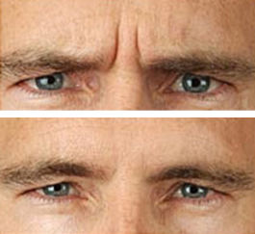
Off-label drug therapies
Often off-label drug therapies for existing drugs are discovered. Botox for example was originally not developed as drug used to reduce wrinkles but as drug against spastic paralysis. Similarly other drugs originally were developed to fight insomnia and are now used as sedative.
A study analyzed the origins of off-label drug therapies that have been discovered in the USA in 1998.
Who discovered the off-label drug therapies?
Please estimate the share of all innovations developed by each of the following groups.
To do so, please pull the blue dot to the the spot that represents your intuition of each actual share.
Please answer spontaneously and if in doubt, just follow your intuition.

Slide 7
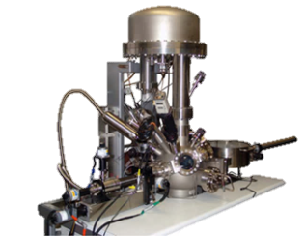
Scientific instruments
When new materials are examined in labs, often scientific instruments to analyzed surface structures are used. Innovations in this area have increased measurement accuracy, and introduced additional functions.
A study analyzed the origins of the most important innovations in this area that have been developed worldwide between 1969 and 1986.
Who developed the most important innovations?
Please estimate the share of all innovations developed by each of the following groups.
To do so, please pull the blue dot to the the spot that represents your intuition of each actual share.
Please answer spontaneously and if in doubt, just follow your intuition.

Slide 8
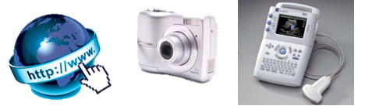
The most important disruptive innovations
Disruptive innovation are radical new products, services, and technologies that dramatically change their respective markets. They often consist of technical breakthroughs and / or have considerable effects on demand and competition in an industry.
A study analyzed the origins of the most important disruptive innovations that were developed worldwide between 1828 and 2010.
Who developed the most important innovations?
Please estimate the share of all innovations developed by each of the following groups.
To do so, please pull the blue dot to the the spot that represents your intuition of each actual share.
Please answer spontaneously and if in doubt, just follow your intuition.

Slide 9
The most important kayak innovations
The equipment used to white water kayak has seen considerable further developments in the past twenty years. For example the shape of kayak was improved, lighter materials were introduced, and additional equipment to increase safety developed.
A study analyzed the origins of the most important kayak innovations that were developed worldwide between 1955 and 2012.
Who developed the most important innovations?
Please estimate the share of all innovations developed by each of the following groups.
To do so, please pull the blue dot to the the spot that represents your intuition of each actual share.
Please answer spontaneously and if in doubt, just follow your intuition.

Slide 10
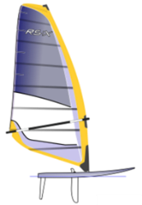
The most important windsurfing innovations
In sports like windsurfing several equipment has been improved and newly developed. For example the stability of the mast was improved and new boards and sails were developed.
A study analyzed the most important windsurfing innovations that have been developed worldwide between 1964 and 1998.
Who developed the most important innovations?
Please estimate the share of all innovations developed by each of the following groups.
To do so, please pull the blue dot to the the spot that represents your intuition of each actual share.
Please answer spontaneously and if in doubt, just follow your intuition.

Slide 11
Your personal summary In this survey, we are particularly interested in estimations of user innovation. Many studies have established that users are a particularly important source of innovation. Yet, surveying over 1,564 public policy makers, managers, and management scholars, we found that 99% of these decision makers largely underestimate the value of user innovation. Such an underestimation has clear negative consequences on the allocation of resources, on innovation dynamics, and on social welfare. The following table compares your own estimations of user innovations and the true values from the corresponding study, indicating to what extent you are aware of the value of user innovation:
Etimation question | Your estimation | True value | Degree of underestimation (-) or overestimation
Disruptiv innovations |  | 44%
Financial services
Corporate banking services |  | 67%
Mobile banking services |  | 52%
Retail banking services |  | 44%
Medicine and science
Medical apps |  | 46%
Off-label drug therapies |  | 59%
Scientific instruments |  | 44%
Sports
Kayaking equipment |  | 87%
Windsurfing equipment |  | 40%
Overall average |  | 54%
This column shows the respondents individual estimations that are programmed to be automatically displayed.
This column shows the respondents individual values that are programmed to be automatically displayed.
If you have any questions, do not hesitate to contact us. Kind regards, Dr. Philip Bradonjic Prof. Dr. Nikolaus Franke nikolaus.franke@wu.ac.at Institute for Entrepreneurship and Innovation Vienna University of Economics and Business Prof. Dr. Christian Luethje c.luethje@tuhh.de Institute of Innovation Marketing Hamburg University of Technology

Slide 12
Further information on questions
Every question to be presented on a separate page
Randomization of order of questions:
The order of questions is to be randomized to avoid order effects with one exception. The questions on corporate and retail banking services are to be presented back to back. Respondents may other wise be aware of the subtle difference and wonder whether the same questions is asked twice.
Randomization of order of responses:
Ideally the order of response categories “universities / research institutions”, “producer firms”, and “users” are randomized as well. For logical reasons, “other innovators” should always be presented in fourth position.

Slide 13
Further information on responses
Here table with the true values
Calculation of respondents’ estimations:
The bars are to be anchored at ”0” for “no share” and “100” for ”large share”. A respondent’s percentage estimation for users relative to the other categories is calculated: number for users divided by the sum of numbers for all four categories.
Under-/overestimation = True value – respondent’s estimation
Error message: In case no bar was moved for either of the four categories and the respondents clicked next to go to the following question, this error message appears:
“Ups! No estimation was given for any of the four categories. Please estimate the share of the different groups. If in doubt, just follow your intuition.”

